Slide 1
Key Considerations and Decisions Before Consortia Implementation
Megan Drake | Senior Implementation Consultant

Slide 2
Welcome and Introductions
Megan Drake
MLS, 2005
Three years at Ex Libris
Senior Implementation Consultant
Consortial Implementations
Workshops
Expert Services
Systems & Applications Librarian at Pacific University
Orbis Cascade Alliance member
Heavily involved in SILS Project
Pacific first to go live in first cohort

Slide 3
Session Objectives
Session Description: Are you a member of a consortium who is planning to migrate to Alma soon? In this session, we will share details of the migration process and talk about what you can be doing now within your consortium and institution to ensure a smooth transition into your project.
Session Objective(s)
By the end of this sessions you will know, understand and/or be able to:
Begin thinking about internal Implementation Team structures
Understand what data cleanup projects may be necessary across the consortium
Articulate the possible ramifications of different policy decisions across all functional areas

Slide 4
Target Audience
Target Audience for the Session:
New/Novice Customers that will have a Network Zone
Systems, Technical and Public Services Librarians
Administrators

Slide 5
Agenda
1
Migration Preparation
2
Policies to Consider – Resource Management and Tech Services
3
Policies to Consider – Fulfillment and Resource Sharing
4
Policies to Consider – Discovery
5
Next Steps, Support Resources and Feedback

Slide 6
Migration Preparation

Slide 7
Migration Preparation: Policies
Establish cataloging and metadata management standards
Establish rules for maintaining uniqueness of the data
Establish shared policies
Establish data sharing agreements if not already in place

Slide 8
Migration Preparation: Implementation Team
Create a core group responsible for recommending shared policies and best practices
Members are chairs of working groups
Each functional area should have a working group
Core working group of 6 – 7 members
Institutional representatives from entire consortium
Empower working groups / implementation team to make decisions
What is the mechanism for member input?

Slide 9
Migration Preparation: Data
Local Extensions
Identify fields that you want to keep locally
Move fields to the 09x, 59x, 69x, and 950 - 999 ranges, and mark them with a $$9LOCAL
After Go Live, entire 9XX range can be used.
Review ‘suppression’ flags
Ensure all bibs have correct OCLC numbers

Slide 10
Policies to Consider: Resource Management and Tech Services

Slide 11
Policies to Consider – Cataloging Standards
Enrich the shared catalog
Work on existing records whenever possible
Do not create duplicate records
Identifiers for matching are sacred

Slide 12
Policies to Consider – Shared Agreements
Use Existing or Create New
Single vs Multiple Records for Print & Electronic
Minimum Records
Creating / Contributing when Ordering
Data that should never be contributed to NZ
Local Vocabularies
Local Field Semantics
Source of Records

Slide 13
Practice: Use existing or create new
Guidelines for when to create a new record vs. reusing an existing one (perhaps with local extensions)
Motivation: avoid duplicates for the same manifestation, agree upon a common description for a resource
Example: OCLC and other shared catalogs have templates here. Alternately, have a policy to use OCLC record when it exists.

Slide 14
Practice: Single vs. multiple records for P&E
Policy for whether to use a single bibliographic record for both physical and electronic versions of a resource
Motivation: Policy is required to determine the scope of description and what constitutes duplication
Example: Different records for physical and electronic resources (separate OCLC number, distinct RDA description) in Alma

Slide 15
Practice: Minimum records
Guidelines for minimum data to include in a record in the NZ when ordering
Motivation: if there is not enough data for later overlay, a duplicate or unused record will be created
Example: Records for resources should include title, creator (if applicable), and at least one identifier

Slide 16
Practice: Creating/contributing when ordering
Workflow for determining whether a record already exists in the NZ when ordering
Motivation: the standard workflow of searching the local catalog prior to ordering will not retrieve NZ resources or leverage the value of a shared catalog
Example: steps to take prior to contributing
Search IZ (to determine current ownership)
Search NZ (to determine consortial ownership)
Create new record in NZ (by either copy cataloging or creating a new brief bib)

Slide 17
Practice: Data which must not be contributed to NZ
Guideline regarding data which must not be included into the shared catalog.
Example: purely local records, such bibliographic records created for iPad, computers, must not be contributed to NZ

Slide 18
Practice: Local vocabularies
If local vocabularies are in use:
Will they be loaded into the NZ
Who will be responsible for updating them
What member edits will be allowed

Slide 19
Practice: Local field semantics
Policy for what local extensions to reserve for what purpose
Motivation: to create Primo normalization rules, policies for internal vs. public-facing data must be defined; it’s also useful to reserve some 9xx fields for network-wide data
Example:
Public-facing extensions: 590-594, 690-694, 950-975
Internal (non-normalized) extensions: 595-599, 695-699, 976-999
Reserved for network-wide public-facing: 900-924
Reserved for network-wide internal: 925-949

Slide 20
Practice: Source of records
Could treat OCLC as authoritative; all work starts in OCLC and is copied to NZ
Aids identifier management
Default record quality standards—use theirs

Slide 21
Policies to Consider: Fulfillment and Resource Sharing

Slide 22
Policies to Consider – Shared Data
Do you have a Data Sharing Agreement in place?
What data can be searched by all institutions?
Can patron information be shared freely among all members?
Will some members share patron information with other institutions? (Allows walk-in borrowing)

Slide 23
Policies to Consider – Shared Standards
What types of items will you circulate?
What will you use for a Courier/delivery mechanism?
Is there a guaranteed turnaround time on requests?

Slide 24
Policies to Consider – Shared Policies
Will all Resource Sharing items have the same circulation periods?
Are digitization/document delivery requests allowed?
Are recalls allowed?
Are renewals allowed?
Will all libraries charge the same fines/fees for Resource Sharing items?

Slide 25
Policies to Consider: Discovery

Slide 26
Policies to Consider – Shared Data
Centralized Publishing from Network Zone bib
Centrally managed records in Primo Central Index
Central ingest of digital repositories

Slide 27
Policies to Consider – Shared Standards and Workflows
Agreement between institutions regarding a set of potential display fields, facets, scopes
Look and feel – defining basic principles for display, services and designing centrally managed CSS
NZ publishing to Primo, PCI, Google Scholar
Maintaining Primo normalization and configuration

Slide 28
Policies to Consider – Shared Configuration
NZ Publishing Profiles
Normalization Rules
Indexes
CSS
General Electronic Services
Display Logic Rules

Slide 29
Next Steps, Support Resources and Feedback

Slide 30
Next Steps and Resources
Include documentation links in the CKC relative to your topic:
https://knowledge.exlibrisgroup.com/Alma/Implementation_and_Migration/Migration_Guides/010Alma_Migration_Considerations_for_Consortia
Additional support resources within the ExLibris Ecosystem:
Idea Exchange
Developer Network
2018 Technical Seminar Presentations (Cross-Product section of CKC)

Slide 31
Questions?
Any Final Questions?

Slide 32
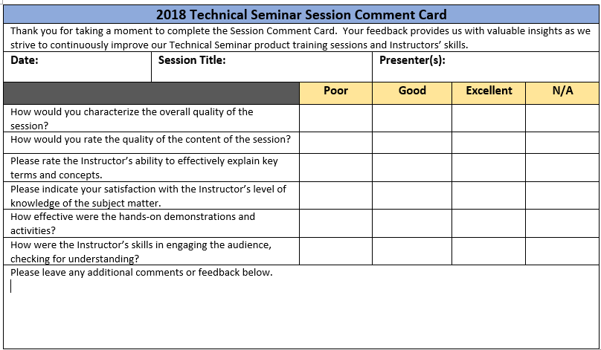
Session Feedback
We Value Your Feedback! Please complete the brief Session Comment Card:

Slide 33
Thank You!

