Slide 1
DESIGNING AND USING NORMALIZATION RULES
Download this presentation:
Ex Libris Knowledge Center >
Cross-Product >
Conferences and Seminars >
2018 Technical Seminar
Connie Braun
Notes:
OPEN CONFIGURATION!!!!!

Slide 2
Welcome and Introductions
Connie Braun
Implementation Services Manager
Have worked with Alma for more than eight years
Deliver on-site Alma workshops
Provide post GoLive consulting
Many of you have met my little friend…

Slide 3
Session Objectives
Session Description: Normalization rules are created and used to modify bibliographic or holdings metadata either individually or using batch processes
By the end of this session you will know, understand and/or be able to:
Create normalization rules
Test normalization rules to ensure correct behaviour
Construct normalization processes
Run a job against a set of records

Slide 4
Target Audience
Target Audience for the Session:
Cataloger, Catalog Manager and Catalog Administrator roles may create and manage normalization rules
Catalog Administrator role is required to associate normalization rules with import profiles

Slide 5
Agenda
1
Creating and Testing Normalization Rules
2
Creating Normalization Processes
3
Creating Sets and Running Jobs
4
Next Steps, Support Resources and Feedback

Slide 6
Creating and Testing Normalization Rules

Slide 7
Normalization Rules
Written in a specific syntax, using the drools language, allowing cataloguing operators to create rules that enable Alma to
Perform a batch update to sets of records by running a job,
Relate a normalization process to an import profile
Apply a normalization rule or process to an External Search resource
Operators may preview the outcome of applying a normalization rule to a bibliographic record

Slide 8
Normalization Rules
Alma operators may create rules to
add fields and subfields
remove fields and subfields
modify text
copy fields
combine
replace field tags
change indicators

Slide 9
Example 1 – New Fields/Subfields May be Added
rule "Add field 590 with subfield a with the text Gift from Class of 2018 if it doesn’t exist"
when
not exists “590.a.Gift from Class of 2018"
then
addField “590.a.Gift from Class of 2018"
end

Slide 10
Example 2 – Fields/Subfields Removed
rule "Remove subfields b and c from 260" when
(TRUE)
then
removeSubField "260.b"
removeSubField "260.c"
end

Slide 11
Example 3 – Replace Text in Field/Subfield
rule "Replace text colors with colours in 650 any subfield (unconditional)"
when
(TRUE)
then
replaceContents "650.*.labour" with “labor"
end

Slide 12
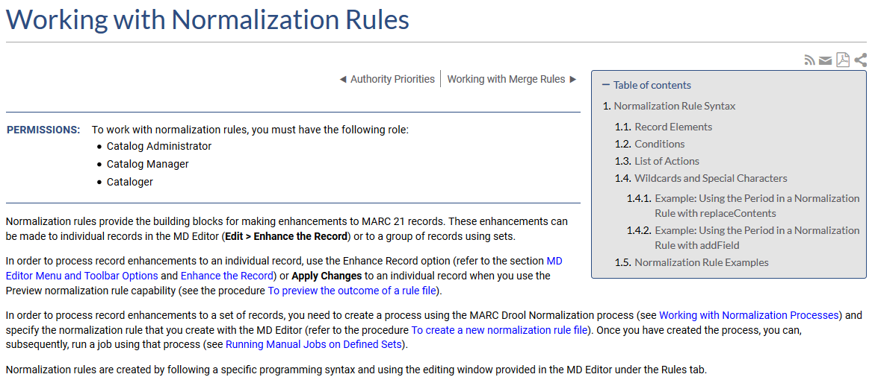
Getting Help
Notes:
Examples of the different rules and the syntax are included in the online help

Slide 13
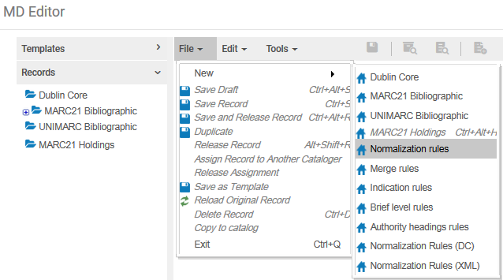
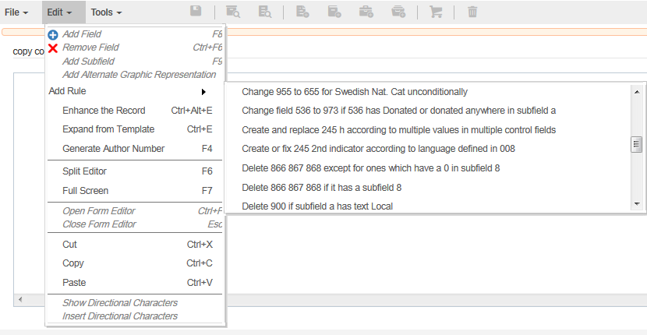
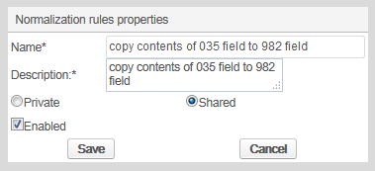
Creating a Normalization Rule Copying Syntax

Slide 14
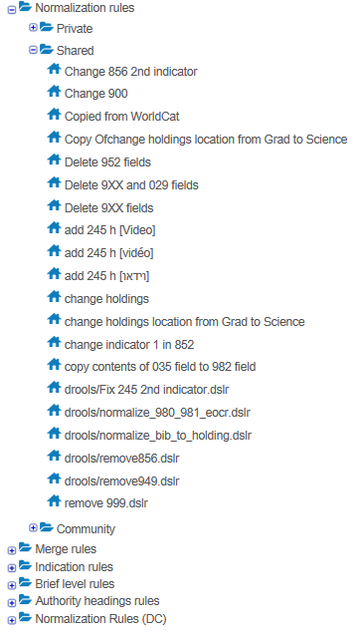
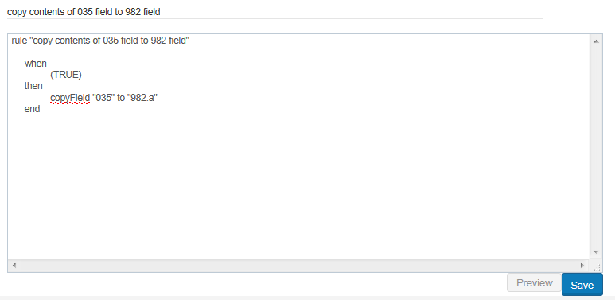
Creating a Normalization Rule From Scratch
Notes:
Here, I’m defining a rule that is not part of the default group.

Slide 15
Hands-On Exercise #1
Create a normalization rule by starting with a sample to add a 590 field with subfield a and specific text when it does not exist
1 | Within the Metadata editor and go to File > New > Normalization Rules.
2 | For Name and Description, add descriptive details such as “Add field 590 with subfield a and text, Donated by Friends of the Library, if it doesn’t exist.”
3 | Indicate whether or not the rule should be Shared, Enable the rule and Save it.
4 | From Edit menu, go to Add Rule and choose “Add 949 with subfields x and t.” Modify the text in the rule canvas to make it look like this: rule "add field 590 with subfield a and text, Donated by Friends of the Library, if it does not exist" when not exists "590.a.Donated by Friends of the Library" then AddField "590.a.Donated by Friends of the Library" end
5 | Save the edited normalization rule.

Slide 16
Hands-On Exercise #2
Create a normalization rule to copy contents of a field from one to another
1 | Open the Metadata editor and go to File > New > Normalization Rules.
2 | For Name and Description, add descriptive details such as “Copy 300 to 901-12).”
3 | Indicate whether or not the rule should be Shared, Enable the rule and Save it.
4 | Enter the following text in the rule canvas: rule "copy 300 to 901-12" when TRUE then copyField "300" to "901.{1,2}" end
5 | Save the edited normalization rule.

Slide 17
Hands-On Exercise #3
Create a normalization rule to replace text
1 | Within the Metadata editor and go to File > New > Normalization Rules.
2 | For Name and Description, add descriptive details such as “Replace hc with hardcover in 020 a (unconditional)”
3 | Indicate whether or not the rule should be Shared. Enable the rule. Save the rule.
4 | From Edit menu, go to Add Rule and choose “Replace text EU with European Union in 650 z.” Modify the text in the rule canvas to make it look like this: rule "Replace text hc with hardcover in 020 $$a (unconditional)" when (TRUE) then replaceContents "020.a.hc" with "hardcover" end
5 | Save the edited normalization rule.

Slide 18
Testing Normalization Rules – Five Steps
Using the Repository Search, locate and open a record on which to test the rule in the Metadata Editor.
Switch to split editor mode with the record in the left pane.
Click on the blank right pane of the split editor.
Go to the Rules tab, select the normalization rule you want to test and click edit to open the rule in right pane.
Test the rule by clicking on the Preview button.
Notes:
Before using or running a normalization rule in a real process or import, we recommend that you test it. The normalization rule may be easily tested in the Metadata Editor.

Slide 19
Hands-On Exercise #4
Test the normalization rules created in Hands-On 1 – 3
1 | For each rule, confirm that the rule you are working with is functioning as expected.
2 | Edit a rule further if there is more that you want to change.
3 | When ready, apply the change to the record.
Notes:
For example #1, use
Stein, Kathleen. The genius engine
Clarke, John R. Looking at laughter
For example #2, use
Wood, Audrey. The Tickleoctopus
Laughlin, Robert M. The people of the bat
For example #3, use
Powell, John. How music works
Flannery, Tim. Here on earth

Slide 20
Creating Normalization Processes

Slide 21
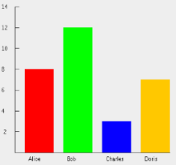
Normalization Processes
Normalization rules, created in the Metadata Editor, may be used in processes that focuses on global data change
Normalization rule processes, configured by a Catalog Administrator, may include one or more normalization rules
Notes:
Requires Catalog Administrator role to create process

Slide 22
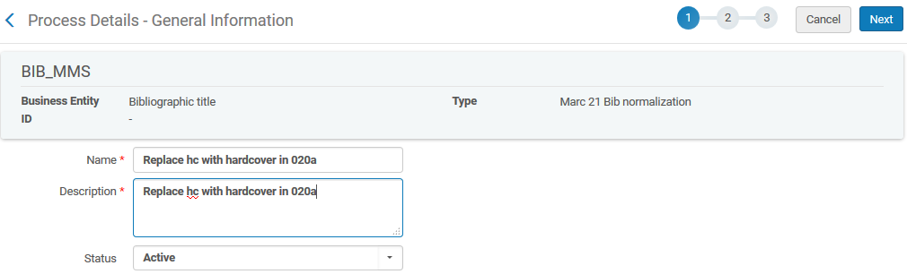
Normalization Processes
Notes:
Go to Configuration > Resources > Metadata Configuration and click on MARC21 Bibliographic. From the Profile Details page switch to the Normalization tab and choose “Add Process”
Give a name and description to the new process. Click “Next” to go to the next step.
Select “MarcDroolNormalization” and click the Add to Selection button. In a situation where you want to include multiple different normalization rules in one process, simply add the number of required “MarcDroolNormalization” entries. Click on Add and Close.
Click on Next to go to the next step in the wizard. Here we select the normalization rule we want to include in the process. If including more than one normalization rule, one Drools File Keys exists for each “MarcDroolNormalization” added in Step 2. The last step in creating this process is to Save it.

Slide 23
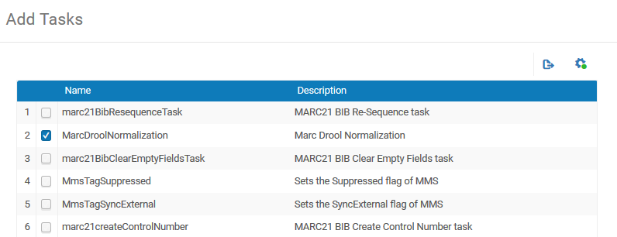
Normalization Processes – Adding Tasks

Slide 24
Normalization Processes – Adding Tasks

Slide 25
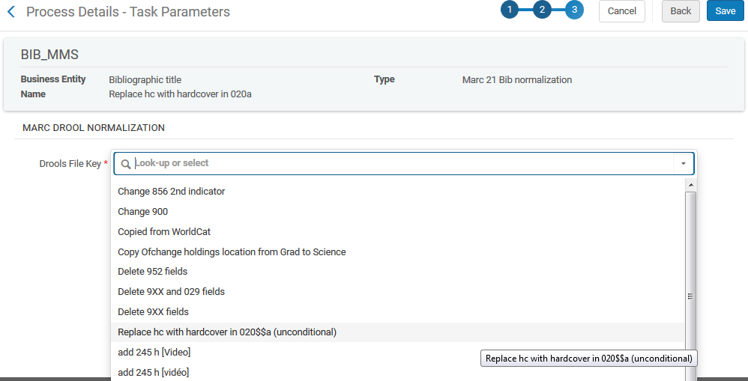
Normalization Processes – Task Parameters

Slide 26
Normalization Processes

Slide 27
Hands-On Exercise #5
Create a normalization rule process using one of the rules created in Hands-On 1 – 3
1 | Go to Configuration > Resources > Metadata Configuration and click on MARC21 Bibliographic. Switch to the Normalization tab and click on the Add Process button.
2 | Give a name and description to the new process. Click on the Next button to go to the next step.
3 | Select “MarcDroolNormalization” and click the Add to Selection button. In a situation where you want to include multiple different normalization rules in one process, simply add the number of required “MarcDroolNormalization” entries.
4 | Select the normalization rule that you want to include in the process. If including more than one normalization rule, one Drools File Keys entry exists for each “MarcDroolNormalization” added in Step 2. The last step in creating this process is to Save it.

Slide 28
Creating Sets and Running Jobs Using Normalization Processes

Slide 29
Running Normalization Processes
Normalization processes may be run…
Via Enhance the record option in Metadata editor
For a set of records assembled via Manage Sets function
When adding a file of records via Import function
While importing individual records via External Search

Slide 30
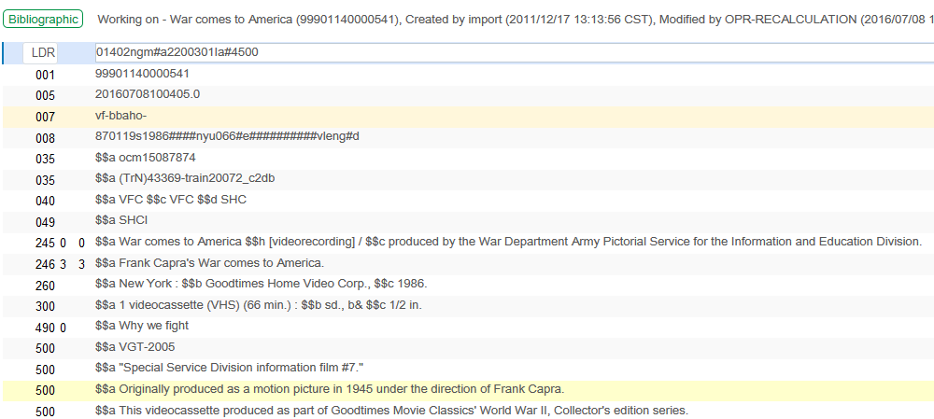
Enhance the Record
Notes:
For Enhance the Record, use
Voices in the ocean by Susan Casey

Slide 31
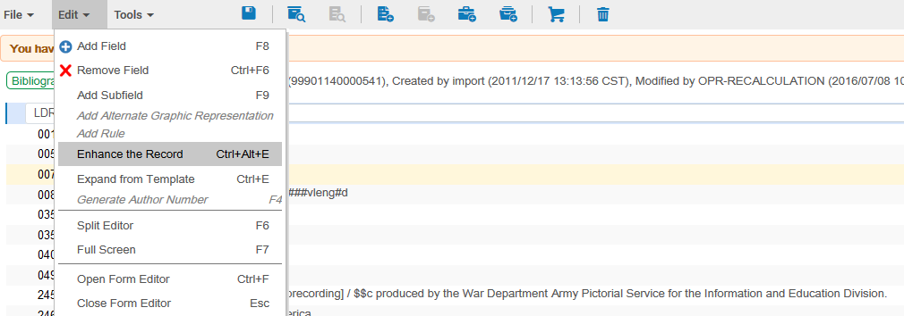
Enhance the Record

Slide 32
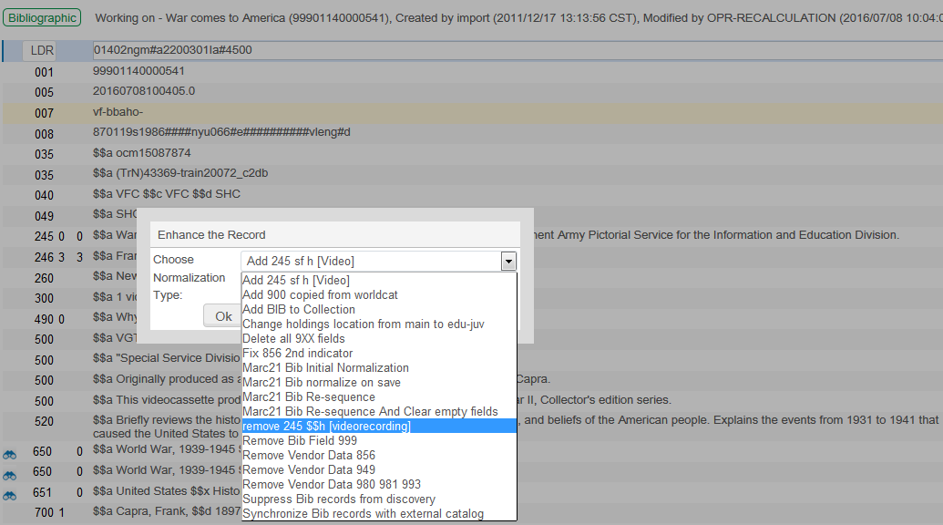
Enhance the Record

Slide 33
Enhance the Record

Slide 34
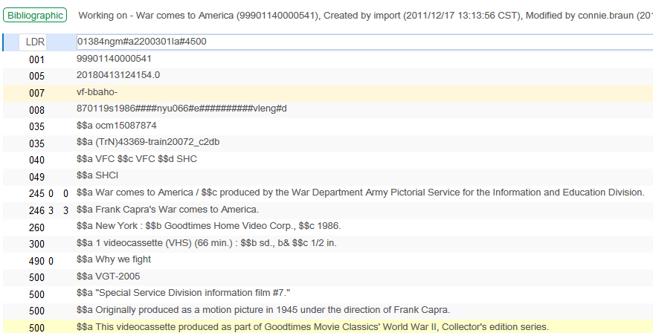
Enhance the Record

Slide 35
Hands-On Exercise #6
Apply a normalization rule by enhancing the record
1 | Open any Bibliographic record in the Metadata editor for which the rule you will apply will have the appropriate effect.
2 | Go to Edit menu and select Enhance the Record (Ctrl+Alt+E).
3 | Select from among the available processes.
4 | Click on OK button to run the process and update the record.

Slide 36
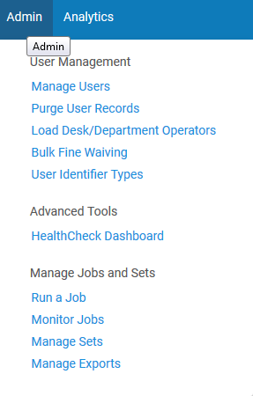
Normalization Job for a Set
Each process may be run on a set of records
Assumes processes have been created
Choose “Run Process” from within Resource Configuration menu

Slide 37
Hands-On Exercise #7
Create a set and run the process
1 | Go to Manage Sets.
2 | Create an Itemized set of three or four physical items against which to run a process.
3 | Run the process.
4 | View and confirm the changes to the records.
Notes:
Use Replace text hc with hardcover in 020 $$a (unconditional) rule.

Slide 38
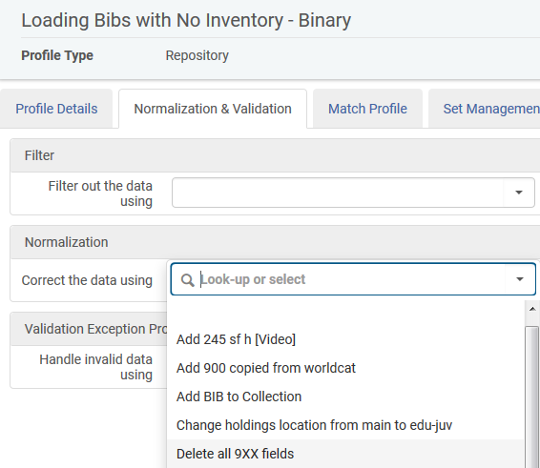
Normalization During Import
Processes we configure may also be used with an import profile to Correct the data of records in the file

Slide 39
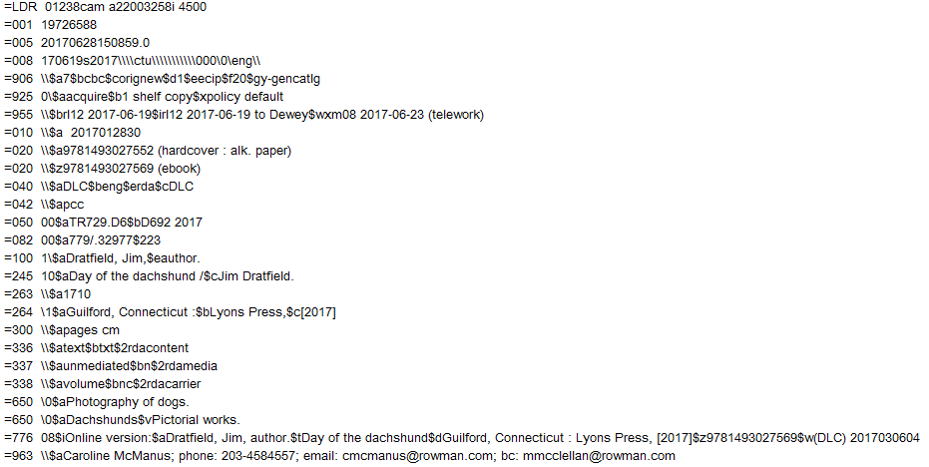
Normalization During Import
Notes:
From the input file, the record with title “Day of the dachshund”, includes 906, 925, 955 and 963 fields.

Slide 40
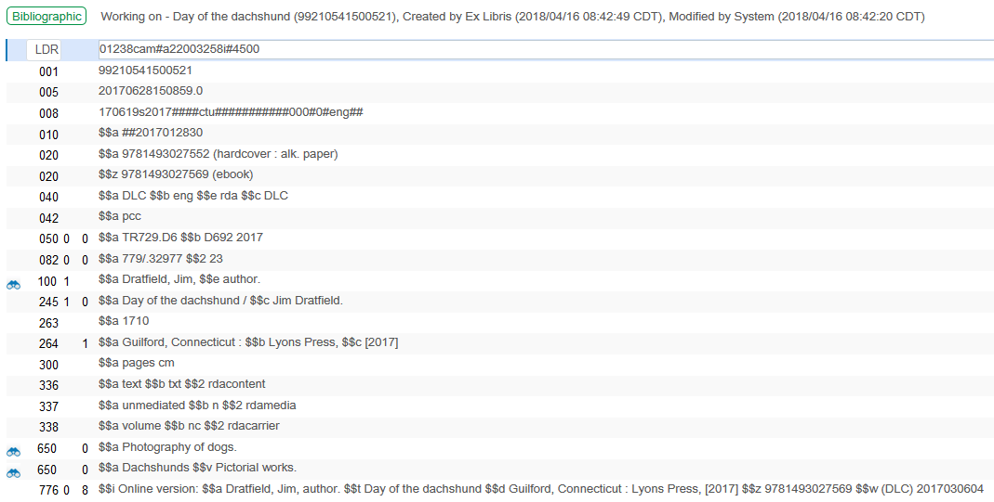
Normalization During Import
Notes:
Following import, the record no longer has the 906, 925, 955 or 963 fields.

Slide 41
Import via External Search
Notes:
We have another normalization rule called “Copied from WorldCat” It adds a 900 field with text “Copied from WorldCat”
It has been added to a process called “Add 900 copied from WorldCat”

Slide 42
Import via External Search
Notes:
We want this process to be applied whenever we import a record from WorldCat via “search external resources.”

Slide 43
Import via External Search
Notes:
First we will see which external resource is used in the external search profile called “WorldCat” This is accessed via Configuration > Resources > Search Configuration > External Search profile
In the Resources List tab of the External Search profile we see that the name of Resource is “WorldCat”

Slide 44
Import via External Search
Notes:
Let’s edit the resource “WorldCat” so that it will use the process called “Add 900 copied from WorldCat” This may be accessed via Configuration > Resources > Search Configuration > External Search Resources. Then we will edit the resource

Slide 45
Import via External Search
Notes:
We choose the normalization process to perform when importing records from WorldCat via External Search.

Slide 46
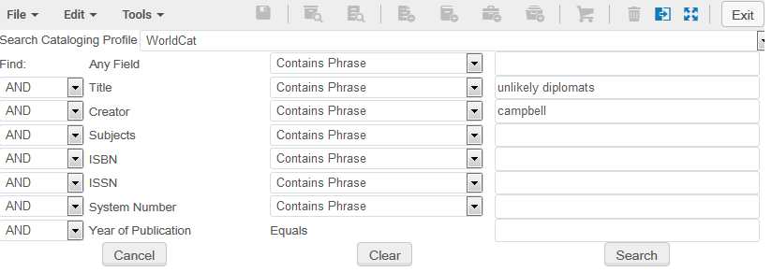
Import via External Search

Slide 47
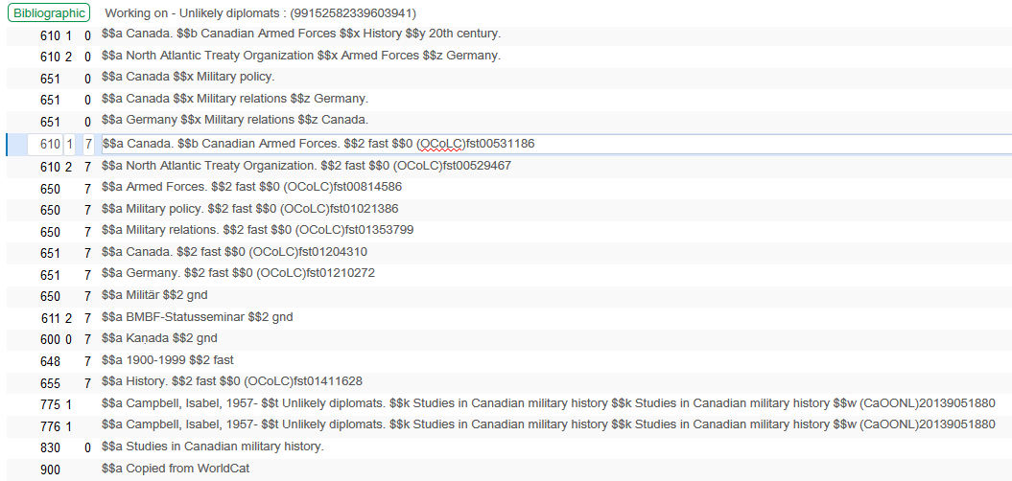
Import via External Search
Notes:
Here, even before the record has been saved to the repository, we can see the addition of the 900 field to the record.

Slide 48
Next Steps, Support Resources and Feedback

Slide 49
Next Steps and Resources
Include documentation links in the CKC relative to your topic:
Working with Normalization Rules
Additional support resources within the ExLibris Ecosystem:
Idea Exchange
Developer Network
2018 Technical Seminar Presentations (Cross-Product section of CKC)

Slide 50
Questions?
Any Final Questions?

Slide 51
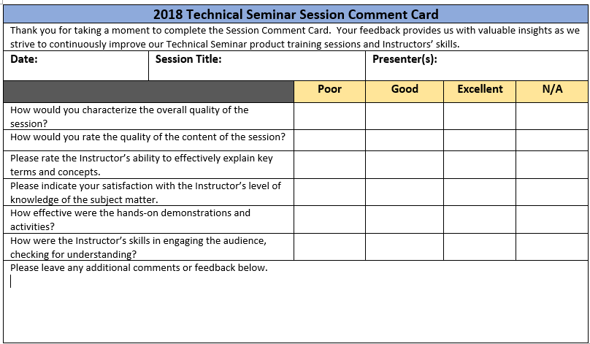
Session Feedback
We Value Your Feedback! Please complete the brief Session Comment Card:

Slide 52
Thank You!

