Slide 1
Introduction to Resource Sharing
Moshe Shechter| Alma Product Manager

Slide 2
Introductions
Moshe Shechter
Alma Product Manager
With Ex Libris for 15 years. After a couple of years on the Aleph development team, I joined the Alma team in 2010 as business analyst and later as product manager.
My focus is in Fulfillment, Resource Sharing, User Management and Integrations.
Notes:
Introduce yourselves

Slide 3
Objectives and Target Audience
By the end of this sessions you will:
  Get a glimpse of Alma resource sharing workflows
  Gain an understanding of resource sharing processes and how they fit scenarios at your library
  Understand the basic configuration elements that make up Alma resource sharing
Session Target Audience:
  Resource sharing library staff, administrators, and technical people, new to Alma resource sharing
Notes:
Short description of the session
Session objectives: (what is it the audience will be now & be able to do as a result of the session?) and appropriate audience for the session.
Intended Target Audience

Slide 4
Agenda
1
Basic Terminology and Configuration Elements
2
Broker Workflows and Integrations
3
Peer to Peer Workflows
4
Fulfillment Network Workflows and Configurations
5
Next Steps, Support Resources and Survey
Notes:
Provide a very high-level agenda / topic outline of your presentation. Be sure there are “agenda” slide separators each section of your presentation.
Please keep Documentation, Support Resources and Survey as the last agenda topic.

Slide 5
Basic Terminology and Configuration Elements

Slide 6
Basic Terminology
When setting up resource sharing, we will always be setting up configuration that describes
  ‘My’ side of the process
  The ‘other’ side of the process

Slide 7
Basic Terminology
For workflows in which I am the borrower:
  ‘My’ side of the process is the borrower side
  The ‘other’ side of the process is the lender side
For workflows in which I am the lender:
  ‘My’ side of the process is the lender side
  The ‘other’ side of the process is the borrower side
Any library may be implementing only a borrower workflow or only a lender workflow. Still, both the ‘my’ and the ‘other’ side must be configured

Slide 8

Basic Terminology
Some coordination is required between how the ‘my’ and the ‘other’ side is configured in my Alma system and how the ‘my’ and the ‘other’ side is configured at the peer (Alma or other) library
Me
The resource sharing partner
Other System
My Side
My Side
Other Side
Other Side

Slide 9
Configuration Elements
The ‘My’ Side

Slide 10
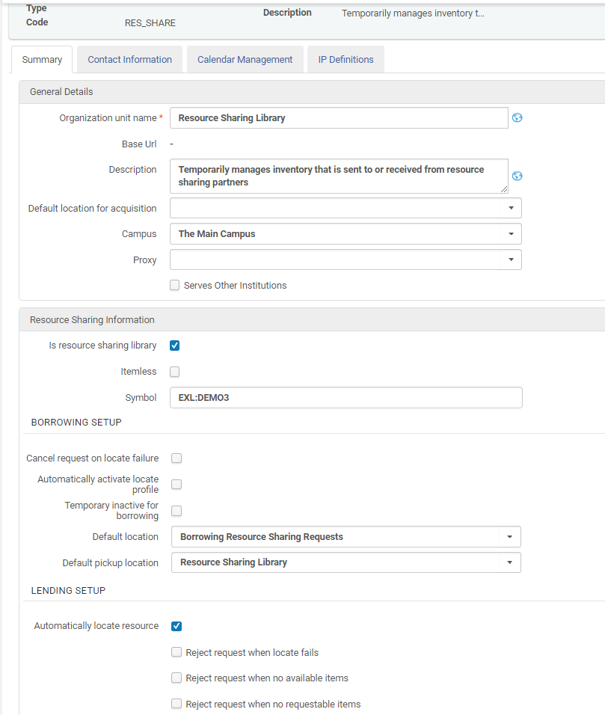
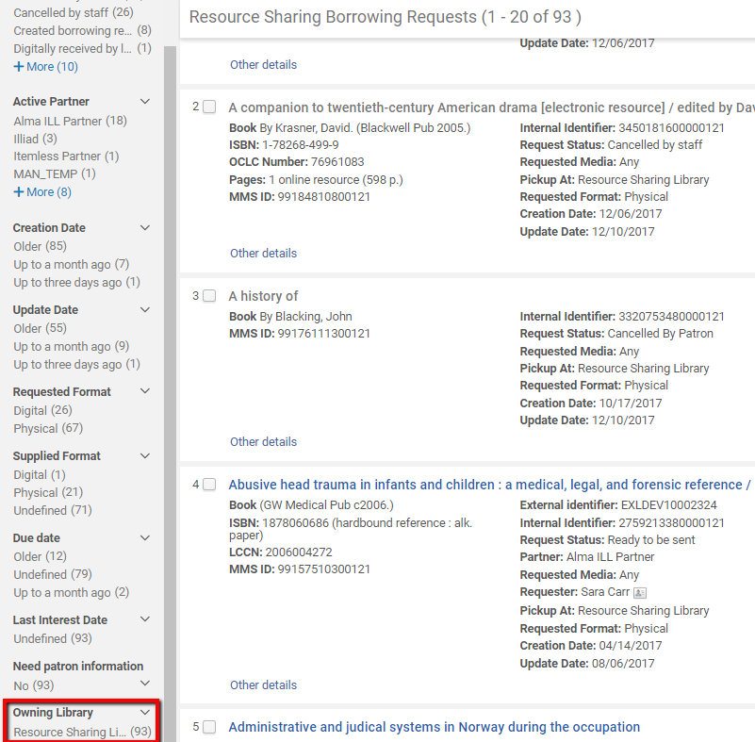
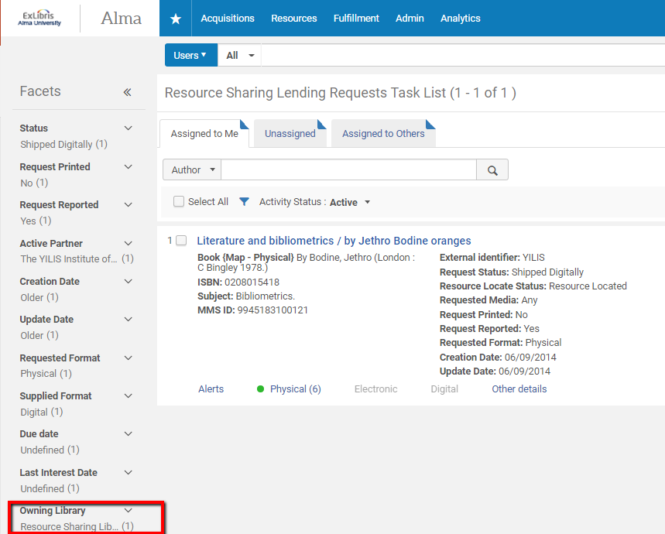
The Resource Sharing Library
The ‘My’ side is the Resource Sharing Library. It owns:
  The borrowing requests I manage as borrower
  The lending requests I manage as lender

Slide 11
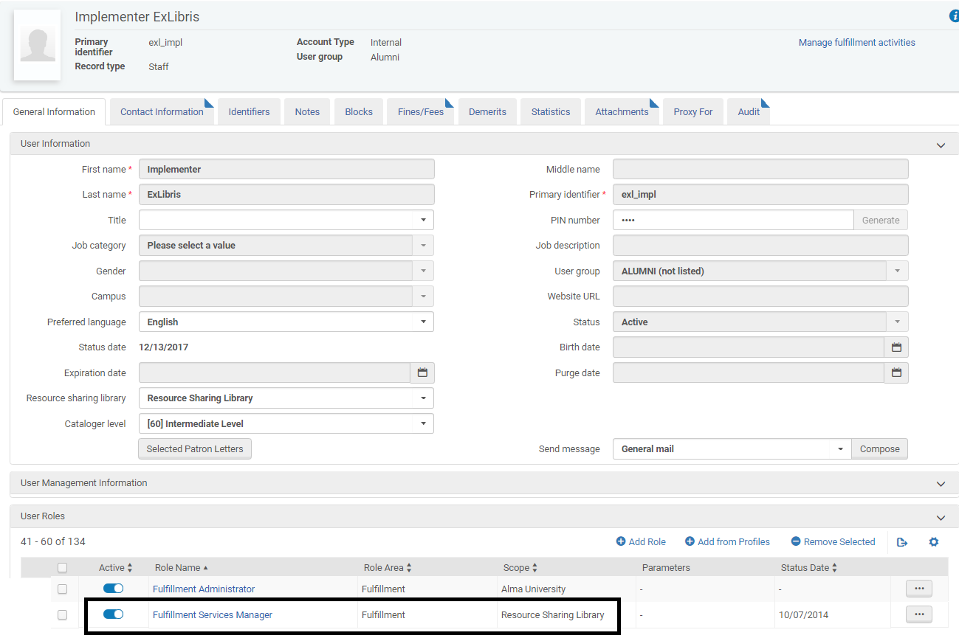
The Resource Sharing Library
In order for staff to be able to view and monitor ‘my’ borrowing and lending requests, their user account must be linked to a Fulfillment Services Operator role, at the scope of the resource sharing library

Slide 12
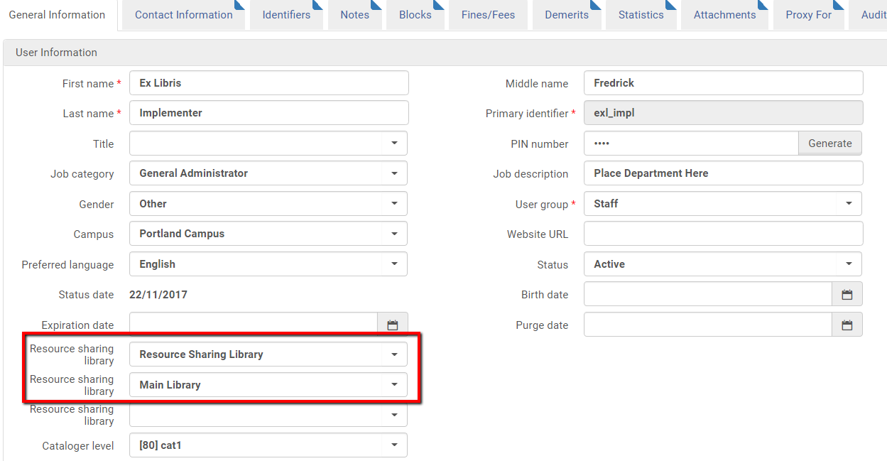
The Resource Sharing Library
In order for patrons to be able to place borrowing requests, they must be linked to one or more resource sharing library(ies)

Slide 13
The Resource Sharing Library
An institution may manage a single resource sharing library, where all borrowing and lending requests are managed
An institution may manage one resource sharing library per every campus
An institution may manage every ‘regular’ library as a separate resource sharing library (e.g. the main library, the humanities library etc.)
An institution may manage one resource sharing library for a group of libraries (one for the law library and one for the rest of the institution)

Slide 14
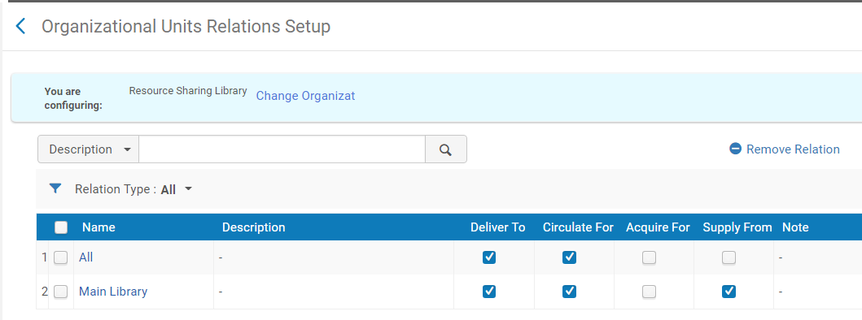
The Resource Sharing Library
The resource sharing library has relations with other libraries, determining:
  In what libraries the items requested for borrowing may be picked up
  What libraries items may be taken from and shipped in order to fulfill a lending request

Slide 15
Configuration Elements
The ‘Other’ Side

Slide 16
The Partner Record
The ‘other’ side is the partner record. It defines:
  How the other side will be contacted , be defining:
    The Profile Type (ISO/Email/SLNP/NCIP)
    The partner’s Parameters
  How the locate process will be run, by defining:
    The Locate Profile to use
    The Holdings Code
  How the workflow will be managed, be defining:
    Whether the partner supports borrowing and lending
    Borrowing and Lending Workflow Profiles

Slide 17
The Partner Record
The partner record may represent an ‘other side’ institution, or any subdivision of the ‘other side’ institution:
  A specific library
  A group of libraries
  A campus
This may be done by setting up the Holdings Code to match the code at the ‘other side’

Slide 18
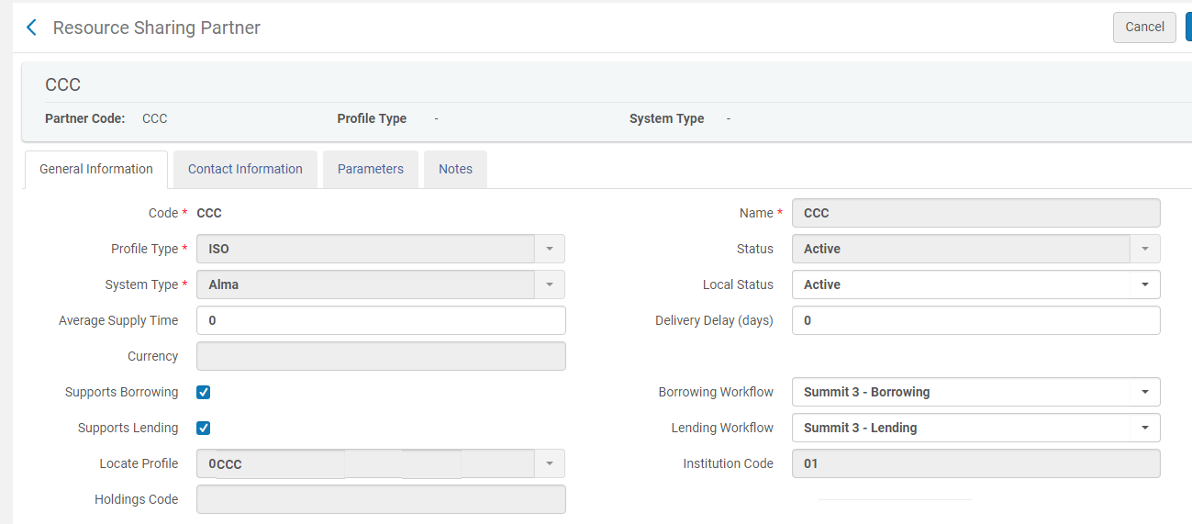
The Partner Record
Partner represents an ‘other side’ institution:
There is no Holdings Code

Slide 19
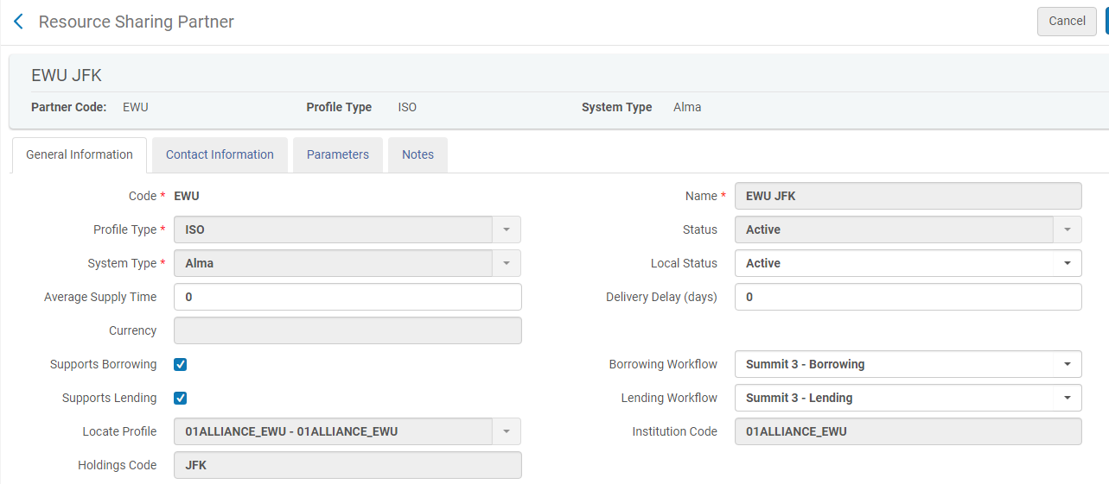
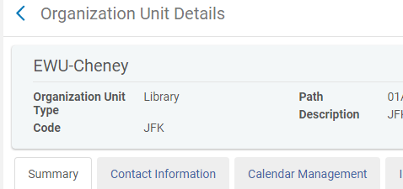
The Partner Record
Partner represents an ‘other side’ library:
Configuration at my institution
The Holdings Code on the partner record matches a library code at the other institution
Configuration at the institution I want to borrow from or lend to

Slide 20
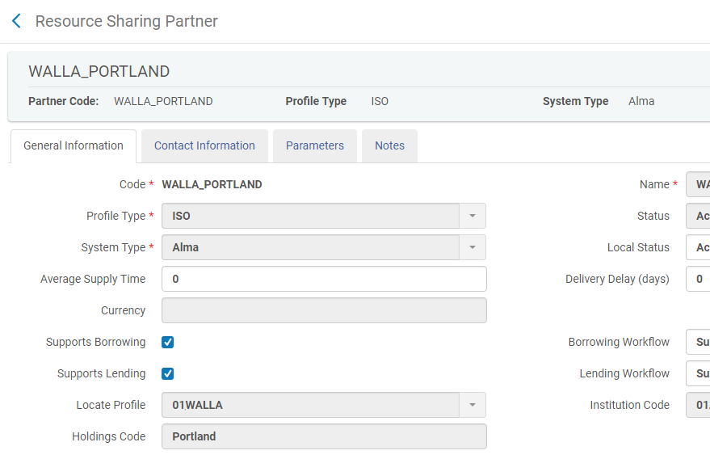
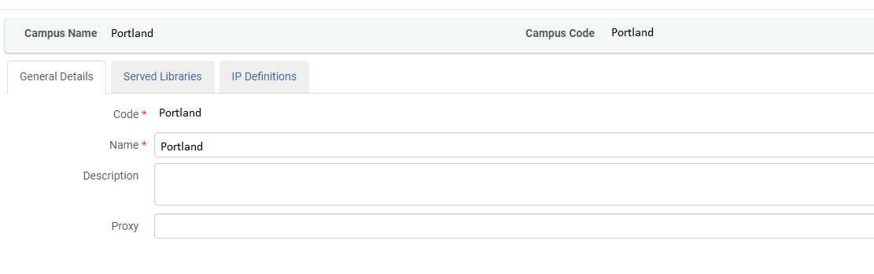
The Partner Record
Partner represents an ‘other side’ campus:
Configuration at my institution
The Holdings Code on the partner record matches a campus code at the other institution
Configuration at the institution I want to borrow from or lend to

Slide 21
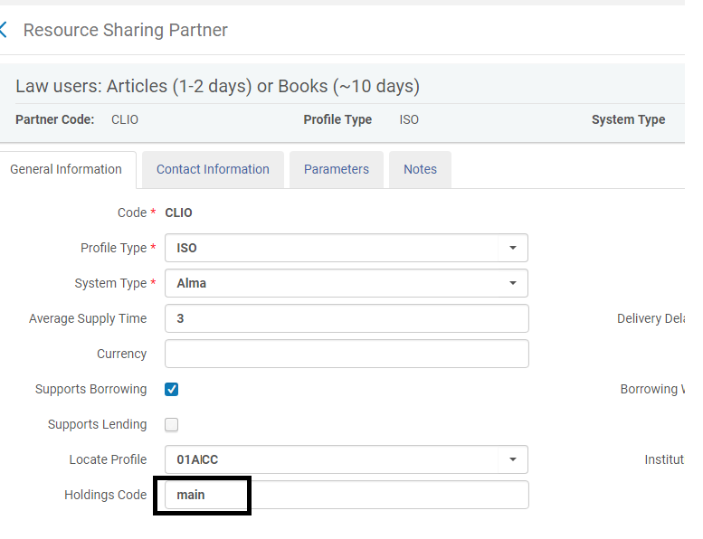
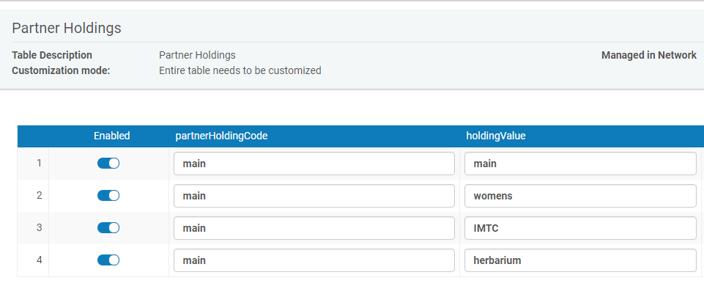
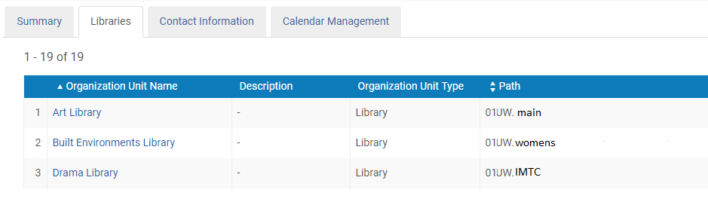
The Partner Record
Partner represents a number of ‘other side’ libraries:
Configuration at my institution
The Holdings Code on the partner record matches a mapped code to library codes at the other institution
Configuration at the institution I want to borrow from or lend to

Slide 22
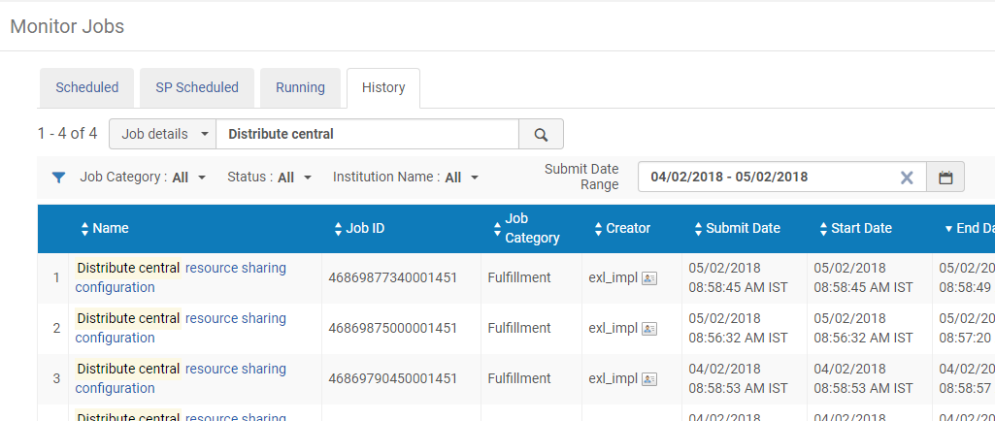
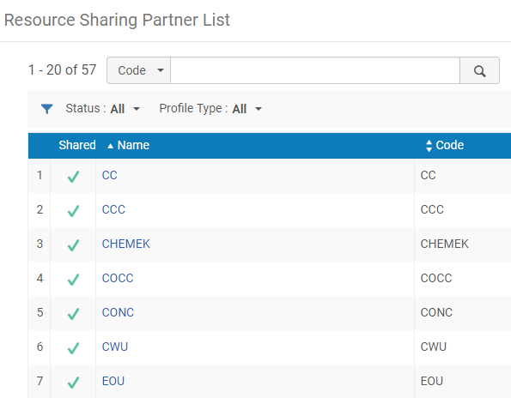
The Partner Record
The list of partners is managed at the institution level
Members of a Network Zone Collaborative Network may centrally manage the list of partners in the Network Zone. A job distributes the partners list to the member institutions.

Slide 23
The Partner Record
Alma
Z39.50
BLDSS
Locate Profile
Partner
Email
ISO
ARTEMail
SLNP
NCIP P2P
BLDSS
Integration Type
Workflow Profile

Slide 24



The Partner Record
Rota
Partner
Locate Profile
1
Integration Type
Workflow Profile
Borrower Institution
Request
Partner
Locate Profile
2
Integration Type
Workflow Profile
Temporary Item
Partner
Locate Profile
3
Loan
Integration Type
Workflow Profile

Slide 25
The Partner Record
Partner
Lender Institution
Request
Integration Type
Workflow Profile
Item Moved to Temporary Location

Slide 26
Locate Profile

Slide 27
Locate Profiles
Locate Profiles:
  Define how to locate the resource in the partner’s catalog
Locating Process:
  Locate the resource in partners’ catalogs
  Partners that cannot fulfill the request are removed from the request’s rota

Slide 28
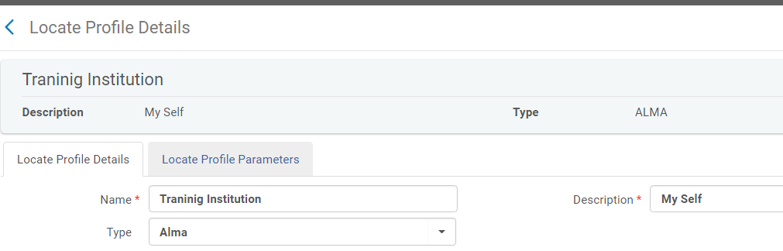
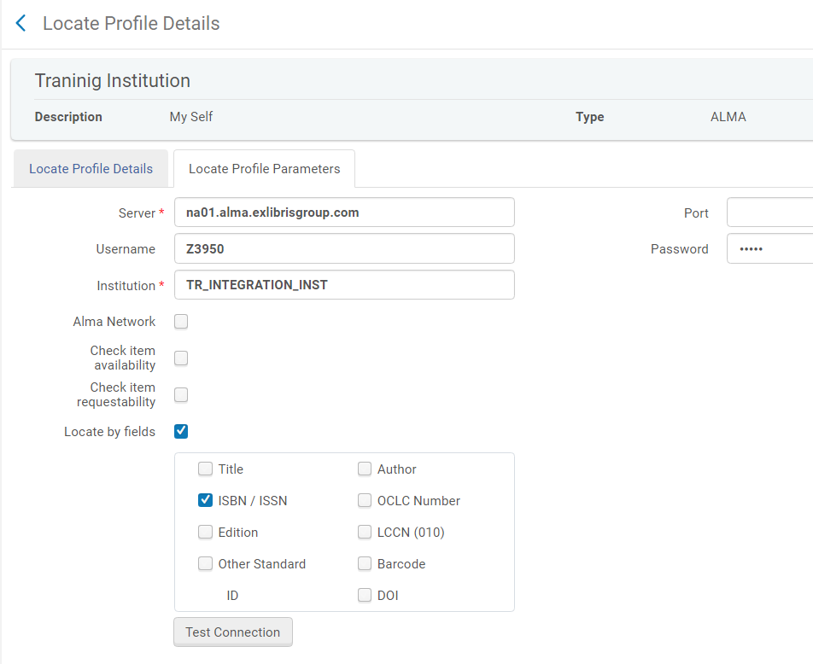
Locate Profiles

Slide 29
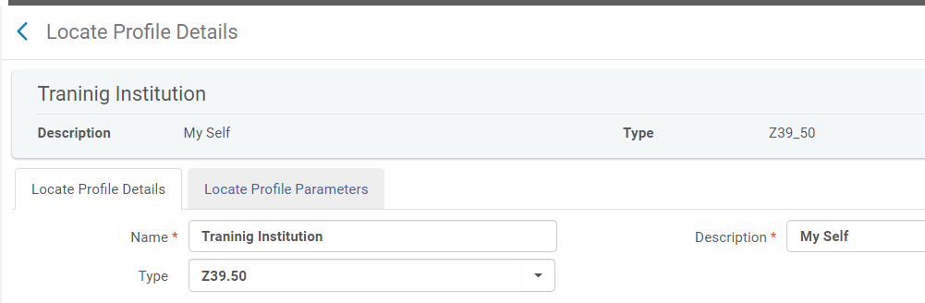
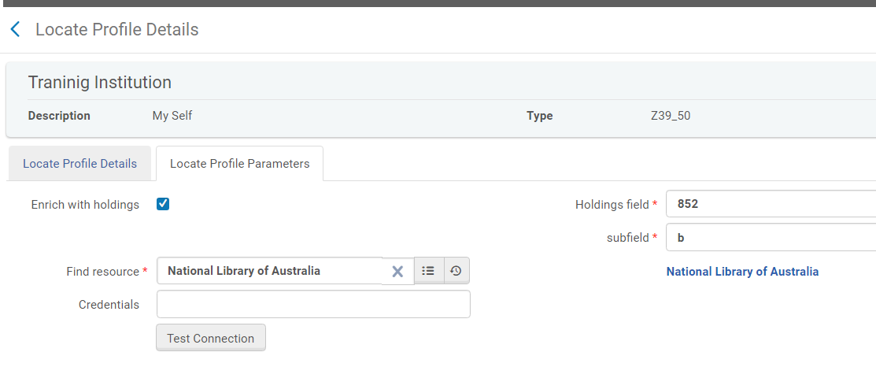
Locate Profiles

Slide 30
User Roles
Resource Sharing Partners Managers may configure resource sharing partners and rota templates
Fulfillment Services Operators or Managers may receive and supply items and manage borrowing and lending requests
Fulfillment or General System Administrators may configure general resource sharing related configurations (assignment rules, workflows etc.)

Slide 31
Peer to Peer Workflows

Slide 32

Resource Sharing in Alma
Borrower
?
Lender
Institution
Institution
Resource Sharing Library
Stub item – owned by resource sharing library
Resource Sharing Library

Slide 33




Resource Sharing Network
Resource Sharing Network

Slide 34

Resource Sharing in Alma
 Ex Libris Ltd., 2014 - Internal and Confidential
Notes:
Demo on Demo, using Sara Carr.
Request Unbroken (OU30)
Do Digital Fulfillment. (activate the rule on OU).
There’s also:
Recall
Renew
Overdue
Expire
Reject/Cancel
Will Supply
Receive/Return/Check In

Slide 35
Broker Workflows and Integrations

Slide 36




Basic Layout
Lender Library
Borrower Library

Slide 37
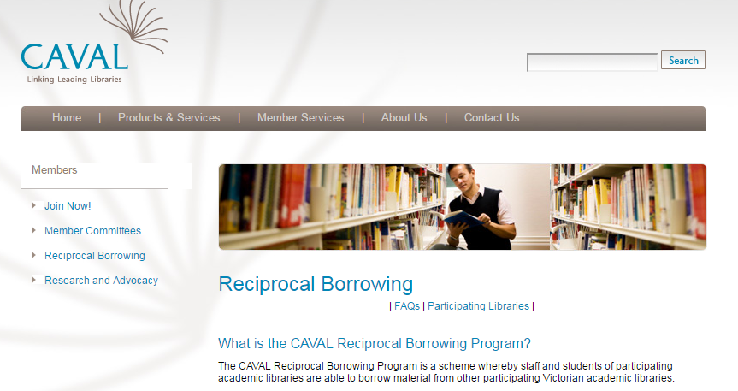
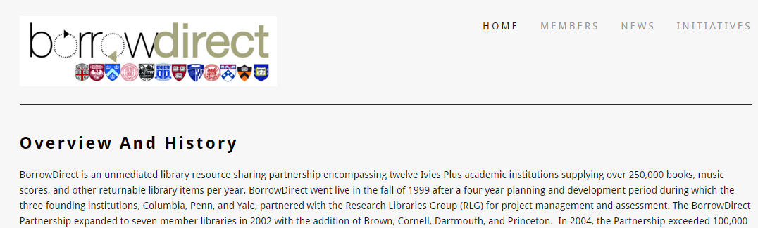
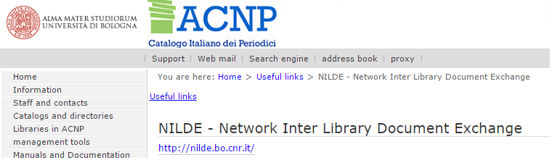
Basic Layout
Notes:
Used in existing networks, at times for historical reasons …
May be based on a shared catalog

Slide 38



Basic Layout
Notes:
Sometimes simply not all members are Alma and not supporting ISO
Not really required if everybody is on Alma.
….
At time, used to bridge until all are Alma

Slide 39
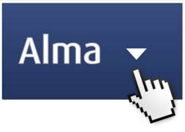

Basic Layout
Notes:
Or to bridge out to a large ‘market’ of lenders …

Slide 40



Borrower Side
Borrower Library
Notes:
Patron:
Can be using Primo or direct accessing.
Obviously, we want to minimize the direct accessing
Staff:
Resource Sharing Staff using the broker system ONLY
Fulfillment Staff using Alma ONLY

Slide 41
Lender Side
Lender Library

Slide 42
Broker Integrations

Slide 43
Integrations
Z39.50 (OPAC)
Notes:
For finding a potential lender
For printing out call slips

Slide 44
Integrations
OpenURL
Static URL
Notes:
A common practice is to use GES to push requests into brokers:
More flexible for defining conditions
More flexible for setting the OpenURL

Slide 45
Integrations
NCIP v2.0
NCIP v2.0
Notes:
InnReach uses V1.0

Slide 46
Broker Workflow

Slide 47
Requesting (1) - Direct
Borrower Library

Slide 48
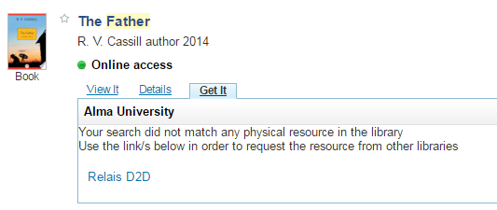
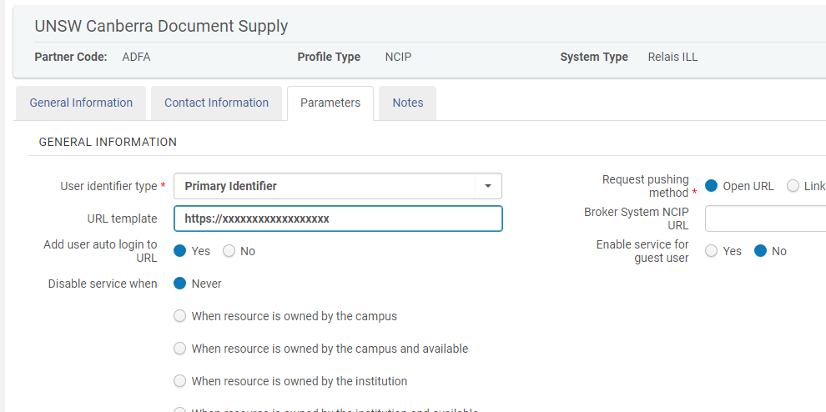
Requesting (2) – Partner Setup
Advantages :
Single requesting point for patron
Depends on patron privilege
Checks patron blocks
May depend on previous login
Borrower Library

Slide 49
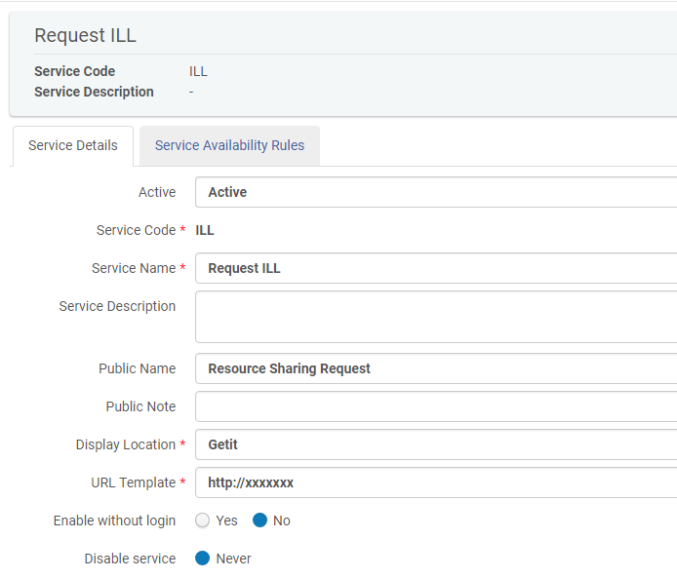
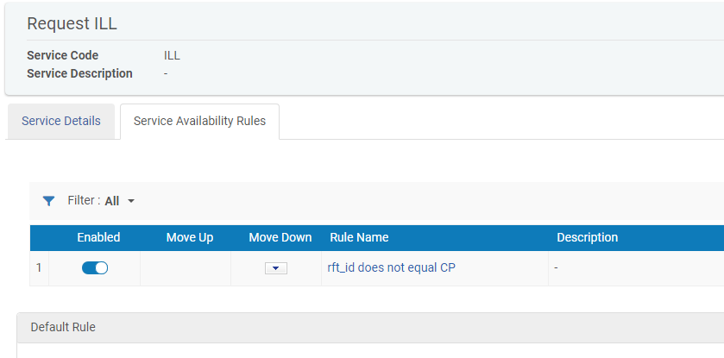
Requesting (3) - GES
Advantages :
Single requesting point for patron
May make use of additional conditions
Borrower Library

Slide 50
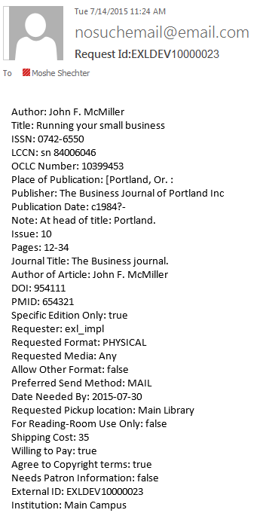




Requesting (4) - Push

Slide 51
Requesting (4)
Notes:
No production success at this point (Alliance), although tests were successful. OCLC support not appearing to be very efficient

Slide 52
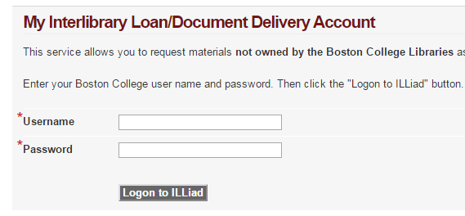
Requesting – Authentication (1) – Independent Auth

Slide 53
Requesting – Authentication (2) – Rely on Alma
LookupUser
Is patron in good standing:
No blocks
No limit
Has Resource Sharing Library
Account active
Borrower Library
Notes:
Relying on Alma login for Authentication
Using NCIP LookupUser for Authorization

Slide 54
Lender Requesting – (1)
Pick from shelf slip
Lender Library
Notes:
Slip printed by broker

Slide 55
Lender Requesting – (2)
Message may include:
ISBN/ISSN
OCLC Number
MMS ID
RequestItem
Pick from shelf slip
Lender Library
Move request may be automatically placed, or using Manage Fulfillment Options
Pick slip may be automatically printed based on circ desk configurations
Notes:
Slip printed by Alma

Slide 56
Lender Shipping
CheckOutItem
Message may include an indication that the shipment is digital.
In this case, the request will be closed
Lender Library
CheckOutItem is used to:
Notify Alma that item has been shipped to borrower
Item is identified as in a resource sharing process
If no RequestItem message was sent, lending request will be created at this point

Slide 57
Borrower Receiving
AcceptItem
Message may include an indication that the shipment is digital.
In this case, the request will be closed
AcceptItem is used to:
Notify Alma that an item has arrived
Temporary item is created in Alma, with a request that is linked to the external request ID
Hold Shelf notification is sent

Slide 58
Borrower Renew Request (1)
CirculationStatusUpdate (Pending Renewal)
Borrower Library

Slide 59
Borrower Renew Request (2)
RenewItem
Borrower Library

Slide 60
Lender Renew Request
RenewItem
Alma will check:
Is item requested ?
Is max renewal
Alma will respond with calculated date, or use broker supplied date
Lender Library

Slide 61
Borrower Renew Request Status
CirculationStatusUpdate (Renewed/Rejected)
Borrower Library

Slide 62
Renew Process
RenewItem
RenewItem
CirculationStatusUpdate (Renewed/Rejected)
Lender Library
Borrower Library

Slide 63
Recall Process
RecallItem
RecallItem
Lender Library
Borrower Library

Slide 64
Borrower Return Item
CheckInItem
Borrower Library
CheckInItem is used to:
Notify Alma that temporary item has been shipped back to lender
Temporary item is deleted in Alma, and the loan is cancelled (if has not been cancelled before)

Slide 65
Lender Check In
CheckInItem
Lender Library
CheckInItem is used to:
Notify Alma that item has been returned by borrower
Item is processed back for shelving at original location

Slide 66
Lender Cancel Request
CancelRequest
Lender Library

Slide 67
Fulfillment Network Workflows and Configurations

Slide 68
Resource Sharing Network
The patron’s home institution is the patron’s service provider.
The patron’s home institution staff uses its own availability information, priorities and workflow considerations
The patron’s home institution is accountable for the loaned item from the perspective of the resource owning library
The home institution may activate a load balancing process to select the appropriate supplier
The pickup location is always at the patron’s home institution.

Slide 69
Resource Sharing Network
Resource Sharing Network

Slide 70
Fulfillment Network
Fulfillment Network

Slide 71
Fulfillment Network
The resource owning library is the patron’s service provider. The patron directly requests the resource from the remote member institution.
The resource may be picked up anywhere
The resource owning library directly manages all aspects of the loan cycle with the requesting patron, including
  Loan management (overdue, lost, renew etc.)
  Fine/fee related issues

Slide 72
Fulfillment Network – User Value
The Fulfillment Network lowers the library involvement in terms of configuration, maintenance of supplier lists and in terms of staff mediation of the requests.
The responsibility for obtaining the resources is levied on to the end user, leaving library staff out of this process.

Slide 73
Fulfillment Network – Considerations
Patron information may be freely shared between the institutions of the network.
Institutions can agree on the policies by which their resources will be lent to different patron types of other institutions
The member institutions inventory is discoverable by patrons of all network members.

Slide 74
Fulfillment Network - Workflows
  A single institution may participate in multiple fulfillment networks
  Functional Highlights
    Walk-In Loans
    Direct Requesting
    Pick up Anywhere
    Consortial patron card in Primo

Slide 75
Fulfillment Network - Workflows
 Ex Libris Ltd., 2014 - Internal and Confidential
Notes:
Demo on Demo, using Sara Carr.
Request Unbroken (OU30)
Do Digital Fulfillment. (activate the rule on OU).
There’s also:
Recall
Renew
Overdue
Expire
Reject/Cancel
Will Supply
Receive/Return/Check In

Slide 76

Fulfillment Network
Fulfillment Network

Slide 77


Fulfillment Network Workflow
Request
Abel, Brian
Loan/Return
We all lost the cold war
Ship
Return

Slide 78
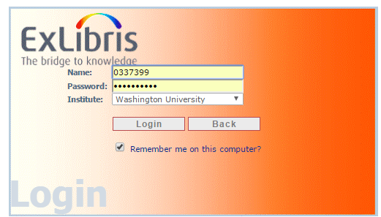
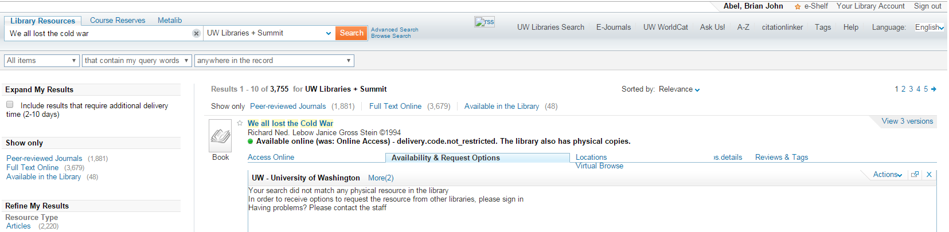
Patron Logs In at U of Washington

Slide 79
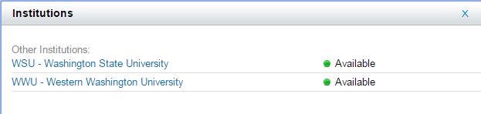
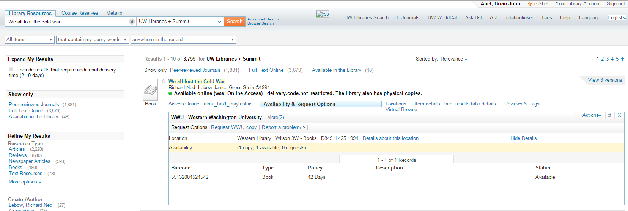
Patron Changes to View Western Washington Holdings

Slide 80
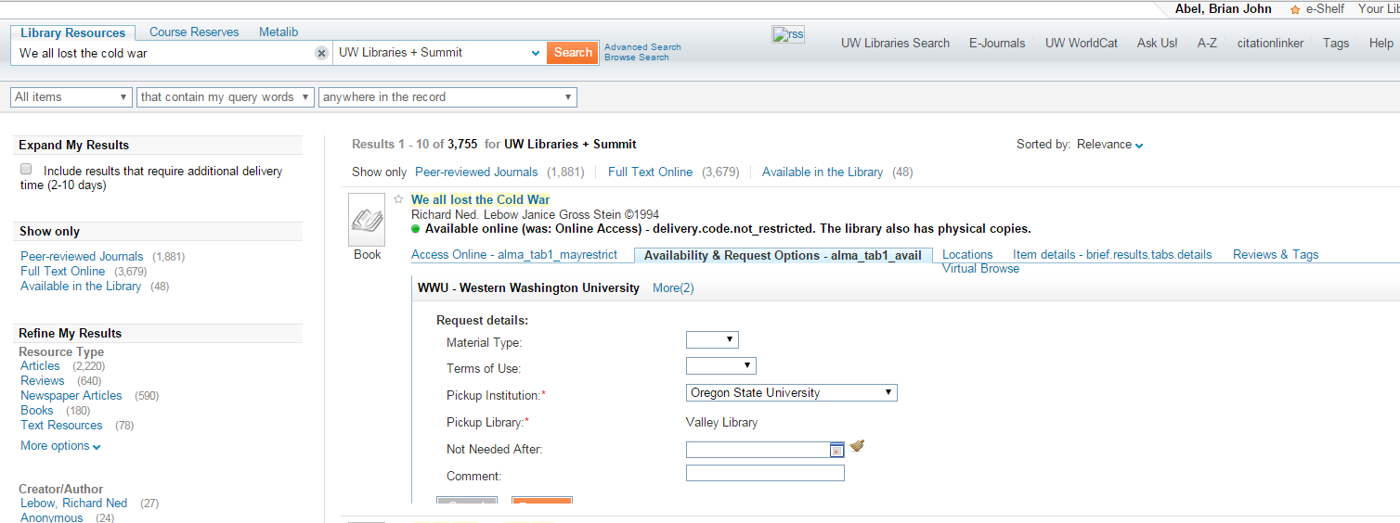
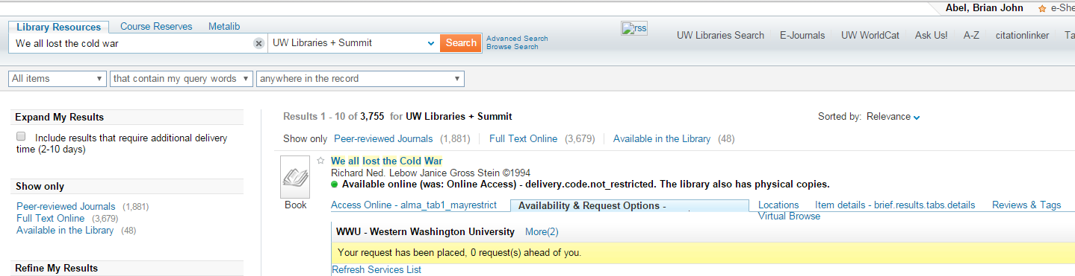
Request is for Pick Up at Oregon State

Slide 81
Fulfillment Network Workflow
Request
Abel, Brian
We all lost the cold war

Slide 82
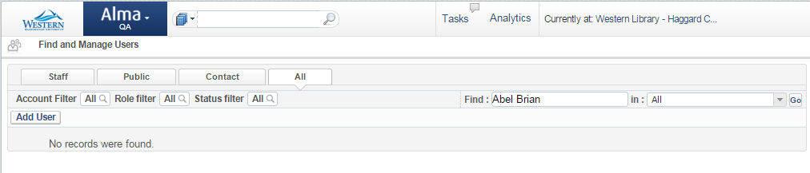
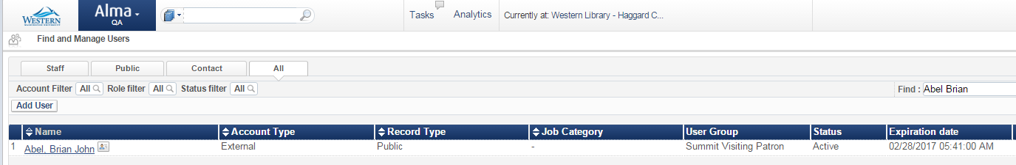
Patron Information is Copied !

Slide 83
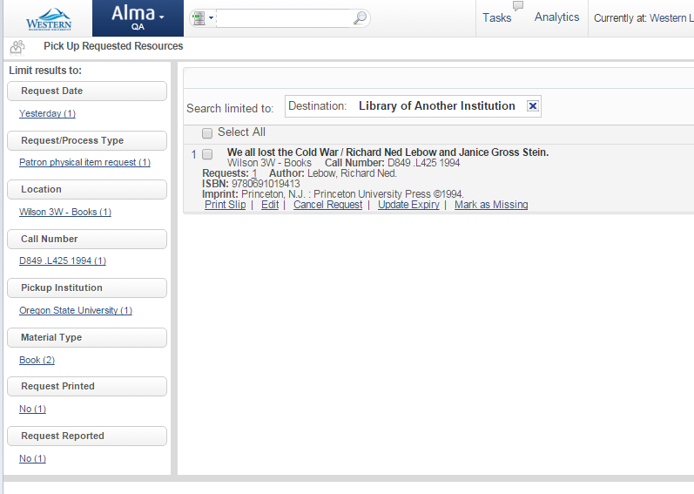
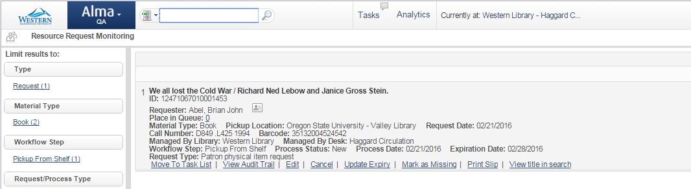
Request is Registered at Western Washington …

Slide 84
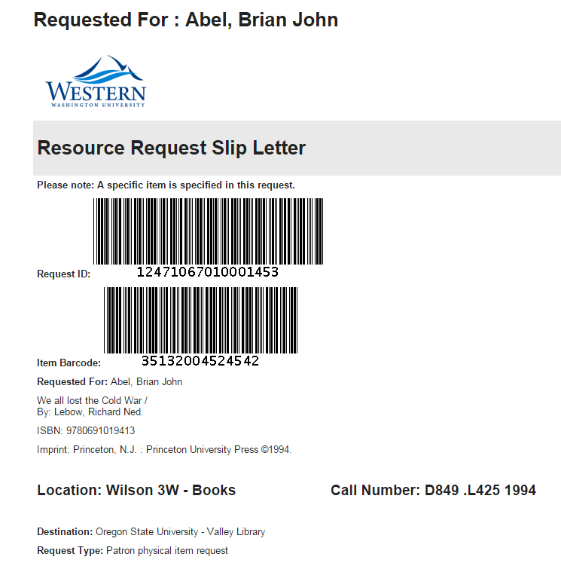
… and Pick Slip is Printed

Slide 85
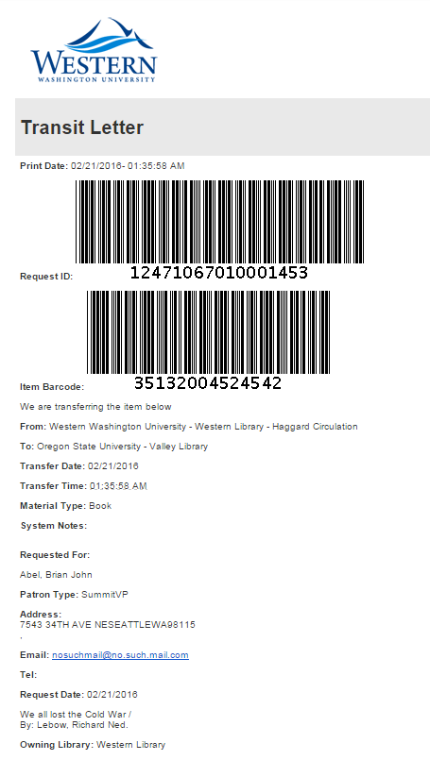
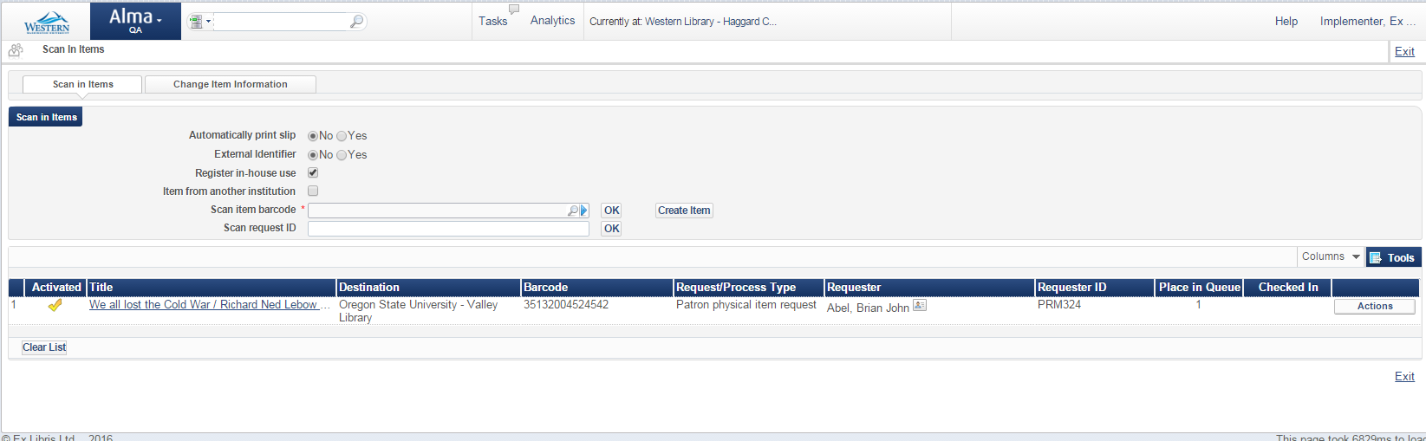
Item is Wanded in …
… and Put in Transit

Slide 86
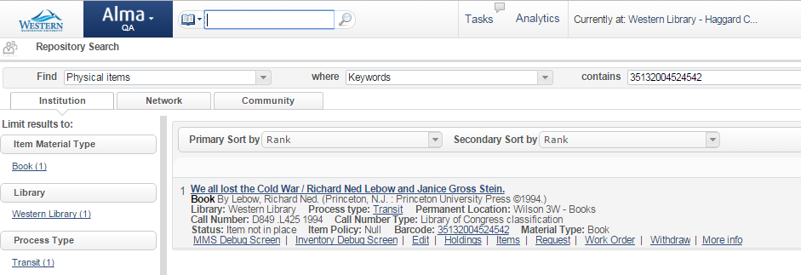
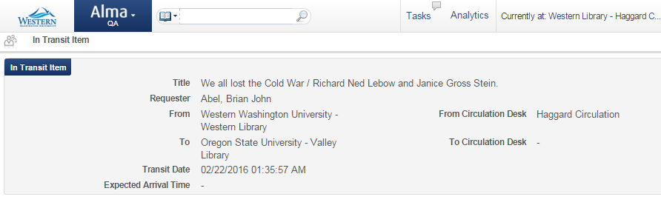
Item is in Transit

Slide 87
Fulfillment Network Workflow
Request
Abel, Brian
We all lost the cold war
Ship

Slide 88
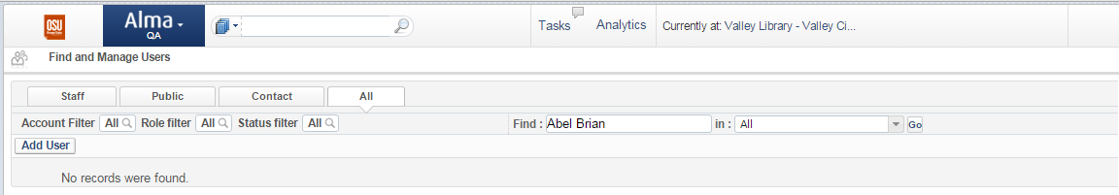
The Requester is not known at Oregon State …
But that is about to change …

Slide 89
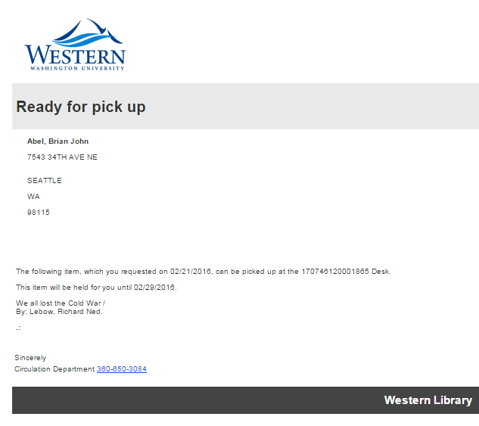
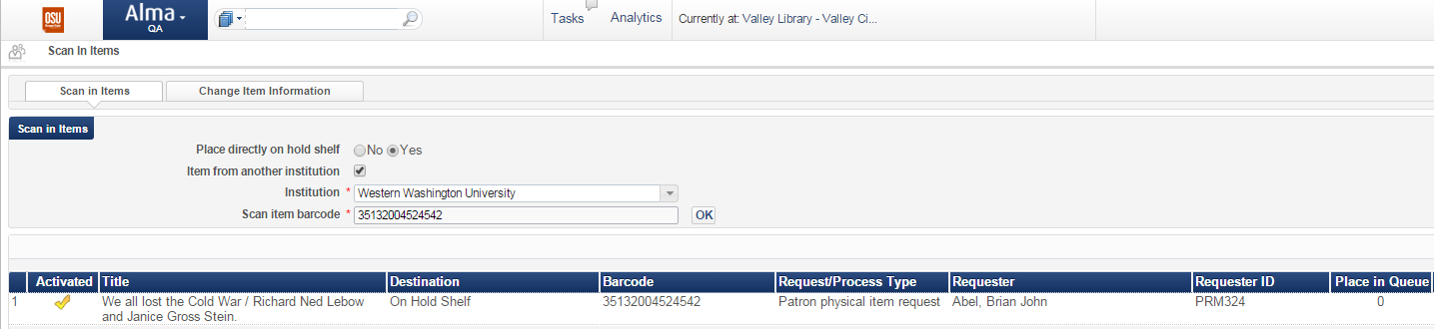
Item is Wanded in at Oregon State …
… and Put on Hold Shelf

Slide 90
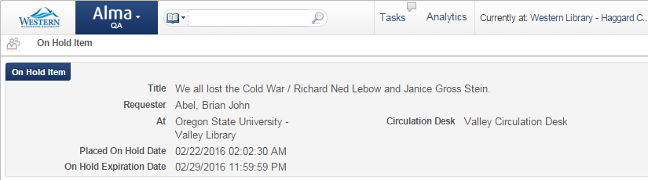
Back Home, Item is Tracked

Slide 91
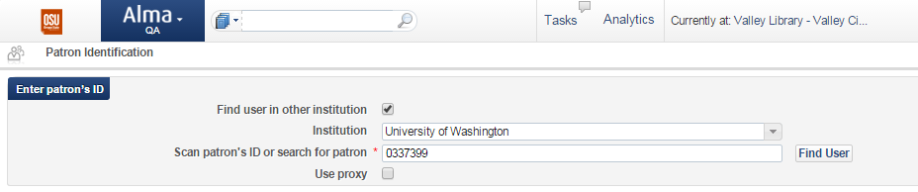
Patron Comes to Collect the Item …

Slide 92

… and is Automatically Registered

Slide 93


Loan Can Go On (with Western’s Item !)

Slide 94

Back Home, Item is Tracked

Slide 95
Fulfillment Network Workflow
Request
Abel, Brian
Loan
We all lost the cold war
Ship

Slide 96



Patron Can Return Where Picked Up ! …

Slide 97

Item is Finally Home !

Slide 98
Fulfillment Network Workflow
Request
Abel, Brian
Loan/Return
We all lost the cold war
Ship
Return

Slide 99

Services are Exposed in Primo

Slide 100
Configuring the Fulfillment Network

Slide 101

Configuring the Fulfillment Network

Slide 102

Members (possible in NZ)

Slide 103

Groups (possible in NZ)

Slide 104

Relations (possible in NZ)

Slide 105

Library Serves Other Institution

Slide 106

Pickup at Any Institution

Slide 107

Consortial Services Privilege

Slide 108
Configuring the Linked Accounts

Slide 109

Linked Account Settings

Slide 110

Restricted Users

Slide 111

Cross Consortia Identifiers

Slide 112
Next Steps and Support Resources

Slide 113
Next Steps and Support Resources
https://knowledge.exlibrisgroup.com/Alma/Product_Materials/Overview_Materials/More_Information_About...
https://developers.exlibrisgroup.com/alma/integrations/resource_sharing/p2p
https://developers.exlibrisgroup.com/alma/integrations/resource_sharing/broker
Additional support resources within the ExLibris Ecosystem:
  Idea Exchange
  Developer Network
2018 Technical Seminar Presentations (Cross-Product section of CKC)
Notes:
Mention what it is the audience should do after the tech seminar is over – how they retain what they learned.
Mention links to relevant documentation articles associated with your topic.
Refer to Idea Exchange to provide development ideas for features they think are important to add
Systems Status page
Dev Network
They can find this session – all of the Tech Seminar – presentations in the CKC (link to the article).

Slide 114

Q & A
Any Questions?
Notes:
Any last questions?

Slide 115


Session Feedback
We Value Your Feedback!
Please complete the brief Session Comment Card:

Slide 116
THANK YOU

