Slide 1
Customize Letters How to customize letters via xsl
Yoel Kortick Senior Librarian
https://www.visitspokane.com/media/photo-gallery/

Slide 2
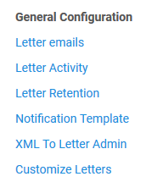
Customize letters - How to customize letters via xsl
The actual configuration of the letters is done under ‘Configuration > General > General Configuration’

Slide 3
Customize letters - How to customize letters via xsl
Customize Letters = Allows staff to configure the XSL of each letter to configure, for example, what data will appear and how.
In this specific presentation we will make one specific change to an XSL letter. For full list of many examples of xsl changes and detailed explanations see https://knowledge.exlibrisgroup.com/Alma/Training/Extended_Training/Presentations_and_Documents_-_Letters
Note that when making a change to the XSL there is often more than one way to achieve the same desired goal. When that is the case one specific option is chosen in these examples, though we are aware that there may be additional possible methods.

Slide 4
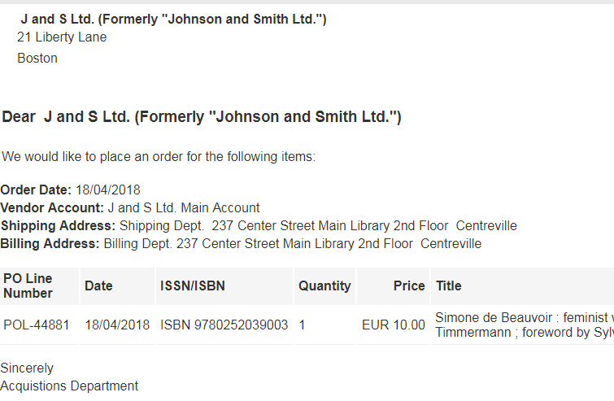
Customize letters - How to customize letters via xsl
Here is the current Letter to the Vendor

Slide 5
Customize letters - How to customize letters via xsl
Institution would like to make a change such that if the vendor name is “J and S Ltd. (Formerly “Johnson and Smith Ltd.”)” then there should be a red bold line at the beginning stating “Please do not forget our 10% discount”.
If vendor is not “J and S Ltd. (Formerly “Johnson and Smith Ltd.”)” then there should be no change.
The first step is to get the XML of the letter (ands this is described in previous presentation on “XML To Letter Admin”)

Slide 6
Customize letters - How to customize letters via xsl
In the XML we see that the vendor name appears as follows:
The path of the vendor name is /notification_data/receivers/receiver/vendor/name
We can get the path by looking at the XML or using a notepad plugin

Slide 7
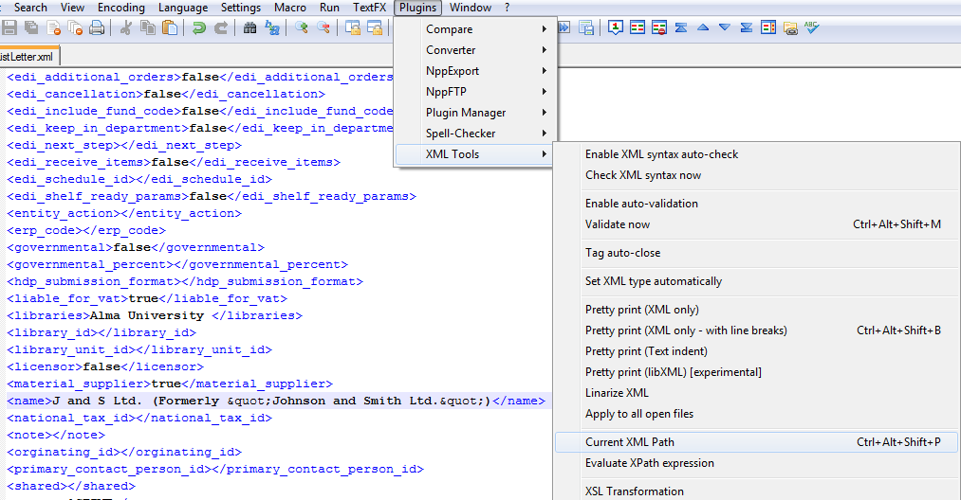
Customize letters - How to customize letters via xsl

Slide 8
Customize letters - How to customize letters via xsl
In the OrderListLetter XSL we will add a condition.
To do this we need to edit the xsl of the letter
Configuration > General > General Configuration > Customize Letters

Slide 9
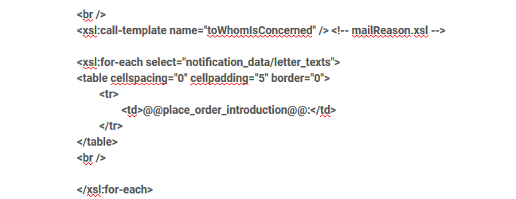
Customize letters - How to customize letters via xsl
The condition which we will add is on the next screen.
Note that it uses the field of the vendor name the exact way it appears in the XML
We will add it after a previous existing “foreach” table combination.
We will add it after this section:

Slide 10
Customize letters - How to customize letters via xsl
<!-- Yoel begin adding next lines -->
<xsl:for-each select="notification_data">
<!-- Make condition for vendor name “J and S Ltd. (Formerly “Johnson and Smith Ltd.”)" -->
<xsl:choose>
<xsl:when test="//notification_data/receivers/receiver/vendor/name ='J and S Ltd. (Formerly &quot;Johnson and Smith Ltd.&quot;)'">
<table>
<tr> <font color="red" size="4"><b> Please do not forget our <u>10% discount</u></b></font></tr>
</table>
</xsl:when>
<!-- For all other situations use the default address from the library definition -->.
<xsl:otherwise>
<table>
<tr> </tr>
</table>
</xsl:otherwise>
</xsl:choose>
</xsl:for-each>
<br />
<!-- Yoel finish adding next lines -->
This is the field and text we found in the XML of the letter

Slide 11
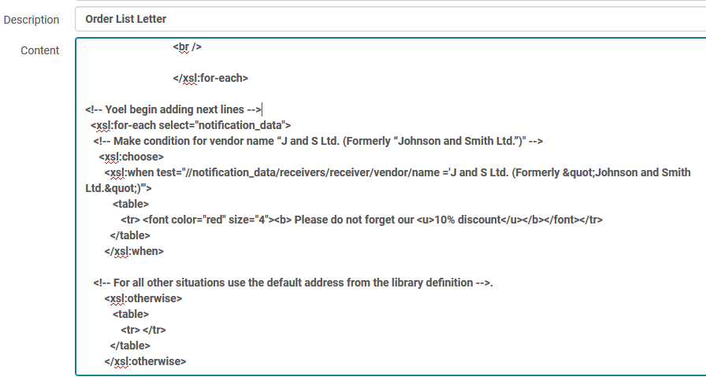
Customize letters - How to customize letters via xsl
Here it is in the letter

Slide 12
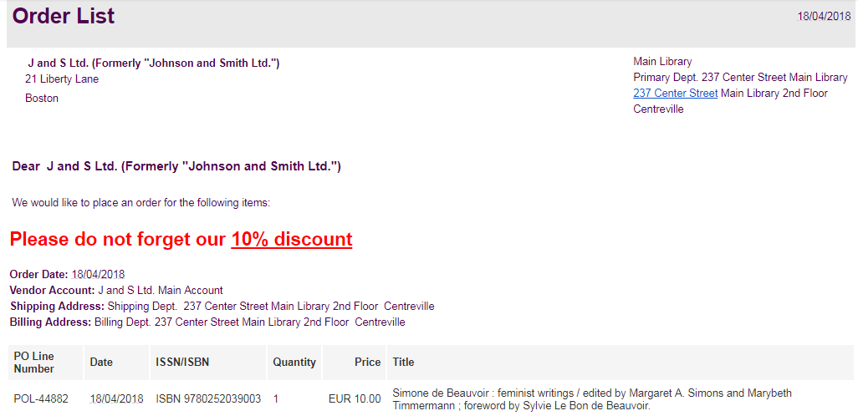
Customize letters - How to customize letters via xsl
Here is the letter when the vendor is “J and S Ltd. (Formerly “Johnson and Smith Ltd.”)”

Slide 13
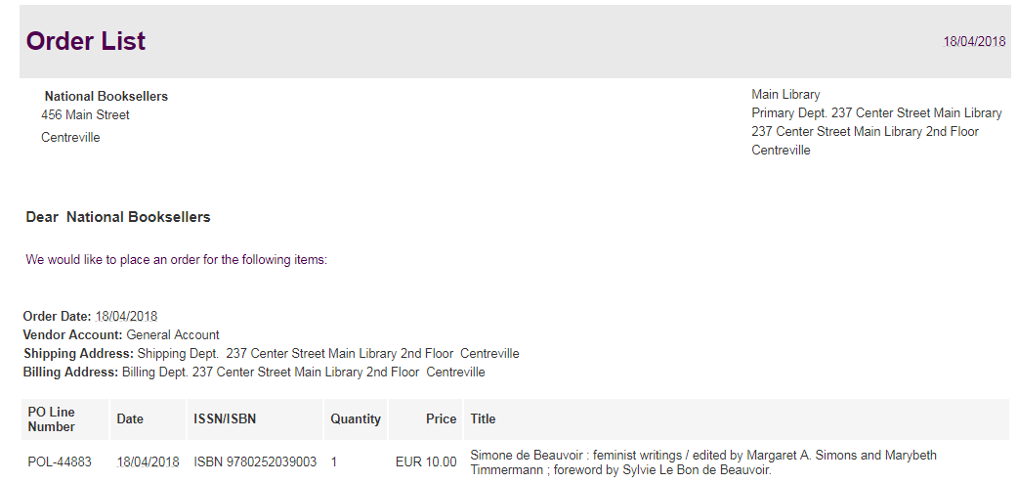
Customize letters - How to customize letters via xsl
Here is the letter when the vendor is not “J and S Ltd. (Formerly “Johnson and Smith Ltd.”)”

Slide 14
Thank you

