Slide 1
Managing COUNTER-Compliant Usage Data in Alma
Vlad Buldryev| Senior Support Analyst
Yaala Ariel-Joel | Support Analyst

Slide 2
Welcome and Introductions
Vlad Buldryev, Senior Support Analyst
Specializes in link resolution and delivery across Ex Libris products.
Holds an MLIS degree from Simmons College
Yaala Ariel-Joel, Support Analyst
Supporting Alma customers
Earlier was a reference librarian in special libraries.

Slide 3
Session Objectives
Session Description: How to load and manage COUNTER-Compliant data in Alma
Session Objective(s)
By the end of this sessions you will know, understand and/or be able to:
Set-up SUSHI Vendor in Alma
Upload files – manually and via SUSHI
Monitor “Load Usage Data”
Brief review of Analytics “Usage Data” and “Cost Usage” subject areas.
Target Audience: Systems, Collection Development, all interested

Slide 4
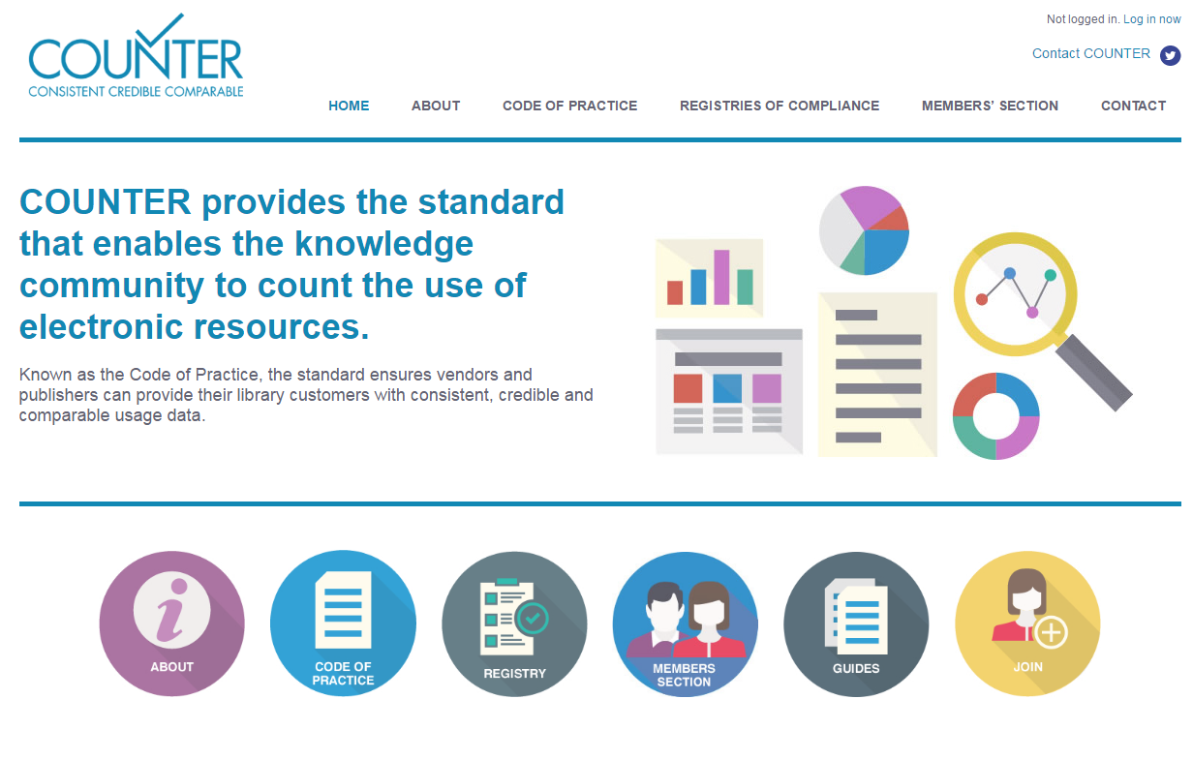
Actually, what is COUNTER?
Project COUNTER –
Counting Online Usage of Networked Electronic Resources
Known as the Code of Practice, the standard ensures vendors and publishers can provide their library customers with consistent, credible and comparable usage data.
www.projectcounter.org

Slide 5
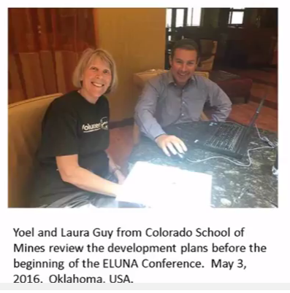
A year on since release:
Today, COUNTER usage data is loaded directly to Alma.
Unified management interface, one login.
Review results – within a day.
More COUNTER Report Types are available now.
Contribute SUSHI setup

Slide 6
Agenda
1
Configuration – Subscriber, Vendors
2
Manually uploading and deleting COUNTER data
3
SUSHI Harvesting
4
Analytics Reporting
5
Next Steps, Support Resources and Feedback

Slide 7
Configuration –
Subscriber, Vendors
1

Slide 8
Roles Required:
Acquisitions Administrator - Configure COUNTER subscribers and activate, deactivate, or manually run the automatic harvesting job.
Vendor Manager - View usage data related to a particular vendor, manually harvest data for the vendor, manually upload data for the vendor, and manage any uploaded data files.
Usage Data Operator - Manually upload or delete data for any vendor, manage the uploaded data files, and view missing COUNTER data.
General System Administrator - Activate, deactivate, schedule, or monitor the automatic harvesting job, view the job's history, report, and events, and configure email notifications for the job.

Slide 9
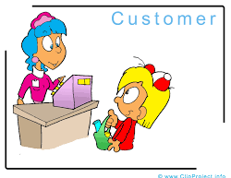
COUNTER Subscriber(s)
Subscribers represent an account with a vendor.
In the vast majority of cases an institution has and requires only one subscriber.
Alma requires at least one subscriber.

Slide 10
Subscribers - Setup
Subscribers are be defined in: Configuration → Acquisitions → General → Subscribers

Slide 11
Subscriber - impact
Data will be reportable by Subscriber (e.g. Law Library, participating campus…)

Slide 12
Vendor Configuration
For manual uploads – any vendor can be used. It is good practice to decide who will be the Alma COUNTER vendors.
SUSHI data will be determined solely by the URL and other information you add when configuring the account.
Yet we recommend adding the account for each vendor on the Usage Data tab of that vendor, for organizational purposes.

Slide 13
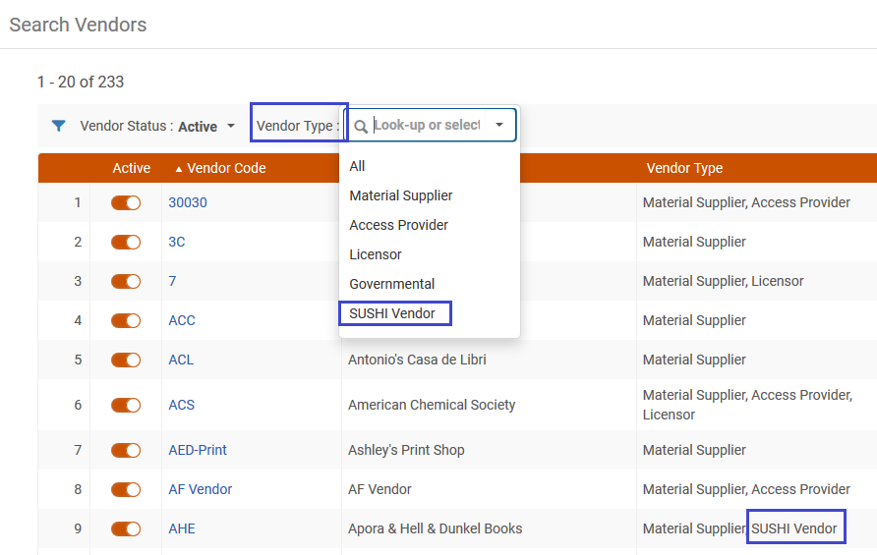
Vendor Filters
If SUSHI account was defined for a vendor, it is easy to find it, being now a “SUSHI Vendor”.

Slide 14
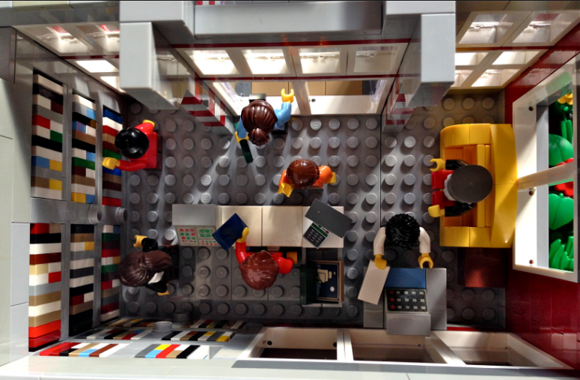
Hands-on Exercise
Which vendors send you COUNTER data?
Is it sent manually, and/or via SUSHI (automatic harvesting)?

Slide 15
Manually Uploading and Deleting COUNTER Data
2

Slide 16
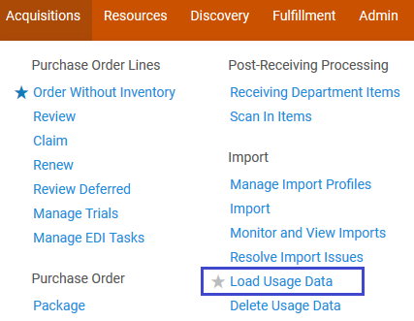
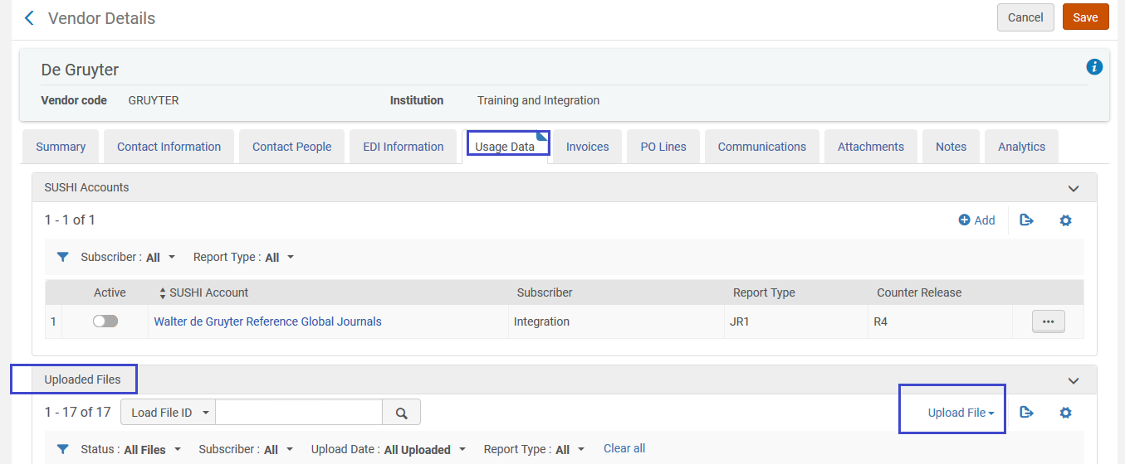
Manually Uploading and Deleting COUNTER Data
Manual uploads can be managed from Load Usage Data
Or directly from the Vendor record

Slide 17
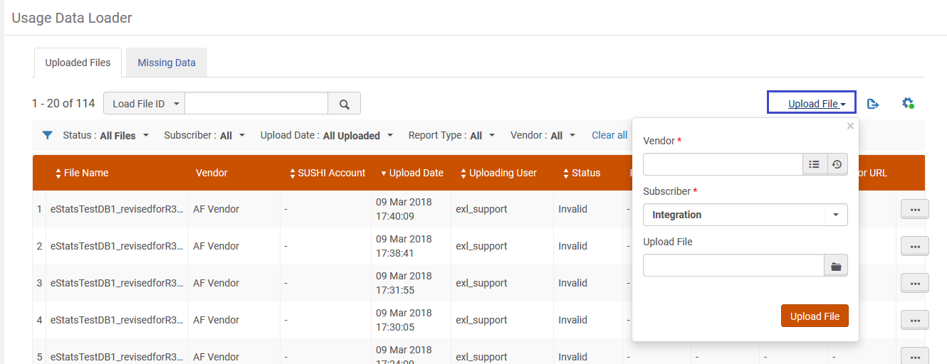
Manually Uploading and Deleting COUNTER Data
Select Vendor, Subscriber, file:

Slide 18
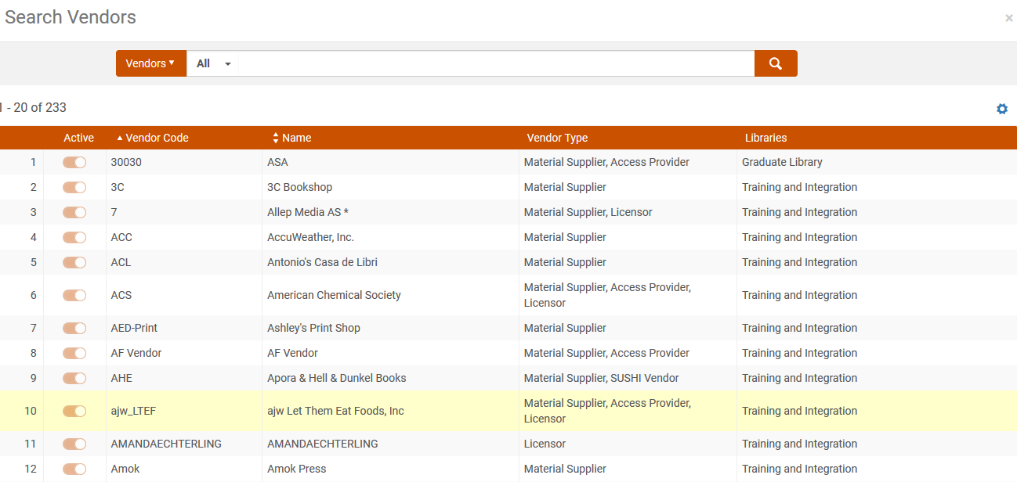
Manually Uploading and Deleting COUNTER Data
Any vendor can be selected:

Slide 19
Manually Uploading and Deleting COUNTER Data
The data must be in one of the following formats: xlsx, xls, csv, txt, or tsv. Some report types enable XML even for manual load (see COUNTER Report Types).

Slide 20
Overlapping Data Checks
Before uploading, Alma checks whether overlapping data exists in the database, according to a unique combination of owner code, subscriber, platform, publisher, measure type, and date (the owner code in Alma is built out of the customer ID and the institution ID).
If data is considered duplicate, the following notification message is displayed, Continue with the upload will delete the old data - Are you sure you want to continue? If you continue, the old data is overwritten by the new data.

Slide 21
Actions available for uploaded files
Multiple actions and filters are available
Filter, view, download or delete files.

Slide 22
Missing COUNTER Data
Inspect if there is data missing for a specific period.
This tab includes data loaded in Alma as well as migrated data.

Slide 23
Hands-on Exercise
Uploading a COUNTER Excel file.

Slide 24
SUSHI Harvesting
3

Slide 25
Configuring SUSHI Accounts
SUSHI accounts enable Alma to automatically retrieve COUNTER reports from vendors.
Again, SUSHI data will be determined solely by the URL and other information you add when configuring the account . Yet we recommend adding the account for each vendor on the Usage Data tab of that vendor, for organizational purposes.

Slide 26
Configuring SUSHI Accounts
From the Vendor record, add a SUSHI account for each report type (and subscriber).

Slide 27
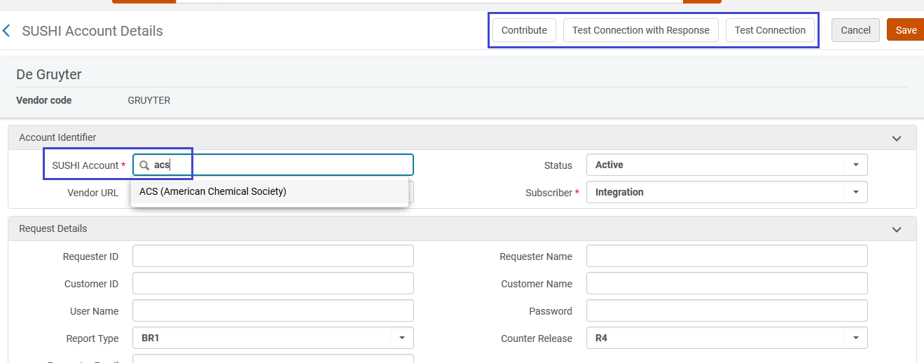
Configuring SUSHI Accounts
From the Vendor record, add a SUSHI account for each report type (and subscriber).
Autofill can find SUSHI-Certified vendors → complete rest of data and test, or contribute:

Slide 28
Configuring SUSHI Accounts
List of Certified-SUSHI Vendors is maintained in the Online Help:
As relevant, special instructions are given:

Slide 29
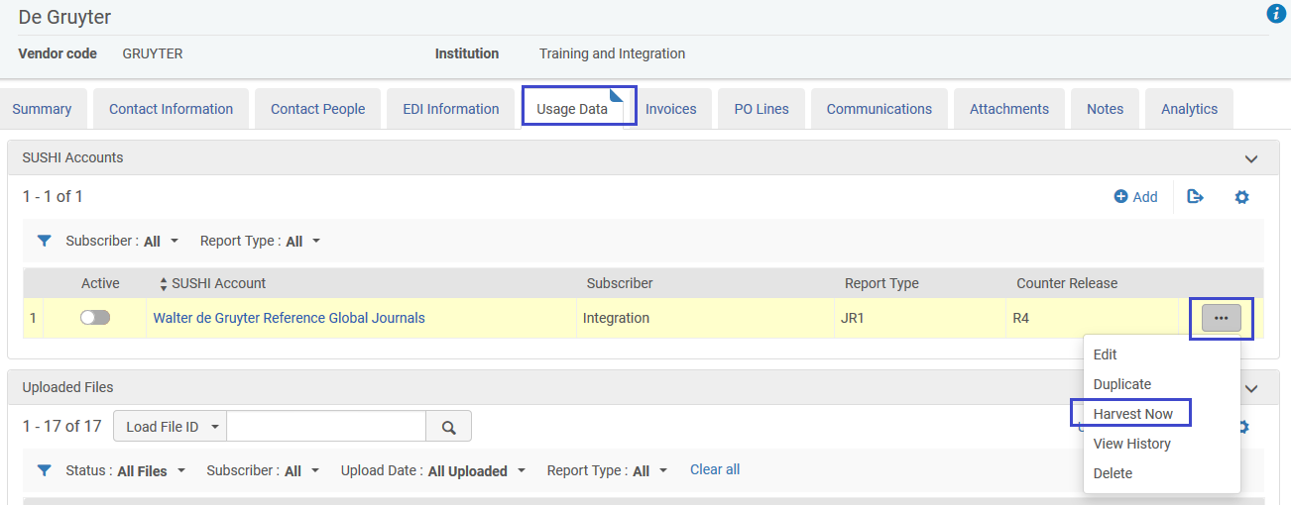
Managing SUSHI Harvesting
Certain Roles can launch the SUSHI job manually.

Slide 30
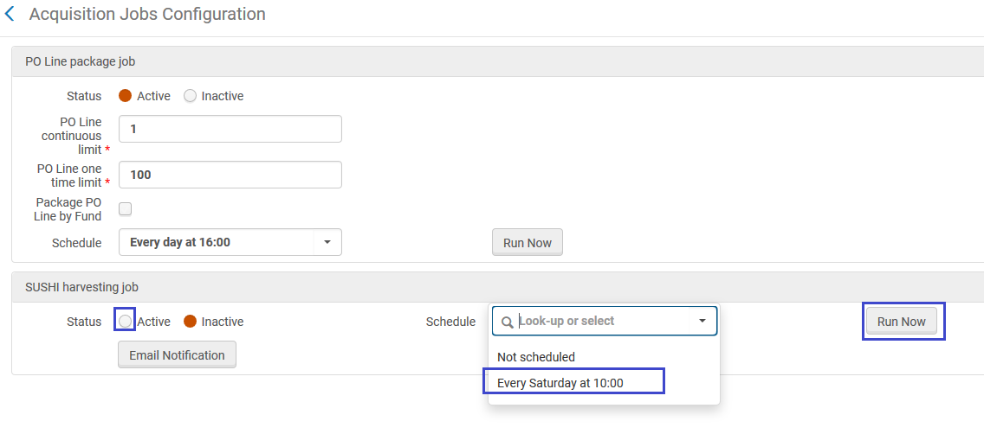
Managing SUSHI Harvesting
To schedule harvesting, go to: Configuration → Acquisitions → Acquisition Jobs Configuration

Slide 31
Hands-on Exercise
For example, add SUSHI account for “ACS”.
Test connection, inspect the answer.

Slide 32
Analytics Reporting
4

Slide 33
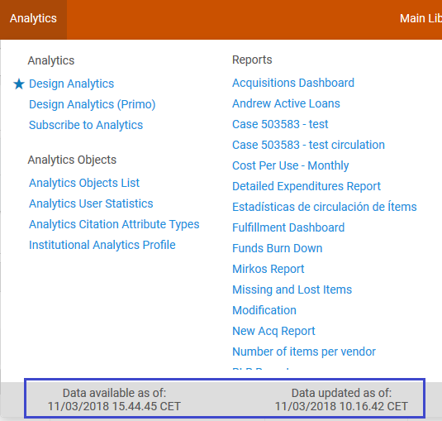
Analytics refresh timeline
Usage data is refreshed daily

Slide 34
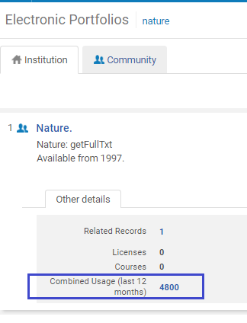
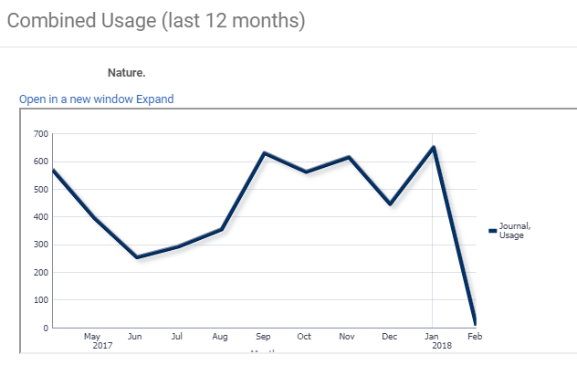
Analytics reporting
Usage data is visible from an Electronic Portfolios search.
Drill down to get to Analytics for further analysis.

Slide 35
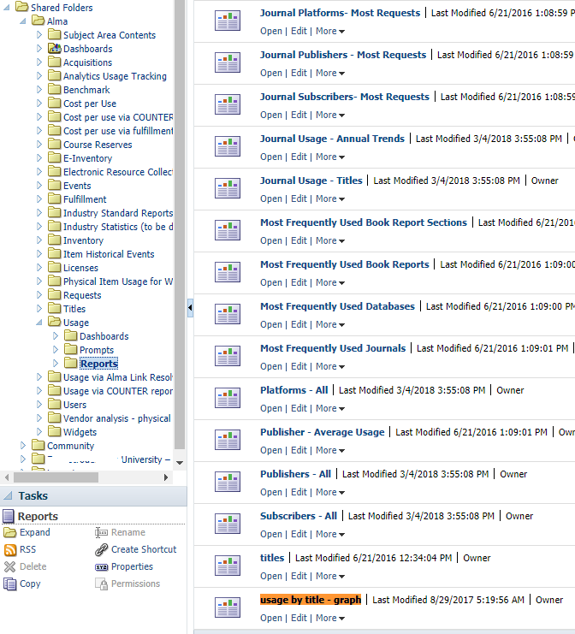
Analytics reporting
The Development Team shared a tip – find the report in:
/Shared/Alma/Usage/Reports/Usage by title graph

Slide 36
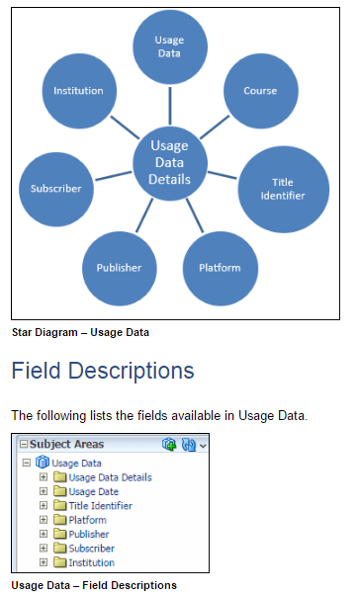
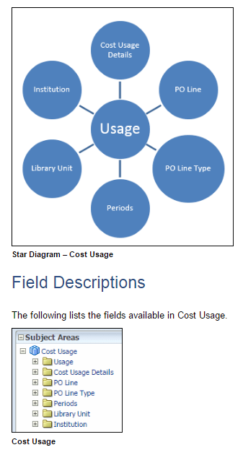
Analytics Reporting
COUNTER data exists in Analytics “Usage Data” and “Cost Usage” subject areas.

Slide 37
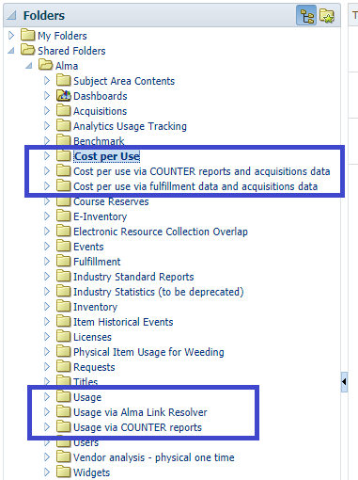
Analytics Reporting
Reports and Dashboards are offered for immediate use:

Slide 38
Hands-on Exercise
Check Analytics report building advice:
Usage Data: https://knowledge.exlibrisgroup.com/Alma/Product_Documentation/Alma_Online_Help_(English)/Analytics/160Usage_Data
Cost Usage: https://knowledge.exlibrisgroup.com/Alma/Product_Documentation/Alma_Online_Help_(English)/Analytics/170Cost_Usage
Remember also the Link Resolver Usage: https://knowledge.exlibrisgroup.com/Alma/Product_Documentation/Alma_Online_Help_(English)/Analytics/150Link_Resolver_Usage
Understanding the “Cost Usage” Subject Area: https://knowledge.exlibrisgroup.com/Alma/Training/Extended_Training/Presentations_and_Documents_-_Analytics
Direct link:
https://knowledge.exlibrisgroup.com/@api/deki/files/48654/Analytics_-_Overview_of_calculation_of_the_cost_per_use_in_the_Cost_Usage_subject_area_with_DB_and_JR1.pptx?revision=2

Slide 39
Next Steps, Support Resources and Feedback

Slide 40
Next Steps and Resources
Documentation:
Managing COUNTER-Compliant Usage Data
https://knowledge.exlibrisgroup.com/Alma/Product_Documentation/010Alma_Online_Help_(English)/020Acquisitions/090Acquisitions_Infrastructure/010Managing_Vendors/Managing_COUNTER-Compliant_Usage_Data
Additional support resources within the ExLibris Ecosystem:
Idea Exchange: https://ideas.exlibrisgroup.com/forums/308173-alma/suggestions/19332850-in-analytics-add-usage-data-to-the-e-inventory-su
Developer Network:
https://developers.exlibrisgroup.com/standards
https://developers.exlibrisgroup.com/blog/UStat-fixing-usage-data
2018 Technical Seminar Presentations (Cross-Product section of CKC)

Slide 41
Questions?
Any Final Questions?

Slide 42
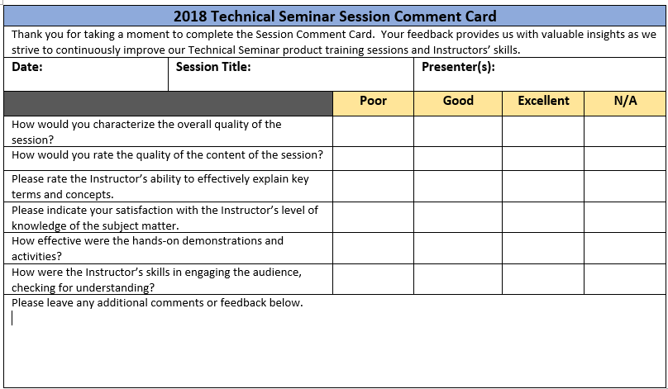
Session Feedback
We Value Your Feedback! Please complete the brief Session Comment Card:

Slide 43
Thank You!

