Slide 1
Creating Courses and Reading Lists in Leganto and Alma
Carolyn Sprague, Training Consultant
Notes:
Welcome to this Leganto session –Creating Courses and Reading Lists in Leganto and Alma

Slide 2
Welcome and Introductions
Carolyn Sprague, Training Consultant- Global Education
9 years at Ex Libris
7 years Technical Implementation Consultant (Primo)
MLS – Simmons College Boston
Notes:
My name is Carolyn Sprague

Slide 3
Session Objectives
Managing Course and Reading Lists in Alma and Leganto
Learn how/what can be managed for Courses and Reading Lists in Alma and Leganto
By the end of this sessions you will know:
How Courses are created and managed by Librarians
How Reading Lists are created and managed by Librarians
Working with Reading List tasks, reading list statuses and publications statuses
Where to configure Course, Reading List and Leganto settings in Alma
Notes:
The focus of this training session will be how librarians interact and collaborate with instructors to create and manage Courses and Reading Lists in Alma and Leganto.

Slide 4
Target Audience
Target Audience for the Session:
All Leganto users who want to know more, get updates and learn about new functionality in Leganto and Alma.
Course Reserves and Fulfillment Services Operators
Fulfillment / Course Reserves Manager
Notes:
This sessions is geared toward staff working directly with Courses and Reading Lists in Alma. Some of the workflows and tasks that we’ll see today may requires manager level roles. For this reason, I’ve included both Operator and Manger Roles in Course Reserves and Fulfillment areas.

Slide 5
Agenda
1
Library staff and Courses
2
Library Staff and Reading Lists
3
Reading Lists Task List / Reading List Statuses
4
Alma Configurations
5
Next Steps, Support Resources and Feedback
Notes:
Here’s our agenda

Slide 6
Library staff and Courses
Notes:
Remember that management of Courses and Reading lists is collaborative and done in cooperation with course instructors.

Slide 7
Courses
LTI- Learning Tools Integration
Alma Developer’s Network
How Courses are added to Alma and Leganto
Course Loader Integration profile
Instructors add Courses
Librarians add Courses
Notes:
Let’s review the different ways that Courses can be integrated with Leganto
1) one way that Links to Leganto can be added to a Course Management System (LTI Integration)
We’ll look at 3 ways Courses are added to Alma
https://developers.exlibrisgroup.com/leganto/integrations/lti

Slide 8
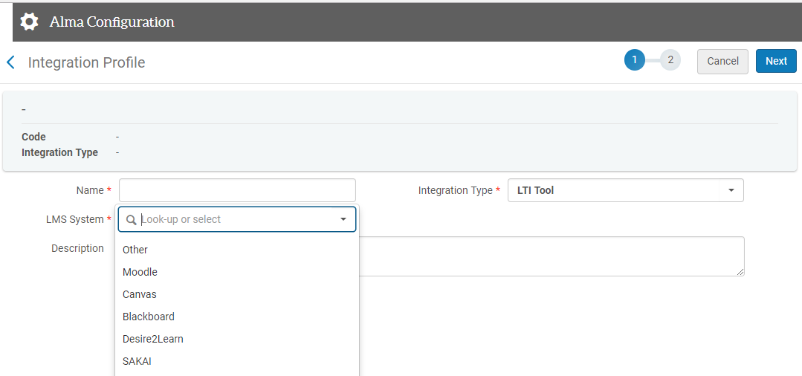
Learning Tools Integration (add Leganto Link to LMS)
1. Create and LTI Integration Profile in Alma
Alma Configuration > General > External Systems > Integration Profiles
2. Configure your LMS
--Moodle
Notes:
Let’s start by talking about how Leganto links can be created and be added to a CMS or LMS
To do this, librarians will set up an integration profile in Alma. (Integration profiles that you may already be familiar with are: OCLC Connexion, BURSAR, SIS)
Under Alma Integrations set up the LTI integration profile.
Configure your LMS – for example Moodle a) (create and external tool using data from LTI step b) Create link to Leganto inside your LMS
Librarians can set up the Integration profile, and configure the LMS or provide the LTI details to instructional designers.
The LTI allows you to put a link in your LMS under s specific course that link to a reading list in Leganto.

Slide 9
Course Loader Integration Profile
Notes:
The first way that Courses can be loaded automatically and in bulk into Alma by using another Integration profile.
The Course Loader Integration profile can be configured from Alma Configuration > General > External Systems >Integration Profiles >Couse Loader.
In this case the Courses can be loaded directly into Alma as an initial setup or on an ongoing basis to update or rollover Courses.
2. Course Loader Integration profile requires a tab-separated (txt or csv) accessible by Alma in a dedicated ftp directory. File must be date-stamped- only the most recent file.
Only the most recent (csv or txt) File will loaded. The date is important because the file can indicate records that are:> new, changed, deleted or rolled over.
https://knowledge.exlibrisgroup.com/Leganto/Product_Documentation/Leganto_Administration_Guide/Configuring_Leganto_Integration_Profiles/Configuring_Course_Loading

Slide 10
Course Loader Integration Profile (continued)
Notes:
The Course Loader File allows you to upload course with the following fields: Course Name, Course Code, Section, Start and End Dates, submit by, instructor, number of participants , weekly hours.
When we look at the Course metadata in Alma you will see the fields listed above.
Mandatory fields: Code and Start and End dates
You can see a number of fields in this form that can be configured to allow for updating or rolling over courses from year to year.
Some fields in the form
Delete associated reading list when deleting a course
Overwrite instructors
Overwrite number of participants
On Rollover: (fields related to reading lists- that would be retained)
Set owners as instructors
Copy citation tags
Copy section tags
Copy student discussion
Copy private notes, etc
I’m not going to go into more depth with the Course Loader- every field is documented in the Knowledge Center to help you configure the loader. Obviously if you are managing a large number of courses and reading lists- the loader can save a ton of time, but will require some administrative oversight- by library staff

Slide 11
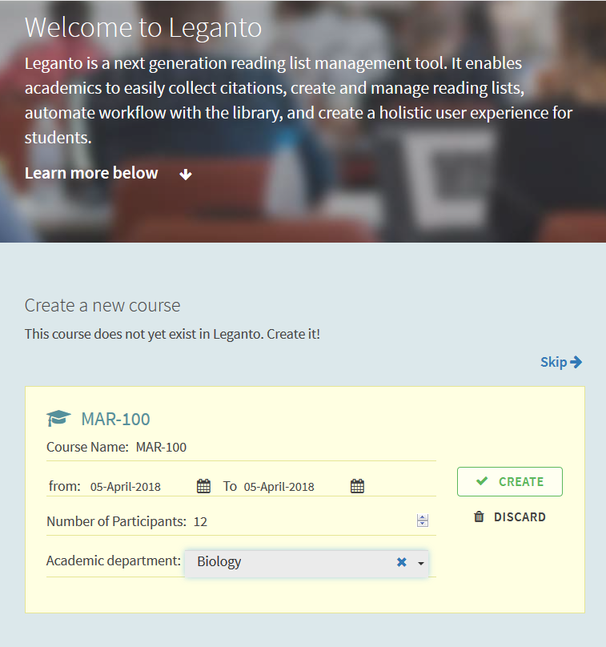
Instructors can create a Course in Leganto
Notes:
The third way that Courses can be added to Alma can be done by instructors but the configuration options are in the hands of Librarians.
The cms_entry_actions parameter in Alma that controls the options that you see in the following slides. By default the parameter value is blank which means that these options must be updated in Alma to offer the following options to instructors.
If Librarians set the value of the cms_entry_actions to Course, Instructors will see as special course – directed welcome screen and have the option to add courses to Leganto when coming from the LMS.
Once the course has been added, the instructor will have the options to create a reading list manually, from scratch for the course that was just added.

Slide 12
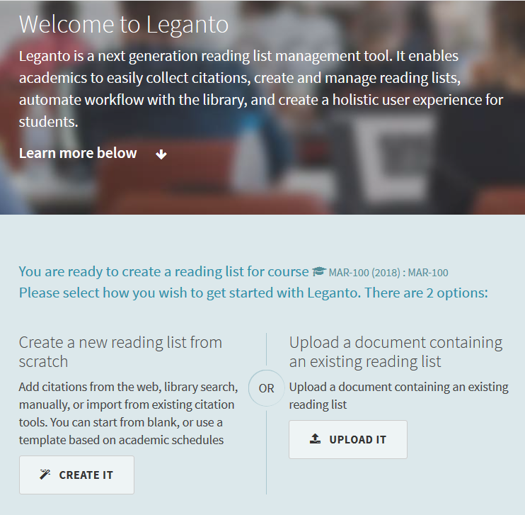
Instructors can upload a Reading list file.
Notes:
If Librarians set the value of the cms_entry_actions to File Instructors will not have the option to add a course, but will have the option to add readings in 2 ways when entering Leganto from the LMS. Notice the option (on the left) which is to create a reading list from scratch- just like in the last example when a course was added.
The second option allows the instructor to upload a document containing a reading list information.
The uploaded file is not processed in any way by Leganto; it is simply sent to the librarians. It is assumed that this file is a manually created text, PDF, or Word document of some kind and that librarians will create the reading list.
We’ll see later on that a Reading list can be created without being explicitly associated to a Course. Alma takes care of linking unattached reading lists to a default course which you’ll learn about later on. Librarian can also associate a reading list with a Couse that was brought it via the Course Loader profile or to a Course that a librarians create.

Slide 13
Instructors can add Courses and upload Reading Lists
Notes:
When Librarians configured the cms_entry_actions value to ALL, instructors will have the option to add a course when coming from the LMS, and the instructor will also have the option to upload the reading list that will be sent to Librarians. Instructors will also have the option to create a new reading list from scratch.
If you don’t want any of these options available to Instructors. – leave the value blank.
Alma configurations > Fufillment > Leganto > Customer Settings

Slide 14
Configuring File Upload Size for Leganto
Configuration Menu > Fulfillment > Leganto > Customer Settings
Enter 0 (zero) as parameter to disable this option.
Empty value - faculty default is 50
Empty value – students default is 2
Notes:
We just talked about the option for instructors to upload a file to be sent to Librarians to create a reading list. In Alma, librarians can configure the size of files that can be uploaded by instructors and by students.
Librarians can configure maximum size of uploaded files (including thumbnails) for items/citations:
Configure the parameters max_file_size_allowed_faculty_MB and max_file_size_allowed_students_MB
(Configuration Menu > Fulfillment > Leganto > Customer Settings). If left empty, the default for instructors (faculty) is 50 MB. The default for students is 2 MB. Enter 0 to disable uploading for the relevant user type. When set to 0, file upload is disabled for the user type

Slide 15
Demo: Add a Course to Leganto
In Leganto
Add a Course from LMS
Add reading lists (from scratch)
Associate a Course to a Reading List
(Collaborators belong to reading list- will be discussed later)
Notes:
https://partners.brightspace.com/d2l/login
[ExLibris.A5 / ExLibris238hsw]
When configured in Alma, instructor will have the option to create a course directly in Leganto. In my example, I have a course in my LMS and when I go to Leganto from the Course, I’m given the option to create a course (on the fly).
Because this a collaborative venture, you should understand how Course can be created and know that you may be asked to create a course in Alma as well.
If the instructor creates a course, she will have the options to create a new reading list from scratch.
An instructor can also choose to upload a reading list of citation from a file. (We’ll touch upon this later when we talk about reading lists.)
We already know that Courses can be created manually in Alma and Courses can be imported into Alma via an integration profile. For now, I’ll add a few citations to my reading list manually.
Notice the Collaborator area when you are in the Reading list view. The person who created the reading list is the list’s first owner. He or she may add additional persons to the list – and designate them to be either owners (of the list) or collaborators.
Owners- all have the same privileges. Can designate other owners and collaborators and can delete the list.
Collaborators – can work on the reading list, adding citations, etc.
Owners and collaborators may or may not be instructors.
Librarians can add instructors for the Course. In Leganto, search for a Course, edit is and click on the Instructors tab – here you can add the instructor, you can also choose to show the instructor but only if it is configured in Alma.

Slide 16
Add a Course in Alma
Notes:
The 4th way a course can be created is by Librarians in Alma. From Fulfillment > Courses – the option to + Add Course appears at the top of the Course list. In this case, the Course list has been filtered by course code MED* to help me locate the Course I am looking for.

Slide 17
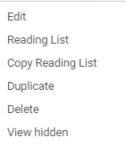
Courses: Actions
Actions menu
Notes:
Course Actions that are available:
As a Librarian creating a Course, you have the option to duplicate any existing Course.
If you duplicate a Course, it will open automatically so you can update the Course Code and name which must be unique.
You’ll also have the following options:
Reading List – see reading lists associated with the course (A course can have multiple reading lists associated with it)
Copy Reading list – associated any reading list in Alma with this course
Delete – to be discussed in the next section.
View Hidden- see other column options that can be displayed (in the Course information row)

Slide 18
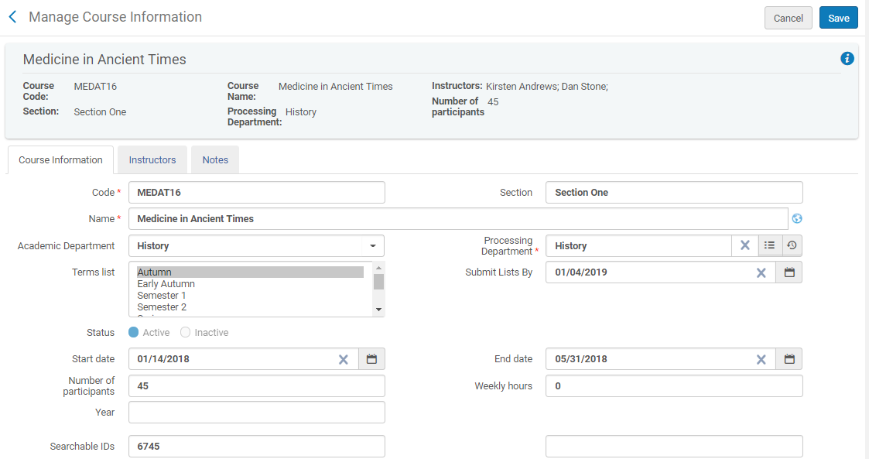
Courses: Metadata In Alma
Fulfillment > Courses
Notes:
I want to review some very important fields related to the Course record in Alma.
When we reviewed the Course Loader Integration profile, a number of these fields were mentioned. Most of the fields here can be imported / populated via the Course Loader integration profile.
Course Metadata: Course Information Tab
Course Start and End Dates (controls that status of the course, but doesn’t have any effect on visibility of reading list or citations)
Number of participants (important for analytics and reporting usage stats)
Submit Lists by (date the Library staff tells the instructor they need to list “sent” by so that they have time to complete citations on reading list)
Section
Searchable IDs (course IDs from other systems such as LMS)
Processing Dept, Code and Course Name are mandatory
Academic Dept
A number of the fields from the Course will display in Leganto when looking at a reading list that is associated with the Course.
They are Course Code, Course Name, Instructor Names, Course Dates and number of participants.
If you fill in the submit Lists By field, a message will appear in the right pane of the reading list page in Leganto. The note will inform instructors the submit by date and course that the instructor needs to prepare for the Library staff.

Slide 19
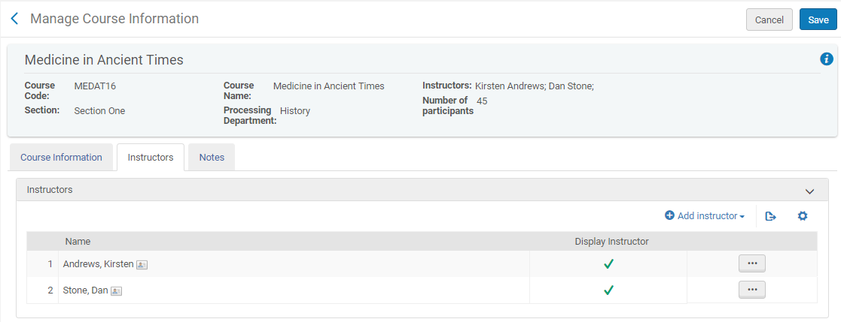
Courses: Instructors
Notes:
Add instructors- to have instructors names show in Leganto this must be configured by Librarians.
You can enable Leganto to display instructor information: a list of instructors in course tooltips and a pane beside a course-related reading list containing the course's instructors. Note that this can also be turned on and off for each instructor.
To enable instructor information in Leganto:
Configure the parameter display_instructors_in_leganto in the customer parameters table (Configuration Menu > Fulfillment > Leganto > Customer Settings) to true. In Leganto, instructor information appears in course-related tooltips and the instructor pane appears.
Display instructor must also be enabled in Alma under the Display Instructor column under the instructors column. You can hide some instructors and display others, but you must configure the display_instructors_in_leganto parameter to TRUE.
In Leganto- instructors and or reading list owners display as Collaborators (collaborators are associated with lists). List owners can add and remove collaborators of the list from Leganto.
Instructors are associated with Courses and may not be the same people that display as collaborators.

Slide 20
Courses: Exlibris_Default_Course
Notes:
Any reading list that is not associated with a Course can be found under the Exlibris_Default_Course. This is a place holder Course for orphaned reading lists. There a number of ways that reading lists can be –unassociated from a Course. Librarians can remove an course association from a reading list and instructors can create reading lists in Leganto without associating the reading list with a Course.
We’ll talk about reasons why you might want a reading list to be stored under the exlibris default course in the next section of this training.
To see all unassigned reading lists in Alma Click Reading List from the Course’s row actions.
Copy Reading List (option to select one or more reading list) to ??? Not sure this is working.
When a Course is deleted (in Alma) all of the associated reading lists are also deleted). Deleted reading lists do not end up in the exlibris_default_course list.
If a reading list is removed from its associated course (by instructor or librarian) the reading list becomes associated with the exlibris default course.

Slide 21
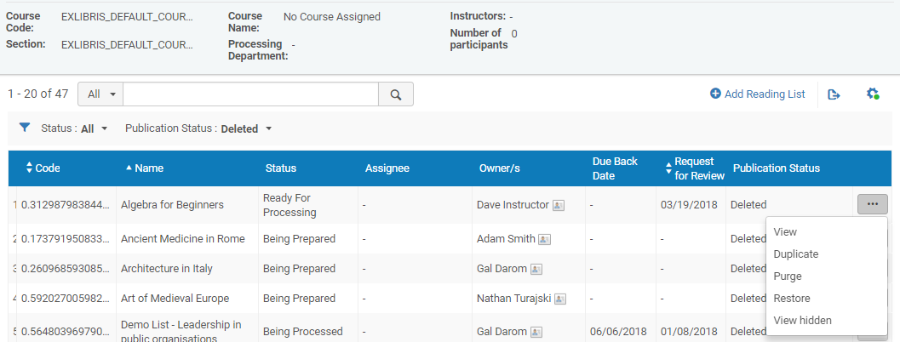
How deleted reading lists are handled
Notes:
If configured in Alma., the delete_reading_list parameter can be set to “logical” and any unassigned reading list that is deleted will remain in Alma with a deleted status
From the reading list row actions, you’ll have the option to purge the reading list or restore it.
Reading list that are subject to this parameter – cannot be associated with a Course. When a Course is deleted, reading lists are deleted and there is no option to restore at that point.
Any reading list that is associated with the ExLibris_default_course can be deleted and restored if the delete_reading_list pararmeter is set to logical.
Note the option to purge the list as well- this really will delete it from Alma.
Use case, if you have a Course with one or more reading list and you want to delete the Course but you want to retain one of the reading lists because you might use it in the future, you can remove the course association from the reading list row actions. This will then associate the reading list with the exlibris_default_course. Then you can delete the reading list but if you change your mind you can restore it or confirm that indeed you want to purge the course entirely.

Slide 22
Demo: Courses in Alma
In Alma
Course Actions
Course Metadata
Instructors / Owners

Slide 23
Library Staff and Reading Lists
Notes:
Continuing in the theme of collaboration, librarians can create or manage reading lists along with course instructors.

Slide 24
Reading Lists
How Reading Lists are created
Instructors can upload reading lists which are sent to Library
Reading List are created by Instructors in Leganto
Manually (from scratch)
Via import from RIS, import of Leganto file, duplicate existing
Librarians can create reading lists in Alma
Notes:
Instructors can upload a reading list into Leganto- as a second step if they have the ability to add a course to Leganto from the LMS/CMS.
When Librarians add a reading list in Alma, the status is set to being prepared- the same status assigned when an instructor is creating a reading list.
So similar to Courses, librarians and instructors can share the responsibility of creating and managing reading lists.

Slide 25
Library Staff Can add a Reading List
Notes:
In order for a Librarian to add Reading list in Alma, it is necessary to be in an existing Course (even if you don’t intend to associate the reading list with the Course). From an existing Course, choose Reading List, any existing reading lists will display and the +Add reading list option will appear.

Slide 26
Reading List: Metadata
Notes:
If you have just created a new reading list the reading list form will open. If you want to edit an existing reading list, click Work on from the row actions – with either option this will open the list to work on citations but also will allow you to edit the reading list information form.
Let’s review some important fields for the Reading list
(Click) Status will be discussed later in this session
Publication Status will be discussed later in this session (Click)
(Click) Reading List visibility fields (start and end date) determine the dates that the reading list will appear in Leganto- if left blank and the reading list is published, the reading list will appear at all times.
A librarian can enable the Lock in Leganto checkbox which will limit what changes can be made to the reading from Leganto.
In Leganto users will only be allowed to add private notes or comments to citations, as well as marking citations as read.
In Alma the list can only be unlocked by a librarian or by the user who locked the list.
Due Back Date- This field applies to citations associated with the reading list. By default the due back date is identical to the Courses End date.
Notice that you can associate a creative common license with the reading list- for the entire reading list. You can still assign copyright clearance to citations (we’ll see this in the next session)

Slide 27
Reading List: Actions
Notes:
Row actions for reading lists can be intimidating so I want to review the options here. We’ve already touched upon some of these actions in our discussion of reading list so far but we’ll recap.
View only cannot edit any fields
Work On allows you to edit Reading list information and to begin working with citations
View in Leganto
Duplicate
Delete (just discussed- what happens to deleted reading lists)
Associate this list with a Course
Remove associated Course (the reading list will be associated with the Exlibris_Default_Course)
Release Assign and Reassign will be covered shortly when we talk about reading list tasks.

Slide 28
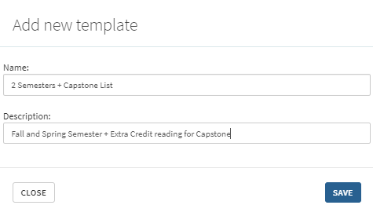
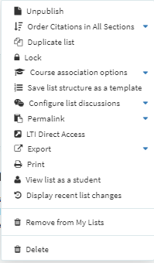
Create a Reading List Template
Notes:
Before we move on to a discussion about Reading list tasks and statuses, let’s change gears and talk about another option related to creating reading list in Leganto. Reading list templates are available in Leganto to both Instructors/ Collaborators and also to Library staff.
Reading List templates are created by Librarians in Leganto.
From the Reading List Page– Click the reading list options menu next to any reading list that will serve as your template.
Choose Save list structure as a template.
The Add new template dialog box appears. Give the template a name and description and Save it.
Now the new Template has been saved and can be used when either an instructor or librarian creates a new reading list in Leganto.

Slide 29
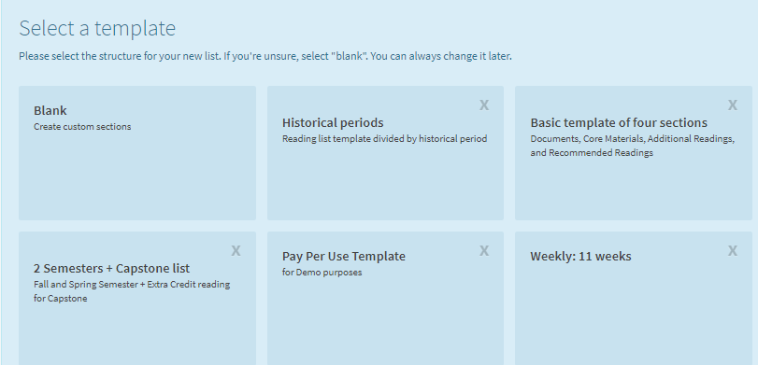
Use a Reading List Template
Notes:
From the Reading list page. Click New List to create a new reading list. The New list dialog box appears. Give your new list a name and description and click create.
Now you’ll have the option to select a template that can be used to create the new reading list. Choose blank if you don’t want to use a template

Slide 30
Reading Lists Task List & Reading List Statuses
Notes:
When you begin to work on a reading list in preparation to fulfil citations, you will need to understand task list functions, reading list statuses and more available actions.

Slide 31
Task List: Reading List Status – Task List
Notes:
I’m sure that many of you are already familiar with the Alma task list and you know that a Reading List task list- can also be added as a widget. At a glance, an operator or manage can see the status of reading lists from the task list.
The task list can be very helpful if you are working on multiple reading lists and they are at different stages of completion. From the list shown you can see that there are 2 reading lists that have been assigned to the logged in user- ready for processing.
At least one reading list assigned to the logged in user with new notes- coming from instructor- which should be checked because they may pertain to a reading list that has a higher priority that those that haven’t been started yet.
If you are a course reserves manager you can see that there are unassigned reading list – that should be assigned to course reserves operators.
Click any of the tasks to be taken directly to the Reading list task list- assigned to me tab (tab for logged in user)

Slide 32
Reading List – Assigned to Me
Notes:
If you click on a task from the task list or navigate to the Reading list from the Fulfillment menu, the assigned to me tab will open.
If you navigate to the unassigned tab and open “work on” any reading list- it automatically becomes assigned to you. This is very common in all areas of Alma as many of you may know.
Generally when you click on an open any task- you become the owner of the task – even if it was un-intentional.
If you have regrets, you can use the “Release Assign” option from the Reading list row action to sent the reading list back to the unassigned tab.

Slide 33
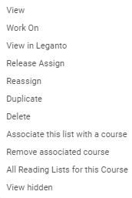
Reading List: Reassign
Notes:
If you have a manager role, you can “reassign” any reading list from any tab to another Alma operator. Click Reassign and a list of Alma operators who have course reserves operator role appears, choose an operator name from the list and reassign the reading list task – optionally, you send an email to let the operator know that he or she is being assigned the reading list to work on.

Slide 34
Demo Reading Lists
In Leganto
Add reading lists / template
Add collaborators
Associate a Course (remove course association)
In Alma (Fulfillment > Reading Lists)
Find the reading list (review metadata)
Add owners / collaborators to a reading list

Slide 35
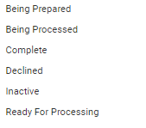
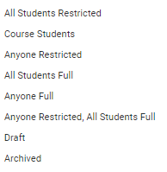
Reading Lists Statuses / Publishing Statuses
Notes:
Reading List Statues track the progress of the reading list from it conception to its completion. The statuses of concern to the Librarian are Reading for Processing (instructor or librarians have completed adding the citations to the reading list and the list has been “Sent” to the library. Library staff should then change the status of the reading list to Being Processed to indicate that the reading list has been assigned to a library operator who will fulfill the citations. Finally, when all the citations have been completed or declined, the Reading list can be set to Complete. Setting the reading list to Complete does not make the list available or visible to students.
The list can only be exposed to student by changing the Publication Status of the list. Draft or Archived statuses will not make the list visible.
All Students Restricted- All students can view the reading list and citations, but access to materials is restricted to those enrolled in the course
Course Student – The reading list and course materials are only available to students enrolled in the course.
Anyone Restricted – Anyone call view the reading list and citations, but access to materials is restricted to those enrolled in the course
Anyone Full – anyone can view the list and citations and can access course materials.
Anyone Restricted, All Students Full – Anyone can view the reading list and citations, and all students can access course materials.

Slide 36
Alma Configurations

Slide 37
Alma Configurations
Courses
cms_entry_actions (course, file, all) OR (empty)
max_file_size_allowed_faculty_MB (default = 50 or zero)
max_file_size_allowed_students_MB (default = 2 or zero)
display_instructors_in_leganto (false/true)
auto_set_instructors_as_owners (false /true)
Reading Lists
delete_reading_list (true/logical)
Reading List Publication Options
auto_publish_default_mode / advanced_publishing_options
Notes:
Configure the parameter display_instructors_in_leganto in the customer parameters table (Configuration Menu > Fulfillment > Leganto > Customer Settings) to true.

Slide 38
Next Steps, Support Resources and Feedback

Slide 39
Next Steps and Resources
Include documentation links in the CKC relative to your topic:
LTI Integration
Course Loader Integration
Configure Reading List Publication Options
Additional support resources within the ExLibris Ecosystem:
Idea Exchange
Developer Network
2018 Technical Seminar Presentations (Cross-Product section of CKC)

Slide 40
Questions?
Any Final Questions?

Slide 41
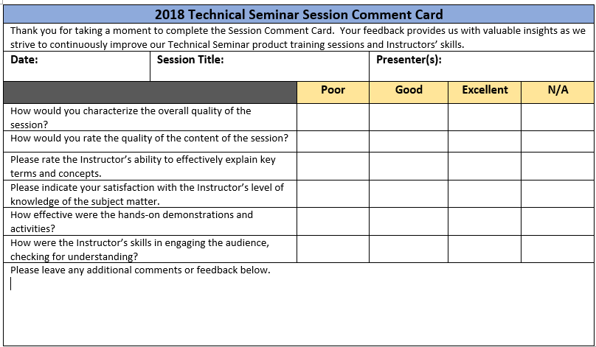
Session Feedback
We Value Your Feedback! Please complete the brief Session Comment Card:

Slide 42
Thank You!

