Slide 1
Primo Analytics
Matt Warnock, Customer Success Manager
Paul McBride, Senior Primo Support Analyst
Notes:
This presentation is designed to go over the basics of Primo Analytics and give some guidance for creating your own reports.

Slide 2
Introductions
Matt Warnock
Paul McBride
Notes:
Before joining Ex Libris I spent about 7 years as a circulation manager at a couple of libraries so I understand the importance of being able to report usage of resources and provide an accurate account of that, as well as appropriate breakdowns of data.

Slide 3
Audience and Objectives
Audience:
New or experienced Primo Staff involved with running reports for Primo.
Objectives:
When this session is over, you should be able to:
Know how to interpret the out-of-the-box Primo Analytics reports
Create your own analyses and dashboards

Slide 4
Agenda
1
How does Primo Analytics Work
2
Working with Analytics
3
OBI General Terminology
4
Editing and Creating Reports

Slide 5
Primo Analytics
What are Analytics?
Allow us to build, customize, and run reports on Primo activities
Built on Oracle Business Intelligence (OBI)
Getting to Primo Analytics
Production Primo Back Office > Primo Analytics
Default page opens to Catalog
Access
Anyone with institution-level Back Office Access (or higher)
Opens in a new window in OBI
Notes:
Analytics uses the same engine as Alma analytics.
Analytics is not running on nor gathering data from Sandbox Primos.

Slide 6
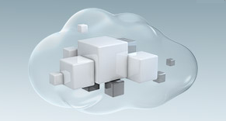
Primo Analytics – How does it work?
Data captured by beacon*
Data collated and inserted into OBI
Institutions use OBI to analyze and report on data
*Data is anonymized at the user level
Notes:
Each action/data that is captured/collected is being sent to an interim server/database called beacon, a data gathering subsystem that exists in certain Ex Libris Products.
2. Each night the data from the beacon servers is being copied to the regional OBI servers and analyzed.
3. The Institution code is the primary identifier of the data and user, so each user will see only data based on the institution s/he belongs to.
ETL: Extract, transform, load – run nightly to get data to OBI server

Slide 7
Action Identification
How to see what is sent to Primo Analytics
Go to Primo FE
Open Development tools (F12 in Chrome)
Switch to Network tab
Search for beacon
Preform an action
Check Query String Parameters
Notes:
This will be demonstrated later…

Slide 8
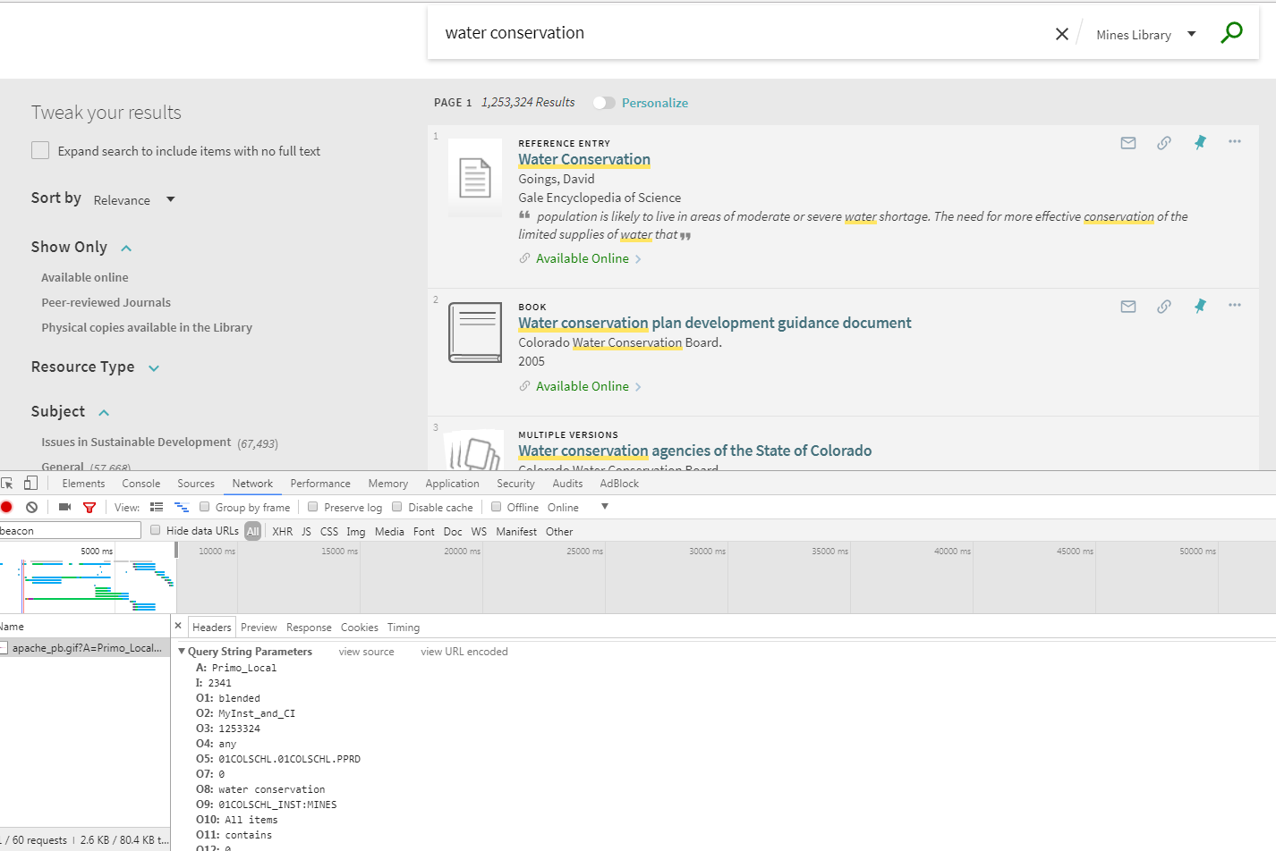
Action Identification
Notes:
Cannot see individual search queries in OBI. This is meant for trend information.
Demonstrate after the slides portion of the presentation on how this is done.

Slide 9
Agenda
1
How does Primo Analytics Work
2
Working with Analytics
3
OBI General Terminology
4
Editing & Creating Reports

Slide 10
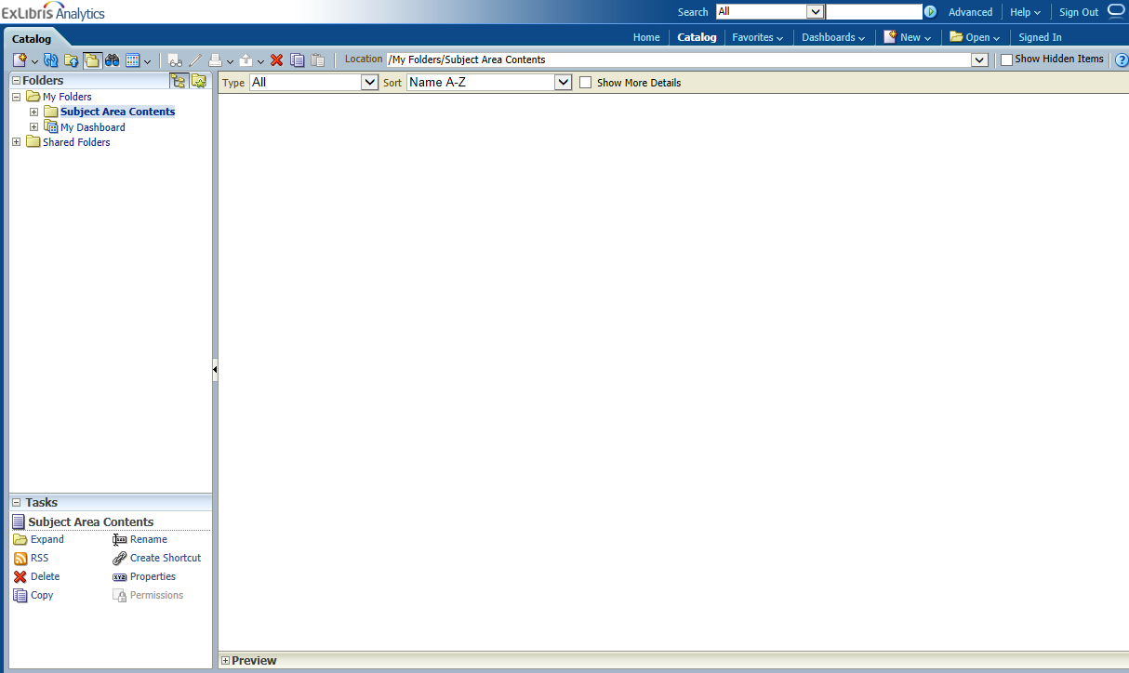
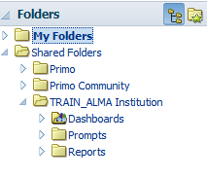
Primo Analytics – Global Header – Catalog
Catalog tab
First screen after logging in
Reports are saved including personal and shared
  My folders – Personal reports and dashboards (your login)
  Shared folders
  Primo (out of box)
    Primo Community (all Primo customers)
    Primo Institution (your institution)
    Tasks – allows the user to make actions on the selected items in the ‘Folders’ section or the ‘Main Pane’ (like copy & paste, etc.)
Notes:
Primo – out of the box, not editable, but can copy & modify
Primo Community – reports and dashboards created by fellow Primo Customers, shared and updated on Fridays
Primo Institution – your institutions’ shared reports and dashboards. Viewable only by users from your institution. No other institutions can see it.

Slide 11
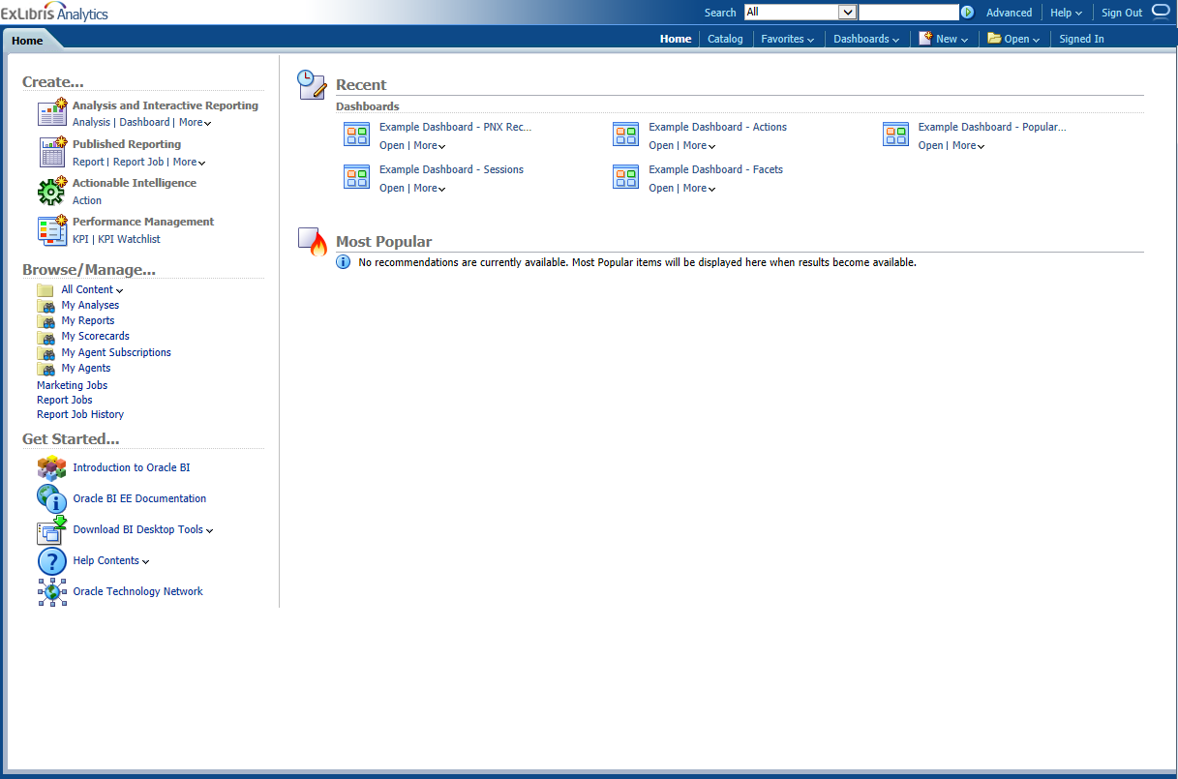
Primo Analytics – Global Header – Home
Home Tab
Centralized workspace
Recent Activity – where I’ve just been
Most Popular
Get Started – OBI Help documentation
Notes:
Get Started – Help documentation pertaining to Oracle Business Intelligence (not related to Primo data)

Slide 12
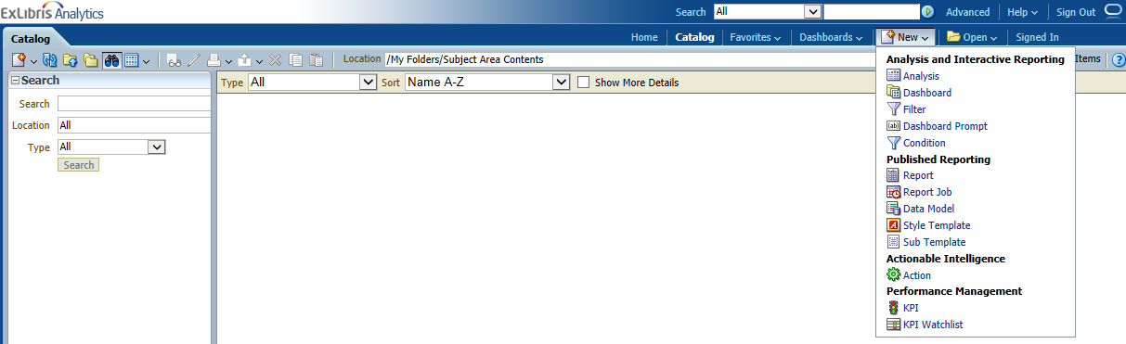
Primo Analytics – Global Header – New
New tab
Analysis – Create a new report
Dashboard – Create a new dashboard
Options under the Published Reporting subhead are
related to OBI only and are not accessible.
Notes:
Zoom in on the drop down to show
NOTE: new report is called ‘new Analysis’ in OBI lingo, not new Report. Clear? Make a joke.

Slide 13
Agenda
1
How does Primo Analytics Work
2
Working with Analytics
3
OBI General Terminology
4
Editing & Creating Reports

Slide 14
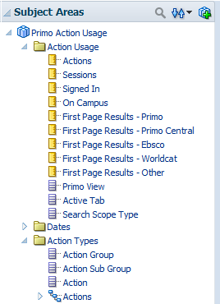
OBI General Terminology
Subject Area
Fact
Measurements
Attributes
Dimensions
Hierarchical Attributes
Notes:
Subject Area: Each report in OBI is built from a Subject Areas. Subject Area –a set of the attributes and measurements that describe a certain usage area in Primo, such as Action Usage, Popular Searches, PNX Records, and Pipes.
Fact Table: a folder with measurements
Measurement: Fields which can be counted or aggregated and have a yellow rectangle are called ‘Measurements’)
Attribute: Fields (also called ‘Attributes’, they contain data which are not counts)
Dimension: Tables that contain descriptive attributes (or fields) that are typically textual fields or discrete numbers behaving like text. Dimension attributes such as Dates, Action Types, or Institutions give facts a context.
Hierarchical Attribute
An attribute holds data values that are organized in a hierarchy. This kind of attribute is displayed using a treelike structure. Individual members are shown in an outline manner, with lower-level members rolling into higher- level members.

Slide 15
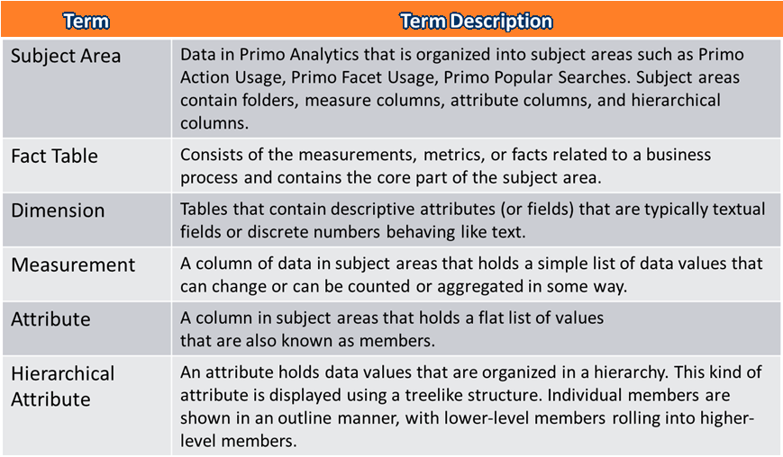
General OBI Terminology
https://knowledge.exlibrisgroup.com/Primo/Product_Documentation/Analytics/010Overview_of_Primo_Analytics#Terminology

Slide 16
Agenda
1
How does Primo Analytics Work
2
Working with Analytics
3
OBI General Terminology
4
Editing & Creating Reports

Slide 17
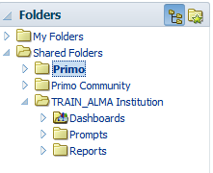
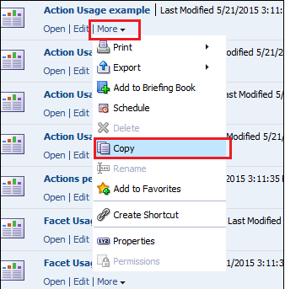
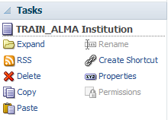
Editing & Creating Reports
1. Creating report by copying a similar report to your institution
Please note: Out-of-the-box reports may include factors to narrow down the information reported, such as limiting the Sessions
Notes:
Ping demonstrates & mentions login details – their own systems will likely be inaccessible due to firewall issues

Slide 18
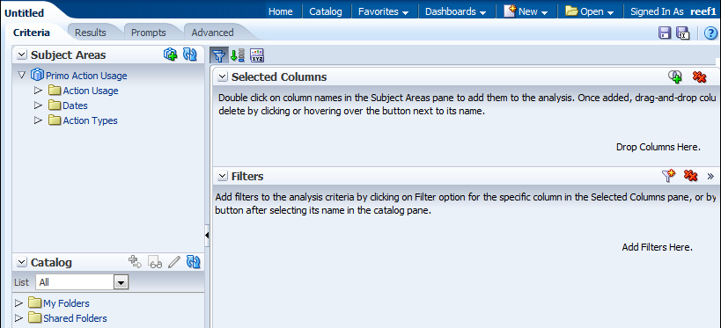
Editing & Creating Reports
2. Creating Report from Subject Area
Go to New > Analysis
Select a subject area
Drag-and drop columns
Add filters in the selected columns
Notes:
Allow time for everyone to login & get to Analytics
Ping demonstrates creating a sample report
Criteria – Used to create the report columns and filters.
Results – Used to display the report with data relevant to your institution.
Prompts – Used to add report prompts.
Advanced – This tab is not described in this document and requires expert knowledge of OBI.

Slide 19
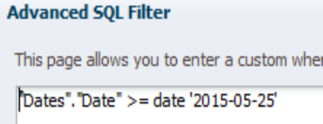
Editing & Creating Reports
3. Configure Date Filter
Convert to sql to set up a fixed period
Notes:
Without date filter Analytics displays historical data that ever exists in your Primo database
Replace the hard-coded date with an sql parameter

Slide 20
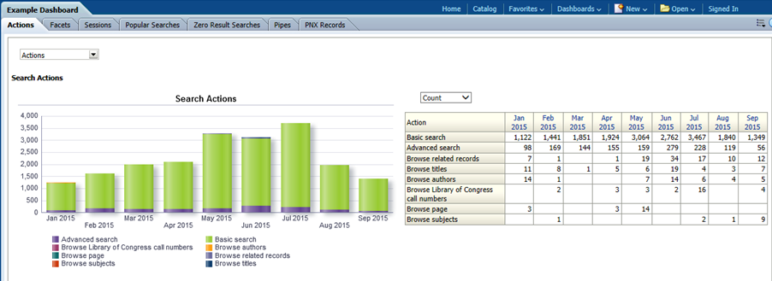
Editing & Creating Reports
Dashboard
    Dashboards provide a personalized view of information
    Can consist of one or more pages
    Can include reports, graphs, and prompts (objects)
    Can be accessed from the Catalog or from Dashboard drop-down list

Slide 21
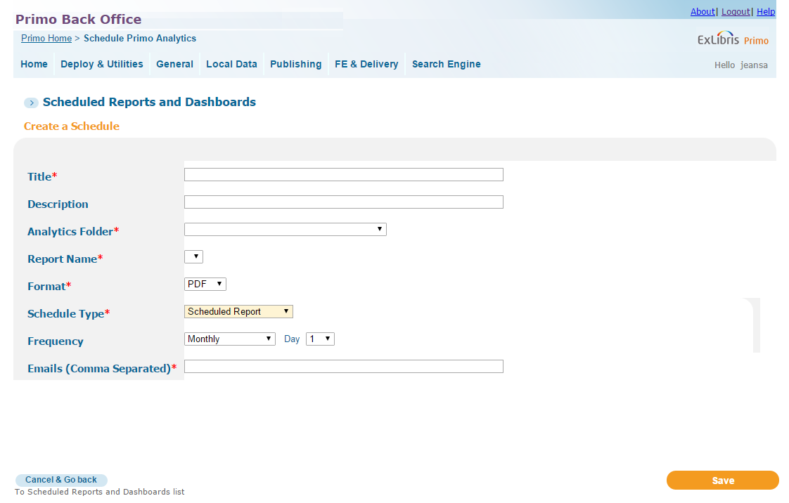
Scheduling Analytics
Notes:
The report or dashboard located under the Primo and Institutional folders in the Analytics database can be scheduled.
It is not possible to schedule a report from "My Folders" or "Community Shared Folders" in Primo Analytics.
If you want to schedule a report that is located in the "Institution-level shared" folder, you would first need to copy the report to your "Institution-level shared" folder. Then go to PBO, you will see the option Your Institution-level Shared Folder appears under the "Analytics Folder". Choosing that folder, you will see the report you have copied and pasted appears in the "Report Name" drop down list.
Reports are available in PDF, Excel or Text

Slide 22
Next Steps and Support Resources
Knowledge
Center
Technical Seminar Presentations
Product Documentation
Additional information on analytics report
Primo Analytics Training Videos
Common Primo Analytics Procedures
Community Reports in Primo Analytics
Additional support resources within the ExLibris Ecosystem
System Status Pages
(located in the Cross-Product section of the CKC)
Single Tenant ENV / Multi-Tenant ENV
Developer Network – Primo Analytics API
Notes:
Mention what it is the audience should do after the tech seminar is over – how they retain what they learned.
Mention links to relevant documentation articles associated with your topic.
Refer to Idea Exchange to provide development ideas for features they think are important to add
Systems Status page
Dev Network
They can find this session – all of the Tech Seminar – presentations in the CKC (link to the article).
Because OBI is an industry standard tool, there are resources available online, particularly on YouTube, that explain some of the finer points of manipulating OBI data.
Primo Analytics Subject Area guide rolled out features – shows which dates information is available from

Slide 23

Q & A
Any Questions?
Notes:
Any last questions?

Slide 24
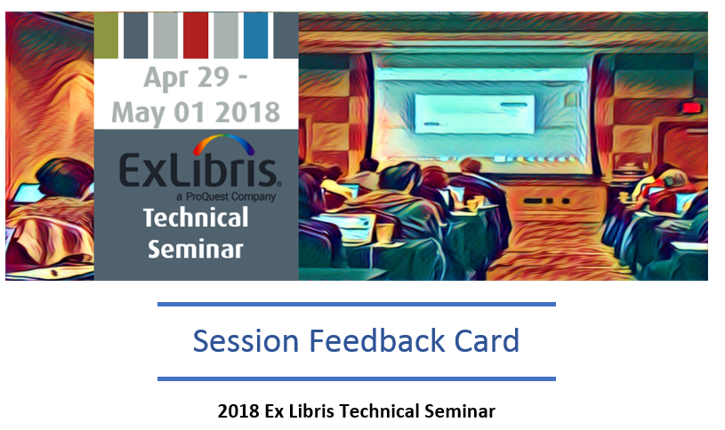
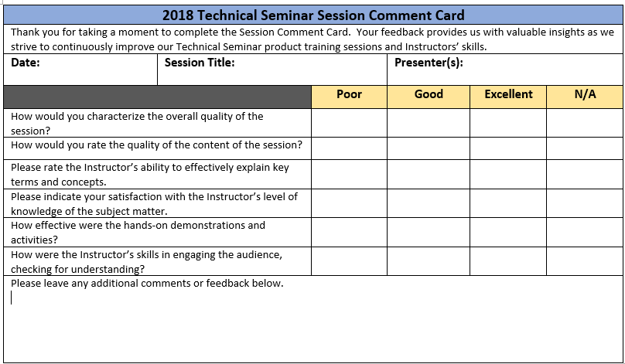
Session Feedback
We Value Your Feedback!
Please complete the brief Session Comment Card:

Slide 25
THANK YOU!
paul.mcbride@exlibrisgroup.com
matthew.warnock@exlibrisgroup.com

