Slide 1
Essential Configurations in the Primo Front End
Jean Cabaup, Training Consultant
Notes:
Introduce myself
Introduction, Agenda, Overview 5
Primo UX 15
Primo Back Office 15
Creating a View 15
Changing Labels 15
Customizing CSS and HTML 15
Questions 10

Slide 2
Welcome and Introductions
Jean Cabaup
  Training Consultant, Global Education Team

Slide 3
Session Objectives
Session Description:
In this session, attendees will learn how to configure the Primo View in the Primo Back Office, how to change labels in the Front End, and how to brand and customize their CSS and HTML pages using the UI Customization Package Manager.
Session Objective(s)
  By the end of this sessions you will know, understand and/or be able to:
    Identify components/functions in a Primo View
    How views are configured
    How to change labels in the Front End
    How to brand and customize CSS and HTML pages

Slide 4
Target Audience
Target Audience for the Session:
  Staff responsible for configuring Primo’s user interface
  Staff new to Primo

Slide 5
Agenda
Primo UX (Front End)
Primo Back Office
Views
Labels (Code Tables)
CSS and HTML
Next Steps, Support Resources and Feedback

Slide 6
Agenda
Primo UX (Front End)
Primo Back Office
Views
Labels (Code Tables)
CSS and HTML
Next Steps, Support Resources and Feedback

Slide 7
Primo UX – DEMO
Accessing the Primo Front End
Show URL with institution and view values
Logo, header area
Main Menu navigation
Basic search bar
Tabs and scopes
Advanced search options
Browse search
Search results – brief, full, facets

Slide 8
Exercise #1
Access the Primo UX (Front End)
Conduct a few different searches

Slide 9
Agenda
Primo UX (Front End)
Primo Back Office
Views
Labels (Code Tables)
CSS and HTML
Next Steps, Support Resources and Feedback

Slide 10
Primo Back Office – DEMO
Navigation Area
Monitoring and Maintenance
Configuration and Management Wizards
Dashboard and Deploy All
Primo Back Office

Slide 11
Access Levels and Institutions List
Super Admin Level
  See and edit all institutions
  Create new institutions
  Dedicated environments (consortia)
Admin Level
  See and edit only institutions available to
  View default institution
  Multi-tenant environments
Primo Back Office > Ongoing Configuration > Institution Wizard

Slide 12
What’s already in place
Administrative Structure
  Institution created and configured
Data
  Library catalog data loaded
  Primo Central interoperability configured
User Interface (UX/FE)
  One view created

Slide 13
Exercise #2
Log into Primo Back Office
Access the Primo Back Office

Slide 14
Agenda
Primo UX (Front End)
Primo Back Office
Views
Labels (Code Tables)
CSS and HTML
Next Steps, Support Resources and Feedback

Slide 15
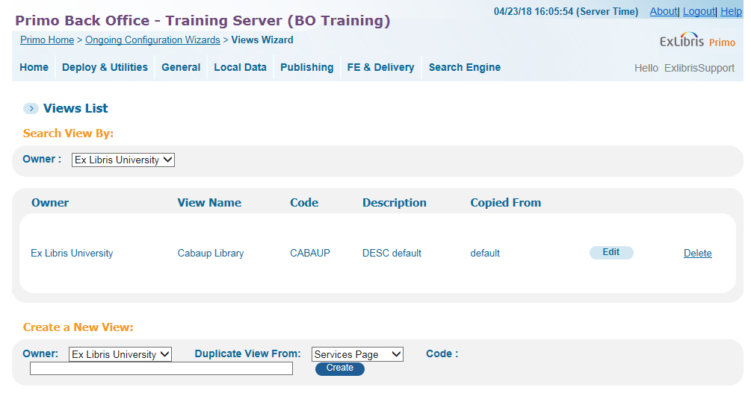
Accessing the Views Wizard – DEMO
Owner – Institution
List of views
Creating/copying a view
Editing a view
Primo > Ongoing Configuration Wizards > Views Wizard

Slide 16
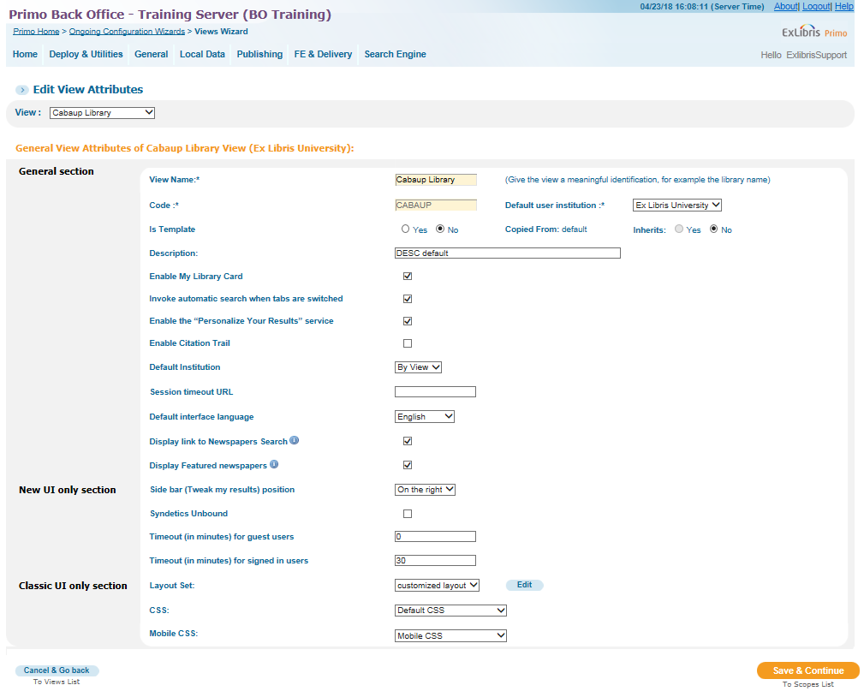
General Attributes – DEMO
View Name (can be changed)
View Code (not editable)
Default user institution
Is Template/Copied From/Inherits
Description (seen in Views List)
Enable My Library Card (in the eShelf)
Invoke automatic search …
Enable the Personalize Your Results
Default Institution
Session timeout URL
Layout set
CSS
Mobile CSS
Default interface language

Slide 17
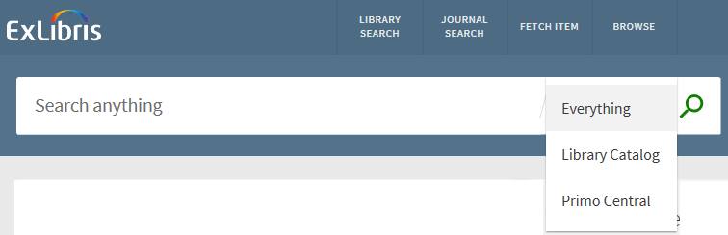
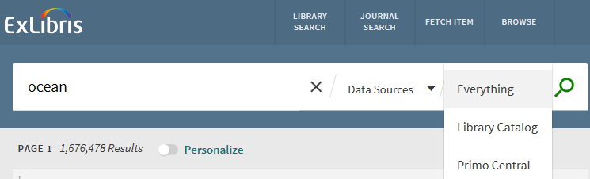
Scopes
What are scopes?
Group resources together for searching
When data is loaded, identify records to include in a scope
Can be used to group records by data source, library, collections, etc.
Scopes in the FE
Appear as a dropdown to an initial search if there’s only one tab
Appear as the second dropdown after tab has been selected and search results are on the screen

Slide 18
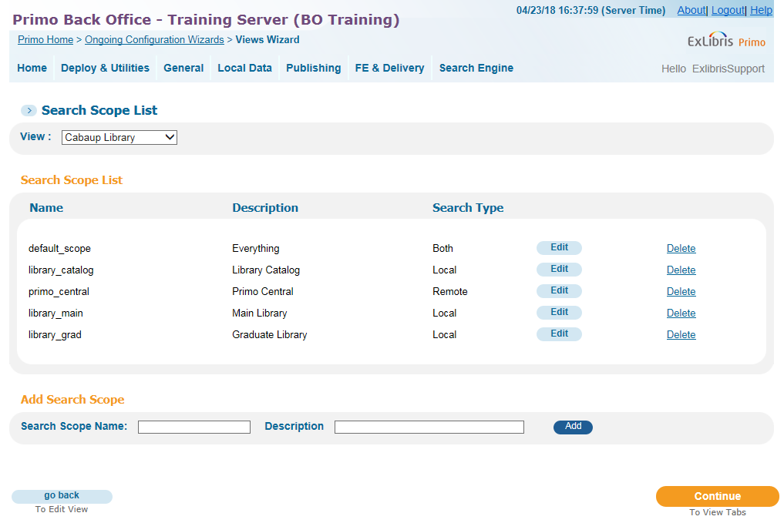
Scopes – DEMO
Scopes in the Views Wizard
Scopes list
No spaces in name of scopes
Description should be helpful in identifying scope (i.e. match it with the Display Name in the next step)
Adding a Search Scope

Slide 19
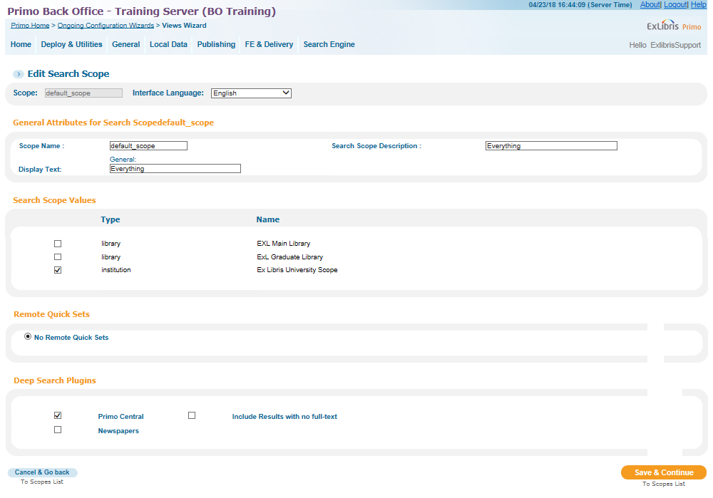
Editing Scopes – DEMO
Existing scope (default)
Name/description/display text
Scopes from scope values list
Remote Quick Sets (MetaLib)
Deep Search Plugins (Primo Central)

Slide 20
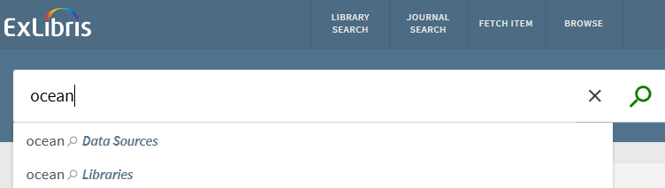
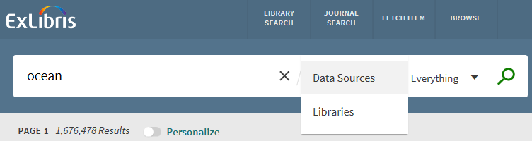
Tabs
What are scopes?
Used to group scopes for display
Tabs in the FE
First appear when typing a search into the search box
After search results are on the screen, they are available in the first dropdown

Slide 21
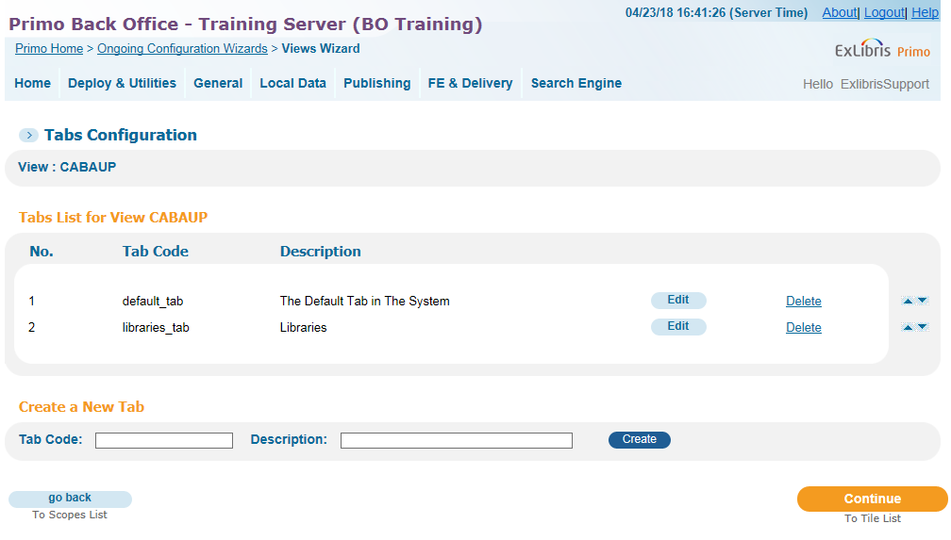
Tabs – DEMO
Tabs in the Views Wizard
Tabs list
No spaces in name of tab
Again ensure Description is helpful (i.e. matches Display Name in next step)
Creating additional tabs – has implications later in the Wizard (Basic Search, Advanced Search, Facets)

Slide 22
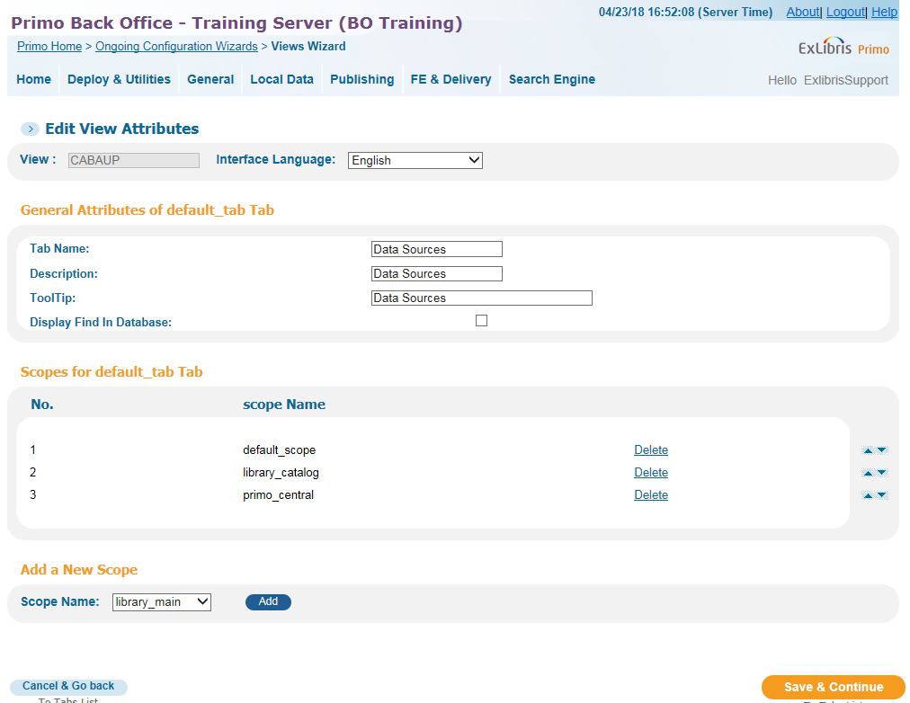
Creating/Editing Tabs – DEMO
Edit default tab
Tab name, description, tooltip
Display Find in Database (MetaLib)
Scopes aren’t visible unless they’re on a tab
Adding scopes to a tab

Slide 23
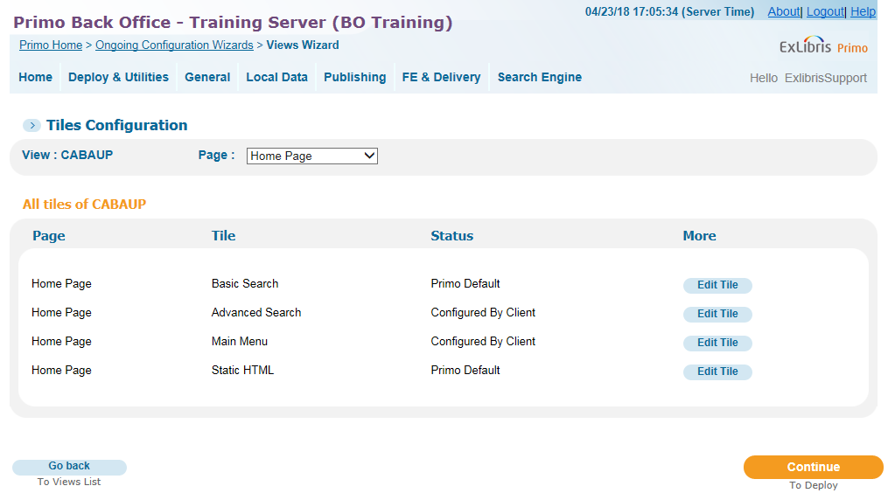
Tiles Configuration – Home Page – DEMO
Basic Search (Classic UI)
  If you have more than one tab, will want to configure
Advanced Search
  Define Search Pre-filters
  Find Database link (MetaLib)
Main Menu
  Links
  Adding/Removing links
  Current window/new tab option
Static HTML (Classic UI)

Slide 24
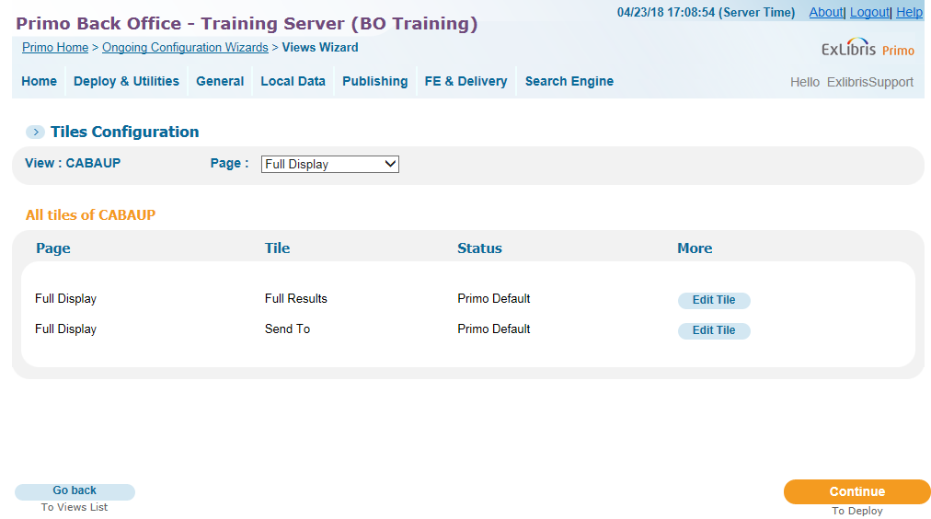
Tiles Configuration – Full Display – DEMO
Full Results (Full Record)
Fields to display
Local fields and normalization rules
Links to display in Full Results
Send To (SMS configuration)

Slide 25
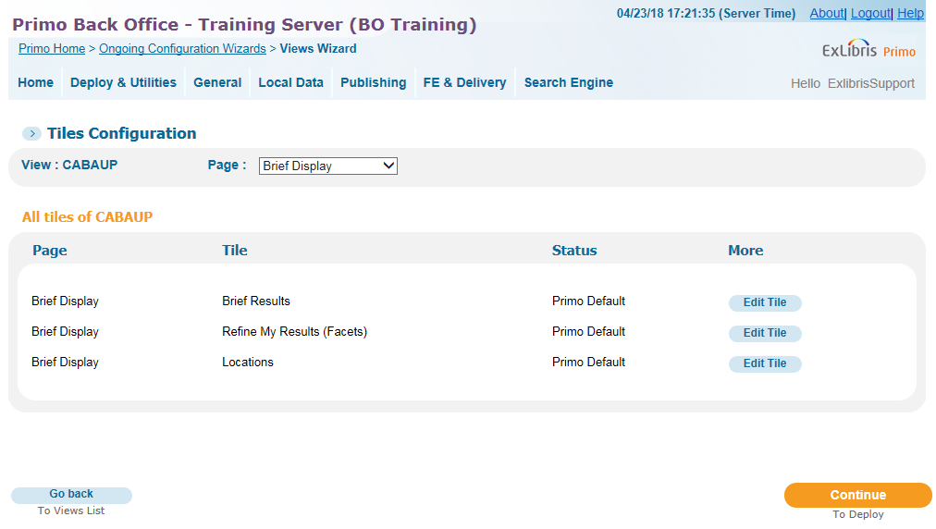
Tiles Configuration – Brief Display – DEMO
Brief Results
Include e-shelf option
Texts of Brief Results Title
Define link from title
Define FRBR
Order of Tabs
Field to display in X line of brief results
Sort Fields (FRBR default)
Snippet Display Options
Institution Boost
Refine my Results (Facets)
Opening and ending text for facet labels
Additional functionalities
Facets to display (nodes, sorting, tabs)
Locations
Real Time Availability
Sorting and including locations (non-Alma)
Display item list filters (non-Alma)

Slide 26
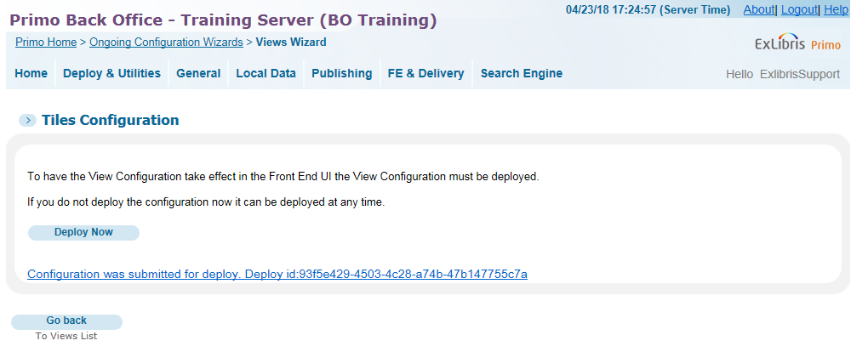
Deploying in Primo – DEMO
Deploy from Views Wizard
Monitoring Deploy Process
Deploy All

Slide 27
Exercise #3
Create a view
Walk through the Views Wizard
Deploy

Slide 28
Agenda
Primo UX (Front End)
Primo Back Office
Views
Labels (Code Tables)
CSS and HTML
Next Steps, Support Resources and Feedback

Slide 29
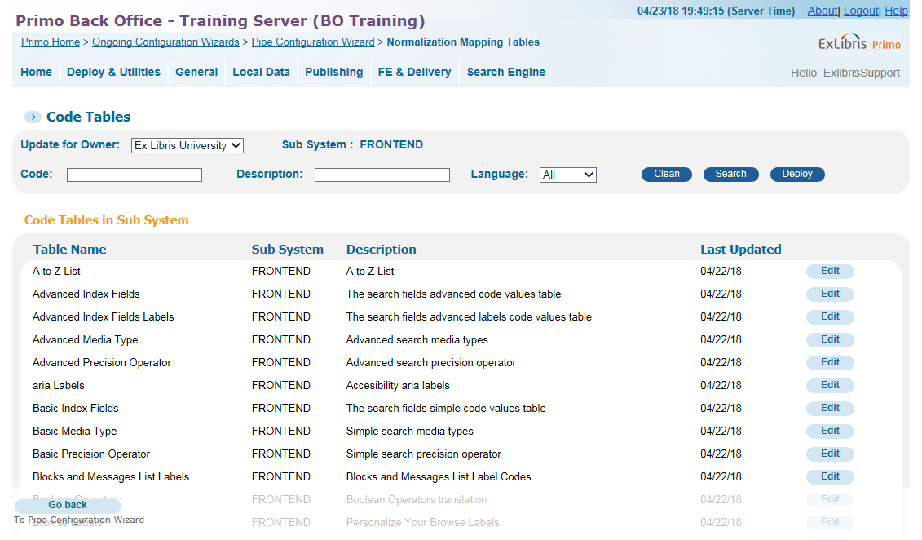
Code Tables
What are Front End Code Tables?
Allow translation of terms visible in Front End
Also allow customization of these terms
Getting to the Code Tables
Primo Back Office > Advanced Configuration > All Code Tables
In main navigation: FE & Delivery > FE Code Tables

Slide 30
Searching Code Tables – DEMO
Filtering
Subsystem (Front End)
Language
Searching
Search for a term (Tweak My Results)
May produce more than one table (Sign In)
In the Code Table
Note once search term is entered, it excludes all other results; remove it to see all entries in table again
New UI codes start with default.nui

Slide 31
Editing Code Tables – DEMO
Editing the Code table
Edit the table
Customize the table if needed
Edit existing rows
Deploy!
Default vs View-specific
By default Code tables are edited at the institution level
It is possible to customize a label for only a View by creating a new code line and changing ‘default‘ to the view code.
Use default.nui.facets.title to change label for all views belonging to the institution
Use YOURVIEWCODE.nui.facets.title to change label for just your view

Slide 32
Exercise #4
Test your View in the FE
Choose a label to use for this exercise
Access Front End code tables
Search for a label in the code tables

Slide 33
Agenda
Primo UX (Front End)
Primo Back Office
Views
Labels (Code Tables)
CSS and HTML
Next Steps, Support Resources and Feedback

Slide 34
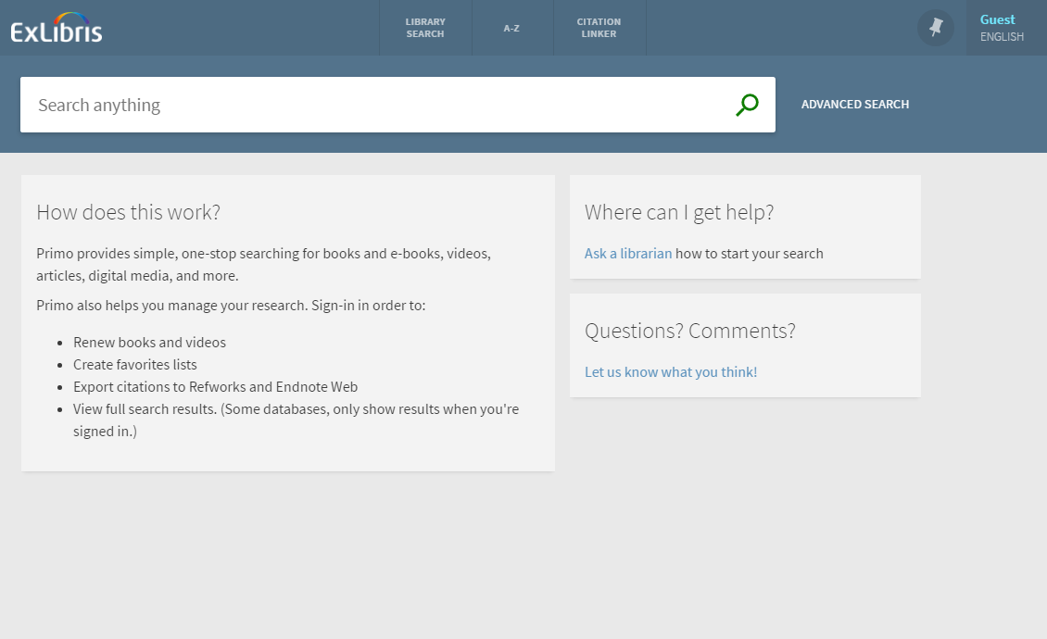
Home Page (default)

Slide 35

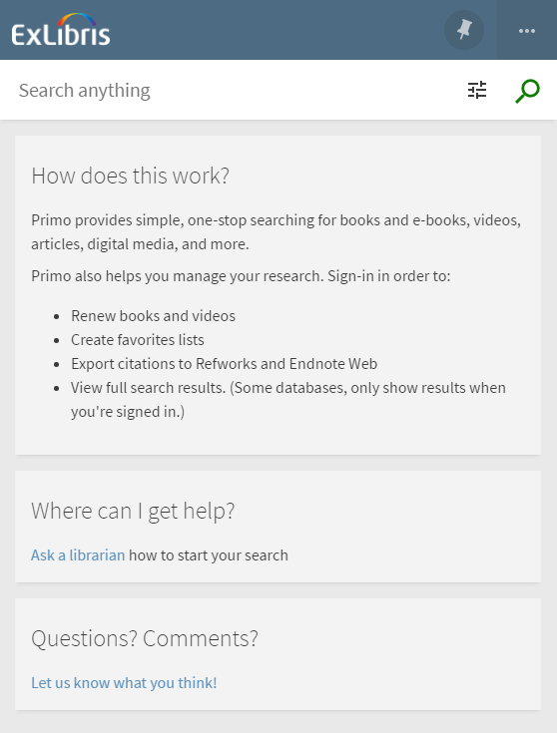
Home Page (mobile)
500 pixels

Slide 36
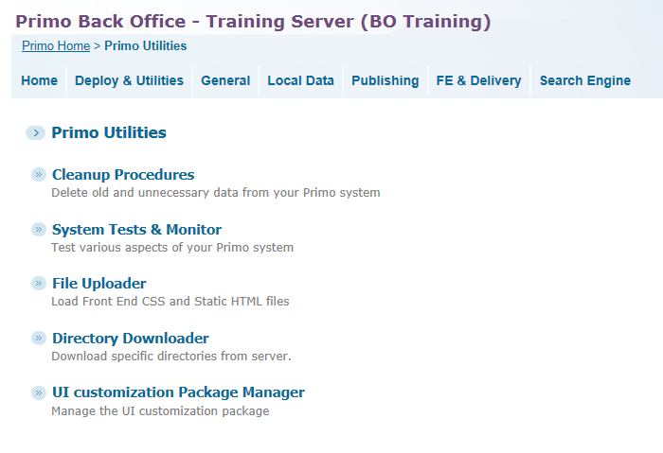
Classic vs New UX customization
Classic vs New UX customization
Classic still uses File Uploader to manage CSS, images & HTML
New UX uses UI Customization Package Manager

Slide 37
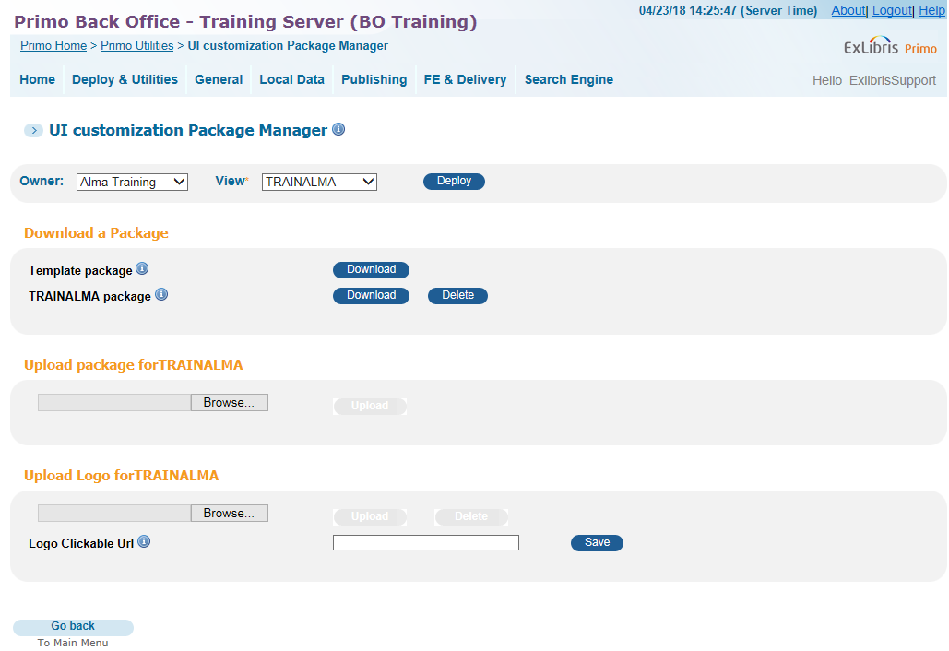
UI Customization Manager
Package Files
Go to Primo Back Office > Deploy & Utilities > Customization Manager
Select Owner and View
Download Template Package
Unzip and rename using View code
Make adjustments to files
Zip and upload package
Deploy
Logo
Upload logo
Add URL if desired
Deploy
Save

Slide 38
CSS – DEMO
Things to remember about custom1.css
  Keep this file name!
  Used in conjunction with a default CSS
  Overrides any other customized css files that may exist
  Use Chrome DevTools or similar app to identify CSS
  Advanced: it’s possible to use GULP to customize CSS
Demonstrate
  Use Chrome DevTools to pinpoint code
  Add sample code below to custom1.css
  Save file in css folder
Sample code to change search bar:
  .prm-primary-bg.prm-hue1,
  prm-journals-search-bar.prm-hue1,
  prm-search-bar.prm-hue1,
  prm-spinner.prm-hue1.overlay-cover.light-on-dark:after,
  prm-topbar .top-nav-bar {background-color: green;}
  prm-search-bar {background-color: gray;}

Slide 39
Images – DEMO
Things to remember about images
  Files must use existing filenames
  library-logo.png
  favicon.ico
  icon_article.png; icon_book.png, etc
  Must be png format
  Recommended sizes
  Logo: 35x100 pixels
  Favicon: 50x50 pixels
  Resource type icons: 60x88 pixels

Slide 40
HTML – DEMO
Things to remember about HTML
  Classic used ‘tiles’ and multiple HTML files for homepage
  New UI uses only one for homepage
  Keep this file name!
  home_en_US.html is recognized as the English version
  Used in conjunction with language functionality
  Possible to implement multiple languages

Slide 41
Exercise #5
Access the UI Customizations Manager
Download the files for your View
Unzip and examine the files

Slide 42

Questions?
Any Final Questions?

Slide 43
Agenda
Primo UX (Front End)
Primo Back Office
Views
Labels (Code Tables)
CSS and HTML
Next Steps, Support Resources and Feedback

Slide 44
Next Steps and Resources
Primo Recorded Training: https://knowledge.exlibrisgroup.com/Primo/Training
Primo Documentation: https://knowledge.exlibrisgroup.com/Primo/Product_Documentation
Additional support resources within the ExLibris Ecosystem:
  Idea Exchange
  Developer Network
2018 Technical Seminar Presentations (Cross-Product section of CKC)

Slide 45
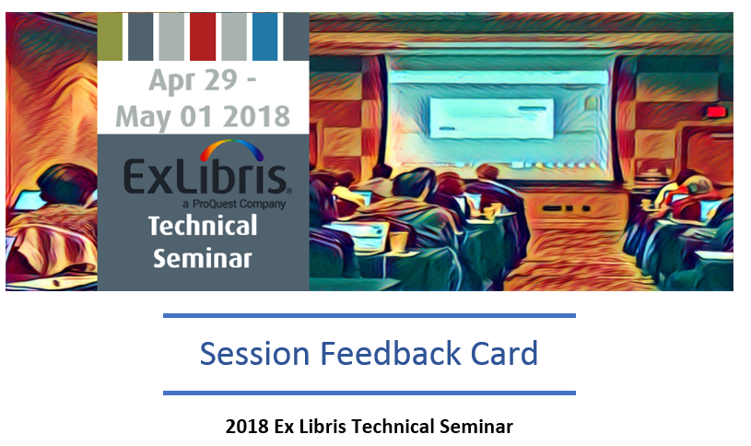
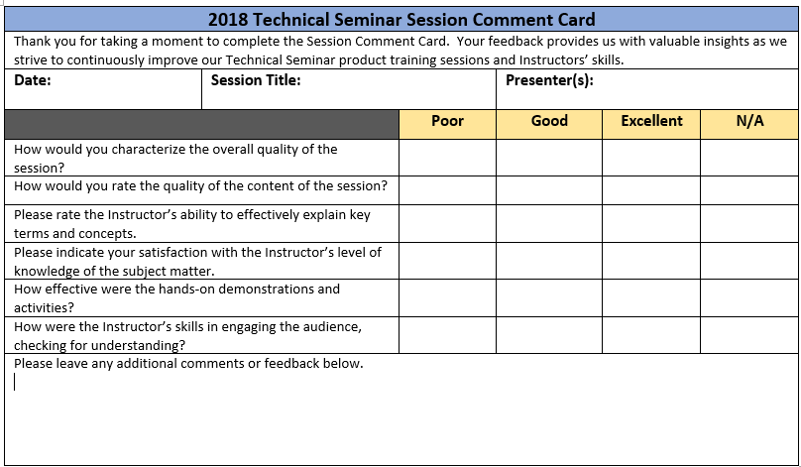
Session Feedback
We Value Your Feedback!
Please complete the brief Session Comment Card:

Slide 46
Thank You!

