Slide 1
Primo RESTful APIs
Paul McBride
Wei Dai

Slide 2
Welcome and Introductions
Paul McBride
  Tier2 Primo Senior Support Analyst
  Joined Ex Libris in 2010
  SME on Primo APIs
  10 years corporate IT application development & support
Wei Dai
  Infrastructure Support Specialist
  Joined Ex Libris in 2005
  Previously did application development for academic libraries

Slide 3
Session Objectives
Session Description:
  Integrate Primo into other software! Primo RESTful APIs can be used to bring the power of Primo to your applications, web portals, library site and more. Different Primo REST APIs and their syntax will be explained and demonstrated as part of this presentation.
Session Objective(s)
  By the end of this sessions you will know, understand and/or be able to:
    Understand the differences in Primo APIs
    Get started with API Gateway configuration
    Perform a brief search using Primo REST APIs

Slide 4
Target Audience
Target Audience for the Session:
  New and Experienced Customers
  Systems Librarians, Web Developers
  On-premises (Local) and Direct Saas (Hosted) Customers will have advantage over TotalCare Saas.

Slide 5
Agenda
1
Primo Legacy APIs
2
API Gateway
3
REST APIs
4
Questions
5
Next Steps, Support Resources and Feedback

Slide 6
Primo Legacy APIs*
What are APIs?
    Application Programming Interface
    No access to source code
  Why use APIs?
    Extend product’s usefulness, value
    Build new tools
    Integrate Primo functionality into your site
Notes:
This topic (Deep Links, Xservices, SOAP) will be covered quickly, just to acknowledge they exist.
Any new API projects by customers are recommended to use REST APIs.

Slide 7
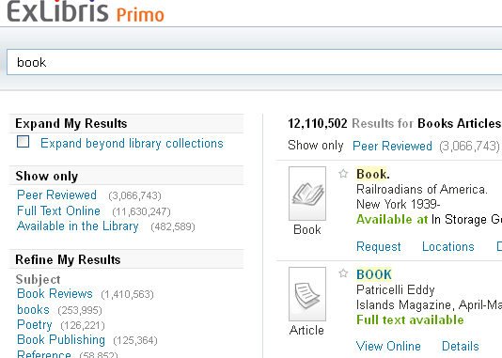
Deep Links
*Supported but Deprecated
Input:
A URL with parameters:
http://myprimo.hosted.exlibrisgroup.com/primo_library/libweb/action/dlSearch.do?
tab=default_tab&vid=01UNIV_main&institution=01UNIV&query=any,contains,economics&search_scope=UNIV_ALMA
Output:
Your Primo site Classic UI*
(*Intended for use with Classic UI,
but does redirect to New UI)

Slide 8
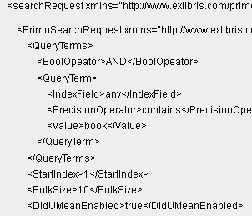
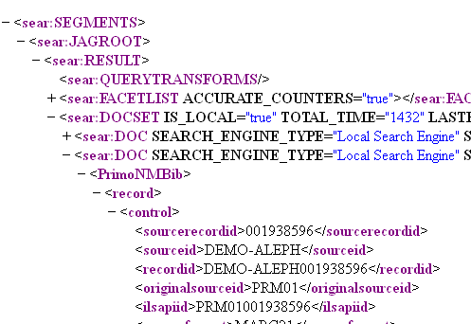
Web Services - SOAP
*Supported but deprecated
Input:
Primo search request XML wrapped in SOAP envelope
Uses POST
Support for many FE UI functions
Output:
Primo search result XML

Slide 9
XServices
*Supported but deprecated
Input:
URL with parameters:
http://primosb-pmtna.hosted.exlibrisgroup.com/PrimoWebServices/xservice/search/brief?
institution=TRIAL_1_INST&indx=1&bulkSize=10&query=any,contains,science&…
Support for many FE UI functions
Output:
A Primo search result XML or JSON
Notes:
XML Output looks just like SOAP

Slide 10
Agenda
1
Primo Legacy APIs
2
API Gateway
3
REST APIs
4
Questions
5
Next Steps, Support Resources and Feedback

Slide 11
API Gateway
Ex Libris Developers Network
API Proxy for SaaS Customers
API Control & Analytics

Slide 12
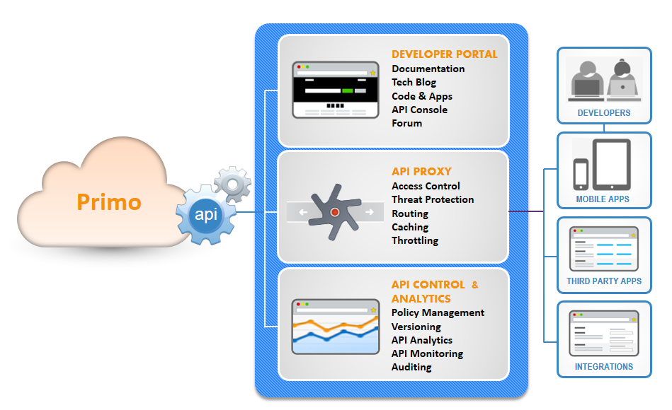
API Gateway

Slide 13
API Governance Thresholds
Maintain optimum performance
Efficient and proper use of infrastructure resources
Reduce the risks of malicious attacks
Two types (for Primo):
  Daily API Request Threshold
    (FTE x 5) REST APIs per day
    Violation = error message for the day
  Concurrent API Request Threshold
    10 REST APIs per institution per second
    Violation requests are queued and may be slower
Since each request made to the API incurs a computational cost, it’s important to make economical use of API requests. If a common function of your application can be performed using fewer requests than it currently does, it should.
https://developers.exlibrisgroup.com/blog/reducing-the-number-of-API-calls
Notes:
ensure no single institution negatively impacts other Primo institutions,
prevent performance degradation and
can help reduce the risks of malicious attacks.
Blog post to help reduce num of API calls.

Slide 14
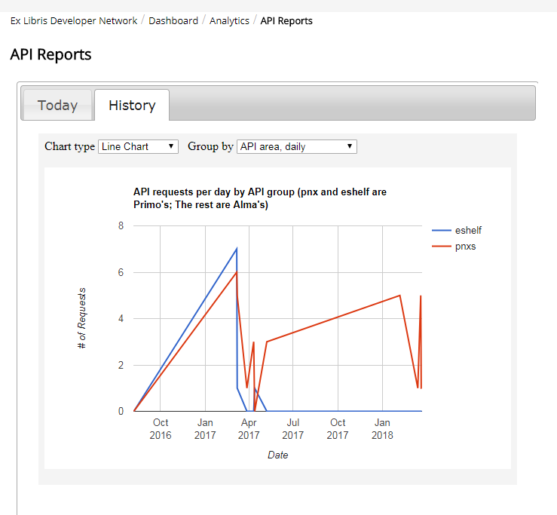
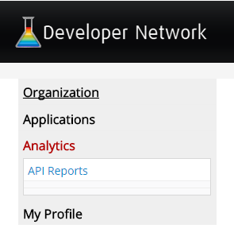
Analytics for REST APIs
Sign in
Dashboard > Analytics
View statistics about your REST API usage

Slide 15
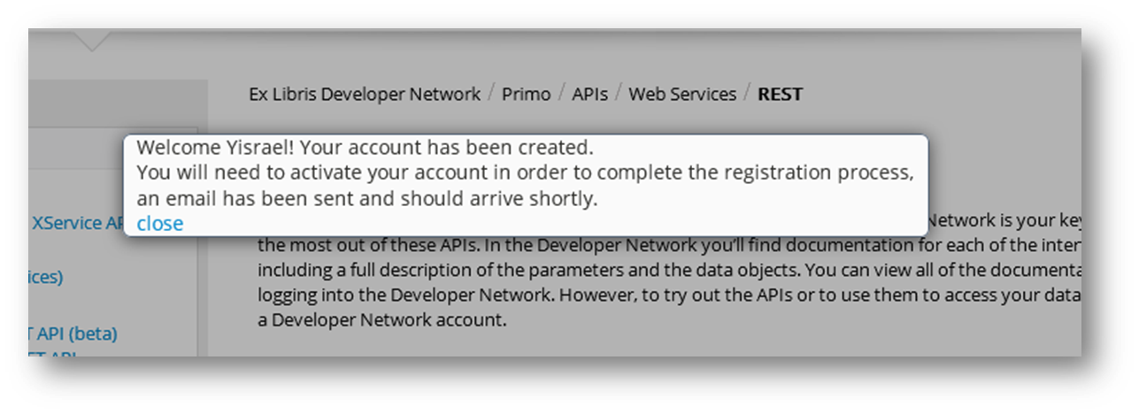
API Gateway
Getting Started with Primo REST APIs
Required for SaaS Customers
Sign-in/ Sign-up in Developers Network
Activate account - confirmation email
https://developers.exlibrisgroup.com/primo/apis/webservices/rest

Slide 16
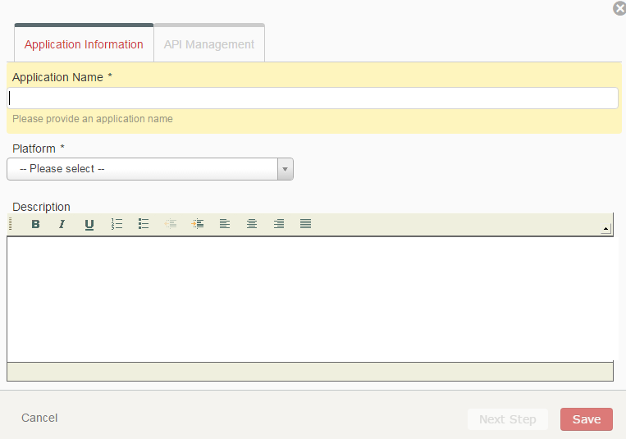
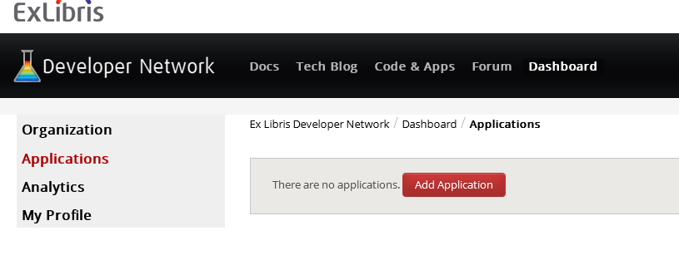
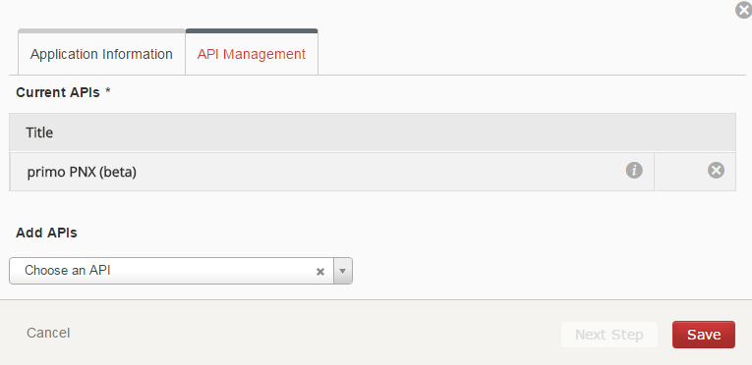
Configuring API Gateway
Add application
  Select Platform = “Web Application”
Notes:
Show the actual REST Getting Started Guide, or sign in and create an app.
Adding Application means giving it a name/platform/description and picking your API to add to the app.

Slide 17

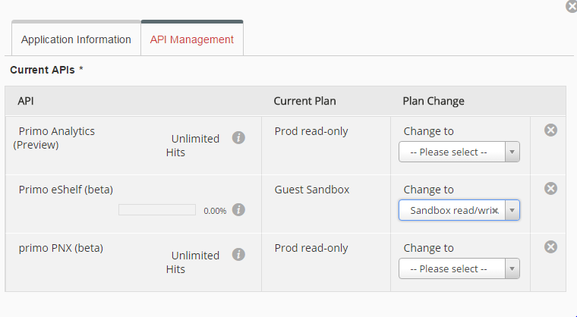
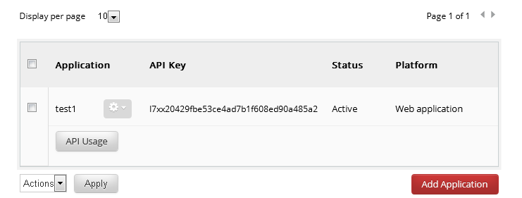
Configuring API Gateway
4. Get API Key – MOST IMPORTANT STEP!
Edit Application (using ) to link to Production or Sandbox
Set read/write permission
Linked to Guest Sandbox (aka Demo Data) by default
Notes:
Review- Step 1: Create Application
Step 2: Edit Application (Link to environment and set read/write permission)

Slide 18
Configuring API Gateway
5. Open Case to Ex Libris Support to connect your new Gateway applications to your relevant Primo environment
  Title – “Primo REST API registration”
  In the description please include the following information:
    Alma Institution code
    Primo Institution code
    Your Production Primo URL
    Your Sandbox Primo URL
Once Primo Support completes the registration process, you will be able to start developing using the REST APIs.
Notes:
PUSH to step #1???

Slide 19
Agenda
1
Primo Legacy APIs
2
API Gateway
3
REST APIs
4
Questions
5
Next Steps, Support Resources and Feedback

Slide 20
Primo REST APIs
REST = REpresentational State Transfer
architectural style and paradigm by Roy Fielding, developer of HTTP
Using links to navigate and utilize an application to represent transferring from one state (page) to another state (page)
“That process [of standardizing HTTP] honed my model down to a core set of principles, properties, and constraints that are now called REST” –Roy Fielding
More than GET, also POST, PUT, DELETE
Notes:
It’s a Concept!
Summary:
Moving from link to link via a web page
Not just GET, also POST, PUT, DELETE…

Slide 21
Search
Mimics search performed in the FE UI
Results returned as JSON
Facets included in searches and results
Advanced searching supported
http://api-na.hosted.exlibrisgroup.com/primo/v1/search? vid=<viewid>&tab=<tab>&scope=<scope>&q=any,contains,<searchterm>&apikey=<apikey>
https://developers.exlibrisgroup.com/primo/apis/search

Slide 22
Pnxs
Full-view of a specific record
Results returned as JSON
Linked Data url (Included in brief results)
http://api-na.hosted.exlibrisgroup.com/primo/v1/pnxs/<context>/<recordId>?apikey=<apikey>
Context = L or PC (Local or Primo Central)
https://developers.exlibrisgroup.com/primo/apis/webservices/rest/pnxs

Slide 23
View Configuration
Displays configuration of specified View
Mapping table values
Can be locale specific
Results returned as JSON
http://api-na.hosted.exlibrisgroup.com/primo/v1/configuration/<vid>?locale=All&apikey=<apikey>
locale=en_US
https://developers.exlibrisgroup.com/primo/apis/config

Slide 24
Translations
Displays label definitions of specified View and Language
Code table values
Results returned as JSON
http://api-na.hosted.exlibrisgroup.com/primo/v1/translations/<vid>?lang=<language>&apikey=<apikey>
lang=en_US
https://developers.exlibrisgroup.com/primo/apis/translations

Slide 25
Favorites / Eshelf*
Eshelf services/methods:
GET - Retrieve items
DELETE - Delete – Remove folder or item
POST - Create – Add folder or item
PUT - Update – Change folder name
https://api-na.hosted.exlibrisgroup.com/primo/v1/eshelf/{userid}/{path}?
apikey=<apikey>
POST Method Example:
https://api-na.hosted.exlibrisgroup.com/primo/v1/eshelf/johnt123/Basket/fishing?
apikey=<apikey>
{"folders":[{"name":"MyNonfiction"}]}
{"basket-items":[{"pnxId":“ALMA00123245","context":"L or PC"}]}
https://developers.exlibrisgroup.com/primo/apis/webservices/rest/eshelf
Notes:
*REVAMP of Favorites/Eshelf API coming in May 2018 Release

Slide 26
JWT
JSON Web Token
Open standard for secure transmission
Mandatory for on-premises Primo customers when using other APIs
Best Practice for Saas Primo customers
Results returned as JSON
<base-local-url>/primo_library/libweb/webservices/rest/v1/jwt/<institution_code>? vid=<view_code>lang=<language>
lang=en_US
https://developers.exlibrisgroup.com/primo/apis/jwt

Slide 27
Analytics
Returns a Primo Analytics (OBI) report in XML format only (not JSON)
Uses the OBI Analytics URL-encoded path to your report
Maximum 65,000 lines response
http://api-na.hosted.exlibrisgroup.com/primo/v1/analytics/reports? path=<report-path>&limit=100&filter<filter>&apikey=<apikey>
Sample:
https://api-na.hosted.exlibrisgroup.com/primo/v1/analytics/reports?
path=%2Fshared%2FPrimo+Lincoln+University+%28New+Zealand%29%2FReports%2FSearches+vs+clickthroughs&limit=50&apikey=<apikey>
https://developers.exlibrisgroup.com/primo/apis/Analytics/Retrieve_Analytics_report
https://developers.exlibrisgroup.com/blog/Working-with-Analytics-REST-APIs

Slide 28
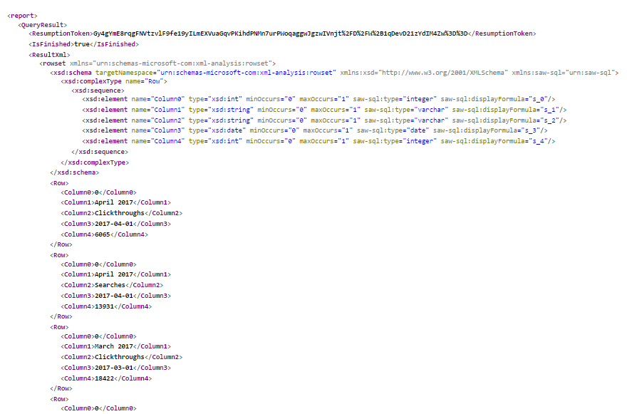
Analytics - results

Slide 29
Analytics – Ex Libris/Tableau Web Data Connector
This Github project provides a way to access data from Ex Libris Analytics (Alma or Primo) with Tableau Desktop.
To access your Ex Libris data in Tableau,
  Define a report in Analytics with the desired data.
  Then add a data source of web data connector to your Tableau workbook for each analytics report you're interested in.
Step by step instructions are available at this blog post.
https://developers.exlibrisgroup.com/blog/Tableau-Web-Data-Connector-for-Ex-Libris-Analytics
https://github.com/ExLibrisGroup/ExlTableauWDC
Notes:
Due to limitation of Primo Analytics APIs, Tableau magnifying glass showing list of reports does not work for Primo (yet)

Slide 30
Saas vs On-Premises
Saas Primo
Saas customers use regional API Gateway
Must be registered for API Gateway and configure Application
Must use apikey parameter
Use jwt as Best Practice
http://api-na.hosted.exlibrisgroup.com/primo/v1/configuration/<vid>?locale=All&apikey=<apikey>
On-premises Primo
Use local Primo servers
API url path is different
Must configure WS and XS IP Address mapping table
Must use inst=<institution_code> parameter instead of apikey
Must use jwt token in header
Analytics API unavailable
<base-local-url>/primo_library/libweb/webservices/rest/v1/configuration/<vid>?locale=All&inst=<institution_code>

Slide 31
Saas vs On-Premises: search
Saas Primo
http://api-na.hosted.exlibrisgroup.com/primo/v1/search? vid=<viewid>&tab=<tab>&scope=<scope>&q=any,contains,<searchterm>&apikey=<apikey>
On-premises Primo
<base-local-url>/primo_library/libweb/webservices/rest/primo-explore/v1/pnxs?
vid=<viewid>&tab=<tab>&scope=<scope>&q=any,contains,<searchterm>&inst=<institution_code>
Notes:
/primo-explore in path is unique to ‘search’
Pnxs api *without* /primo-explore is the *old* pnxs search

Slide 32
Saas vs On-Premises: JWT
On-premises must use guestJwt API to retrieve token
On-premises must use jwt token in header
needs more than browser for testing ('Try It' button, POSTman, RESTtesttest.com)
Example using curl:
curl --include --header "Authorization:Bearer eyJraWQiOiJwcmlt[…etc]" \
--request GET \
'<base-local-url>/primo_library/libweb/webservices/rest/v1/configuration/<vid>?
locale=All&inst=<institution_code>'
https://developers.exlibrisgroup.com/primo/apis/jwt
Notes:
Token is 639 characters in this example.
Would a JS example be better?

Slide 33
Agenda
1
Primo Legacy APIs
2
API Gateway
3
REST APIs
4
Questions
5
Next Steps, Support Resources and Feedback

Slide 34
Questions?

Slide 35

Useful Guides and Articles
API Road Map
  https://developers.exlibrisgroup.com/blog/Ex-Libris-API-Road-Map
REST APIs
  Concepts - Part 1, Part 2, Part 3
    https://developers.exlibrisgroup.com/blog/How-we-re-building-APIs-at-Ex-Libris
    https://developers.exlibrisgroup.com/primo/apis/webservices/rest/linked_data
    https://developers.exlibrisgroup.com/blog/Ex-Libris-API-Road-Map
  Getting Started/Registration https://developers.exlibrisgroup.com/primo/apis/webservices/rest
  Thresholds https://developers.exlibrisgroup.com/blog/reducing-the-number-of-API-calls
  Brief Search https://developers.exlibrisgroup.com/primo/apis/search
  Analytics – Part 1, Part 2
    https://developers.exlibrisgroup.com/blog/Working-with-Analytics-REST-APIs
    https://developers.exlibrisgroup.com/primo/apis/Analytics/Retrieve_Analytics_report
Analytics of REST APIs
  https://developers.exlibrisgroup.com/dashboard/reports/api-reports

Slide 36
Useful Stuff
Helpful tools (Chrome Web Store)
  JSON Formatter
  Postman
  XML Tree
  Resttesttest.com

Slide 37
Agenda
1
Primo Legacy APIs
2
API Gateway
3
REST APIs
4
Questions
5
Next Steps, Support Resources and Feedback

Slide 38
Next Steps, Support Resources and Feedback

Slide 39
Next Steps and Resources
Additional support resources within the ExLibris Ecosystem:
  Idea Exchange
  Developer Network
2018 Technical Seminar Presentations (Cross-Product section of CKC)

Slide 40

Questions?
Any Final Questions?

Slide 41

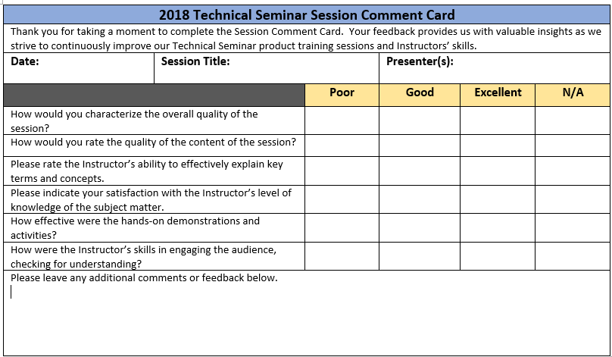
Session Feedback
We Value Your Feedback!
Please complete the brief Session Comment Card:

Slide 42
Thank You!

