Slide 1
Configuring the color theme
In Primo VE NDE
Yoel Kortick | May 2026

Slide 2
Agenda
  Introduction
  The steps to select the color theme
  A live demo to change the color theme

Slide 3

Introduction

Slide 4
Introduction
The institution can quickly and easily change the color theme of a Primo view with no need to create a customization package.
The color schemes affect many elements in the NDE UI and adhere to the accessibility guidelines for color and contrast.
For an additional method (to what is now being shown here) for changing the color scheme, see Customizing a Color Theme.

Slide 5
The steps to select the color theme

Slide 6
The steps to select the color theme
To select a color theme:
  Access “Configure Views”
  Edit the View
  Select the “Manage Customization Package” tab
  In the Color Theme - New UI section, select a color icon. Purple is the default color.

Slide 7
A live demo to change the color theme

Slide 8
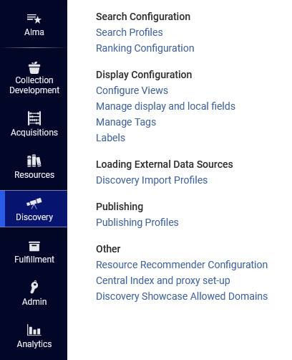
A live demo to change the color theme
Access “Configure Views”

Slide 9
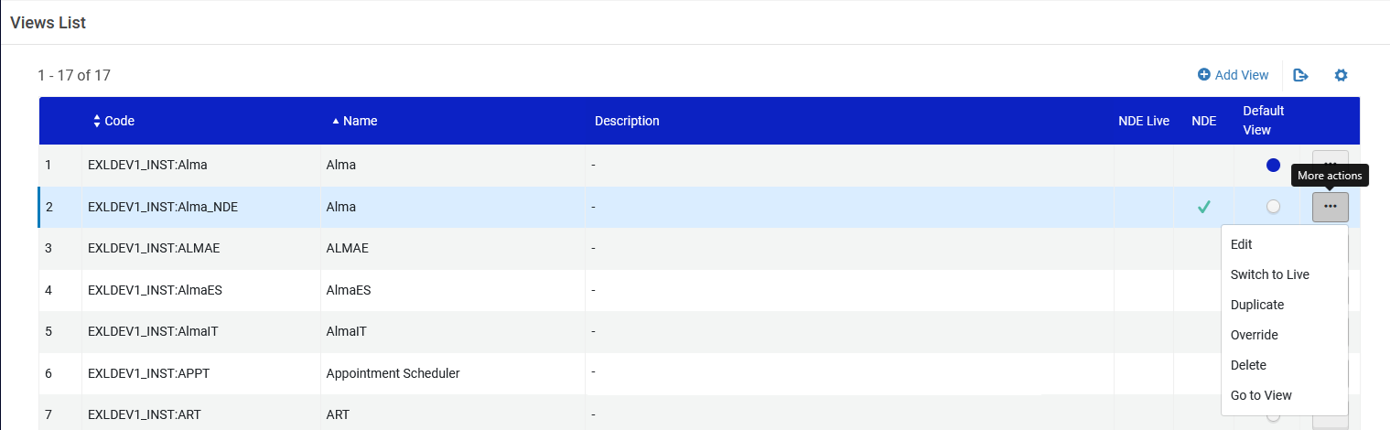
A live demo to change the color theme
Edit the view

Slide 10
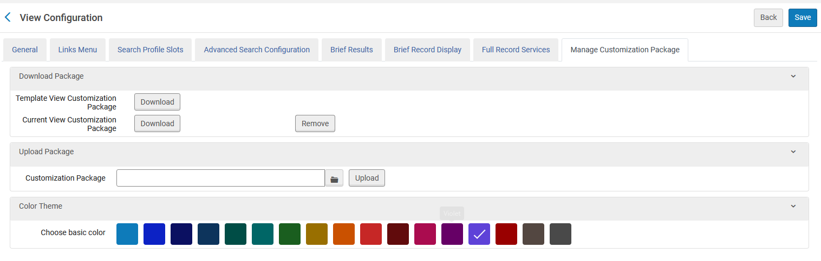
A live demo to change the color theme
Select the “Manage Customization Package” tab
This “Color Theme” section is new for Primo VE NDE

Slide 11
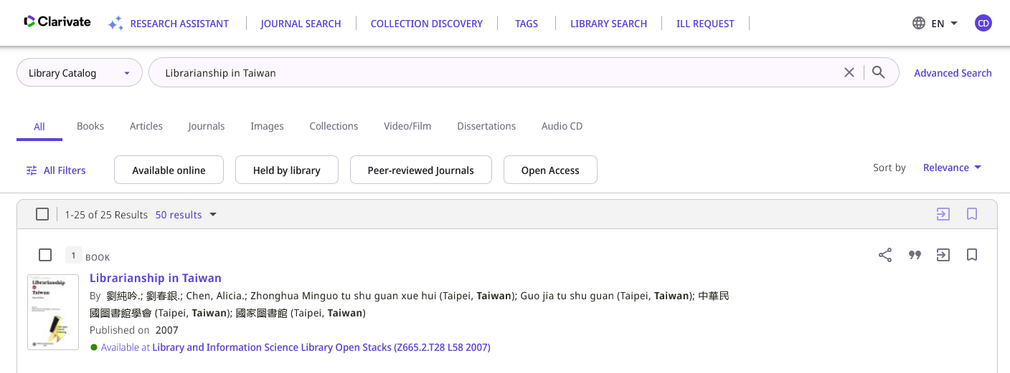
A live demo to change the color theme
Here is the “Before” color scheme in Primo VE NDE

Slide 12
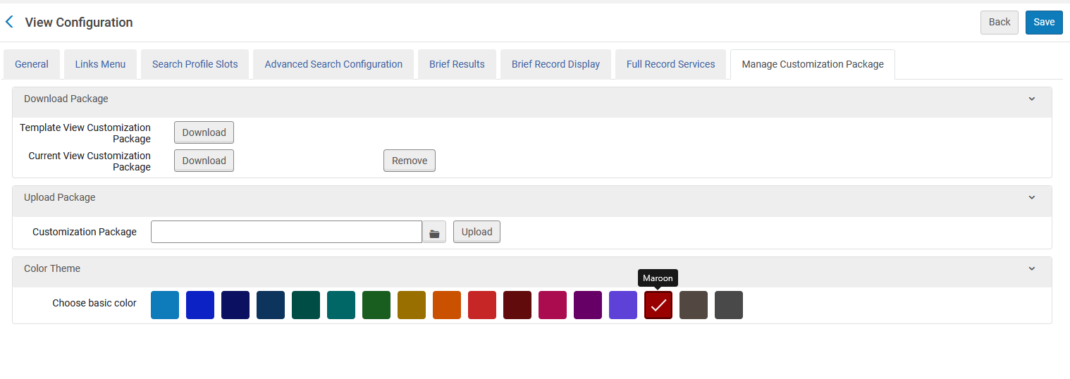
A live demo to change the color theme
In the Color Theme section, select a color icon. Purple is the default color. We will select Maroon.
We will select Maroon
Save when done

Slide 13
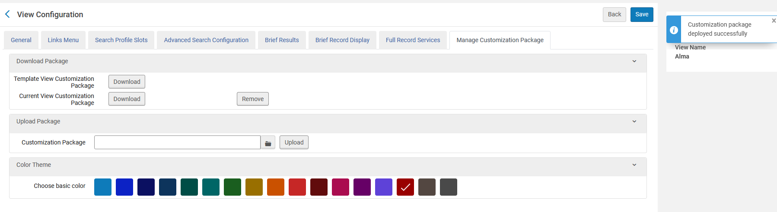
A live demo to change the color theme
After clicking “Save” the customization package is deployed successfully

Slide 14
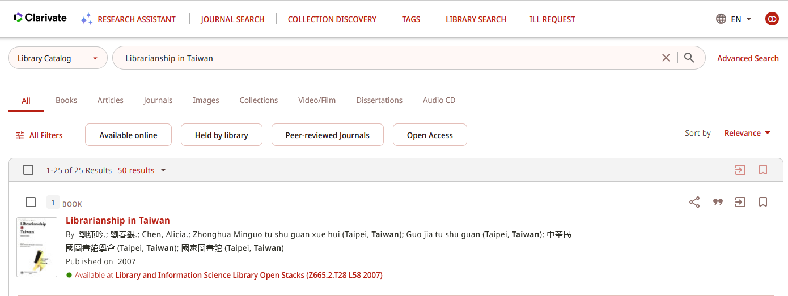
A live demo to change the color theme
The color has changed

Slide 15

A live demo to change the color theme
After
Before

Slide 16
Thank You

