Slide 1
Enabling "Did You Mean"
In Primo VE NDE
Yoel Kortick | May 2026

Slide 2
Agenda
  Introduction
  What is "Did You Mean"?
  Using "Did You Mean" Example 1
  Using "Did You Mean" Example 2
  Using "Did You Mean" Example 3
  Now we will uncheck "Did You Mean"
  Not Using "Did You Mean" Example 1
  Not Using "Did You Mean" Example 2
  Not Using "Did You Mean" Example 3
  How does the "Did You Mean" work?

Slide 3

Introduction

Slide 4
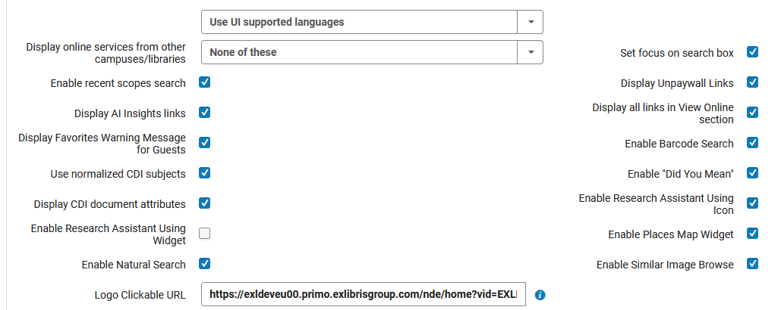
Introduction
When configuring a Primo VE NDE View, the "General" tab of the view contains a checkbox "Enable "Did You Mean"".

Slide 5
Introduction
This checkbox indicates whether the "Did You Mean" feature is enabled for the NDE UI.
In Primo VE (not NDE):
  The "Did You Mean" feature is enabled out-of-the-box, and it is not configurable.
  If the institution wants to hide this functionality in a non-NDE environment, then they must make the change via the CSS.
  This is described at Linguistic Features for Primo VE (in the section Did You Mean)
In Primo VE NDE:
  The "Did You Mean" feature can easily be turned on and off by checking the box "Did You Mean"

Slide 6
What is “Did you mean”?

Slide 7
What is "Did You Mean"?
"Did You Mean" is a mechanism whereby in specific situations suggestions are given to the end user performing a search in Primo discovery.
These suggestions are designed to improve search queries.
The suggestions correct typographical errors and common misspellings in search terms, thereby enabling a situation whereby the end user performing a search will receive the expected search results.
"Did You Mean" suggestions are provided when the original query returns less than the threshold of 15 search results, which is not configurable.
See also: Did You Mean.

Slide 8
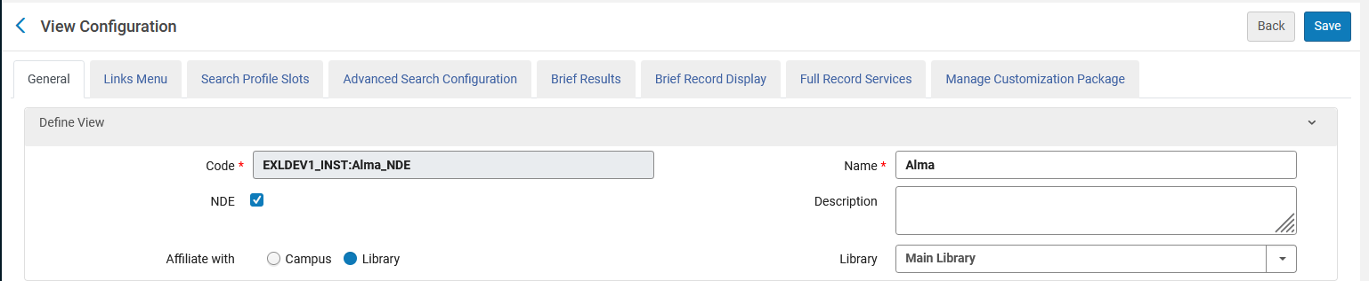
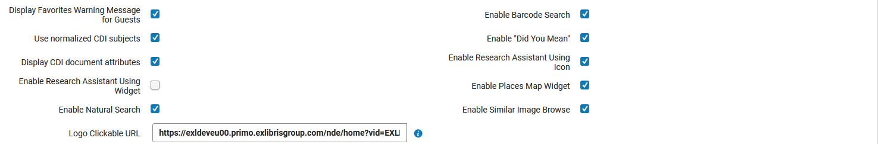
What is "Did You Mean"?
The feature is active when in the "General" tab of the Primo VE NDE View the "Did You Mean" checkbox is checked

Slide 9
Using "Did You Mean" Example 1

Slide 10
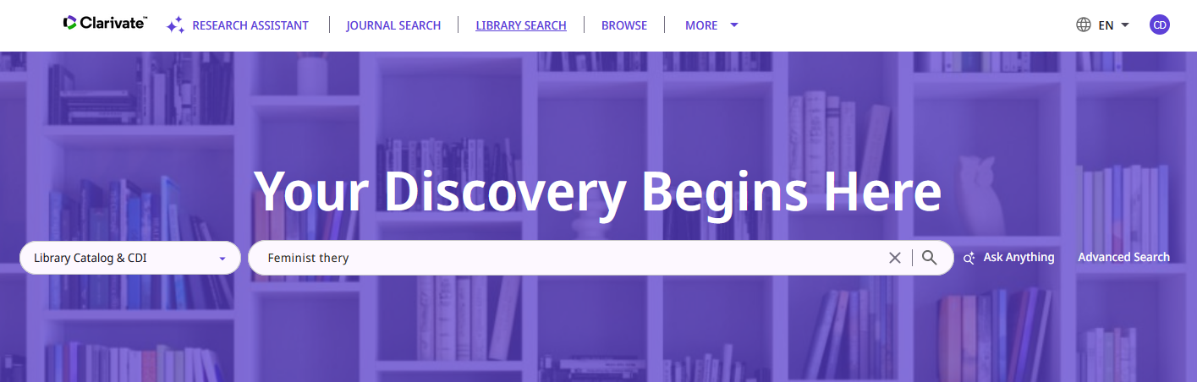
Using "Did You Mean" Example 1
The user searches the Library Catalog & CDI for "Feminist thery" instead of "Feminist theory".
The user "by accident" made a spelling error.

Slide 11
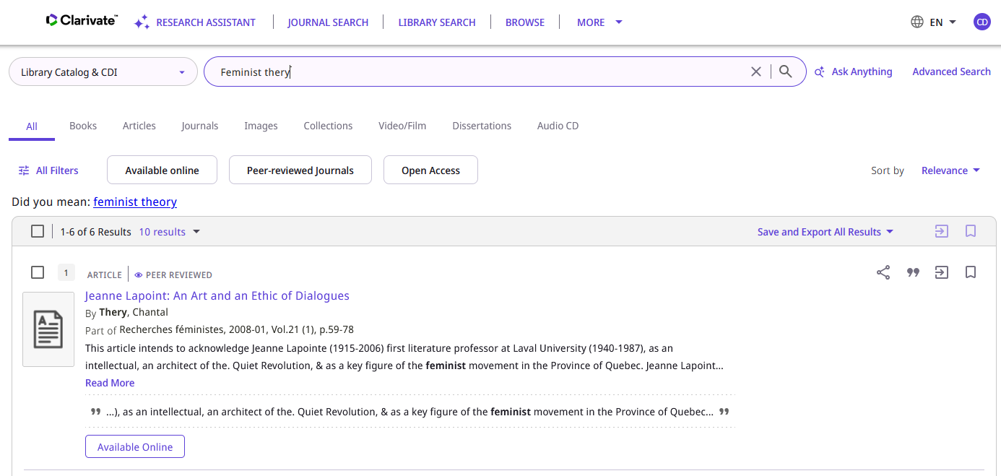
Using "Did You Mean" Example 1
The user receives a suggestion "Did you mean: feminist theory"
Clicking this link will perform a search for "feminist theory"
The reason there are results is because "thery" was searched as a keyword and it does exist.

Slide 12
Using "Did You Mean" Example 2

Slide 13
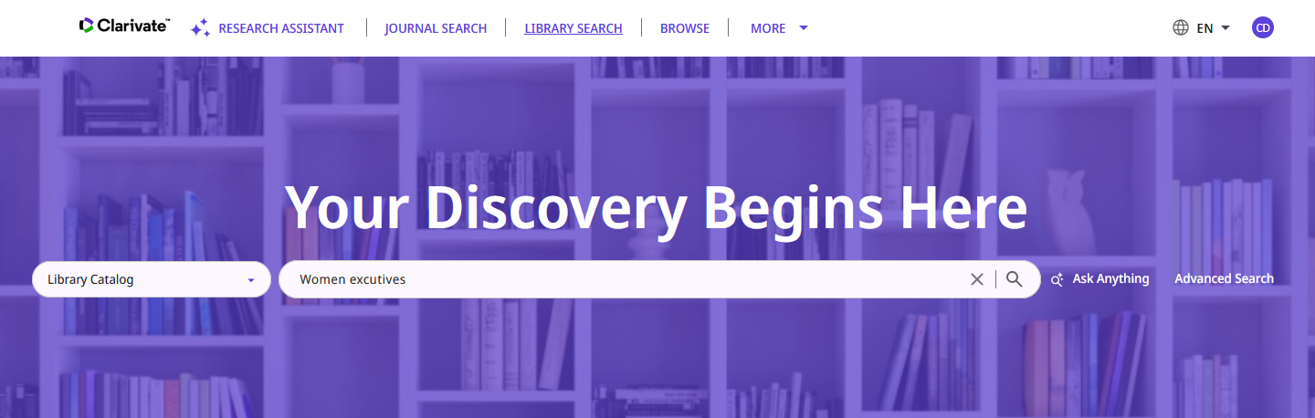
Using "Did You Mean" Example 2
The user searches the Library Catalog for "Women excutives" instead of "Women executives".
The user "by accident" made a spelling error.

Slide 14
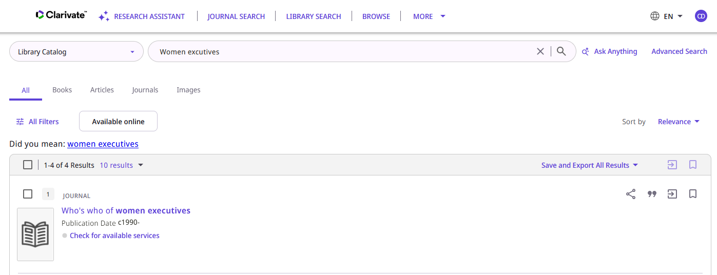
Using "Did You Mean" Example 2
The user receives a suggestion "Did you mean: women executives"
Clicking this link will perform a search for "women executives"

Slide 15
Using "Did You Mean" Example 3

Slide 16
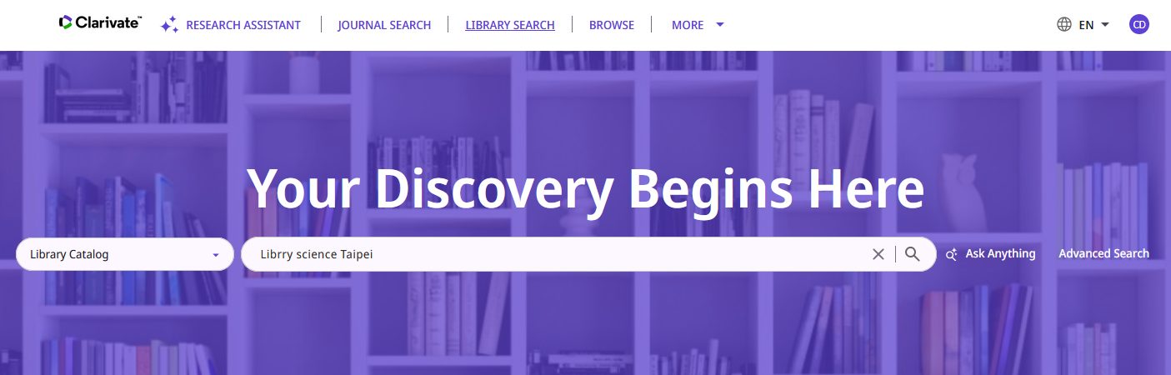
Using "Did You Mean" Example 3
The user searches the Library Catalog for "Librry science Taipei" instead of "Library science Taipei".
The user "by accident" made a spelling error.

Slide 17
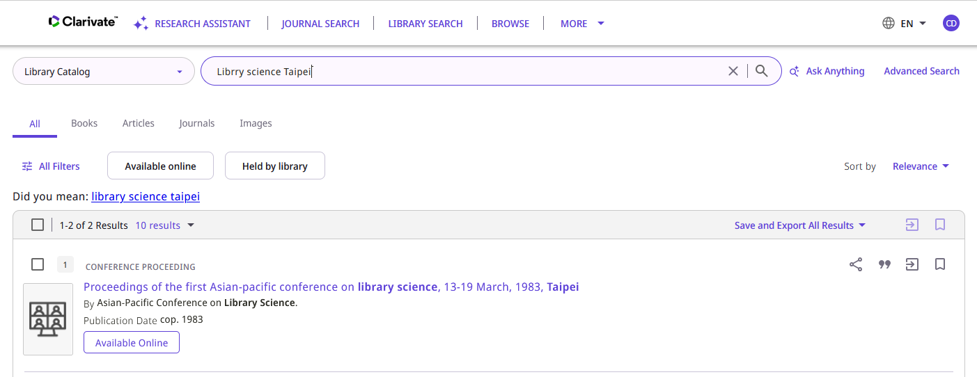
Using "Did You Mean" Example 3
The user receives a suggestion "Did you mean: library science taipei"
Clicking this link will perform a search for "library science taipei"

Slide 18
Now we will uncheck "Did You Mean"

Slide 19
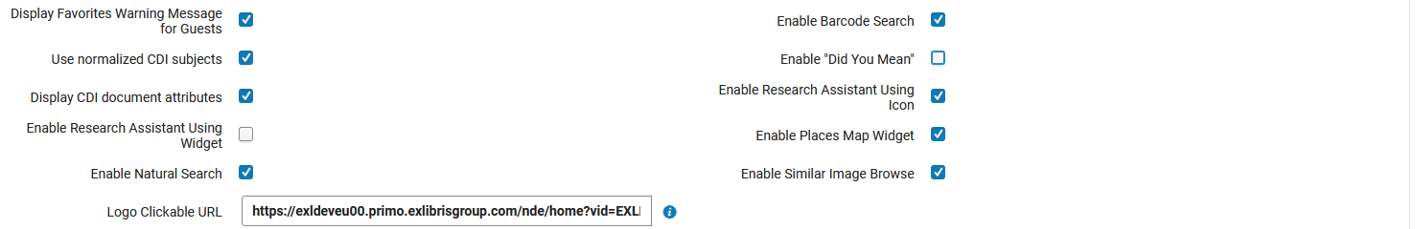
Now we will uncheck "Did You Mean"
The feature is no longer active because in the "General" tab of the Primo VE NDE View the "Did You Mean" checkbox is no longer checked

Slide 20
Not Using "Did You Mean" Example 1

Slide 21
Not Using "Did You Mean" Example 1
The user searches the Library Catalog & CDI for "Feminist thery" instead of "Feminist theory".
The user "by accident" made a spelling error.

Slide 22
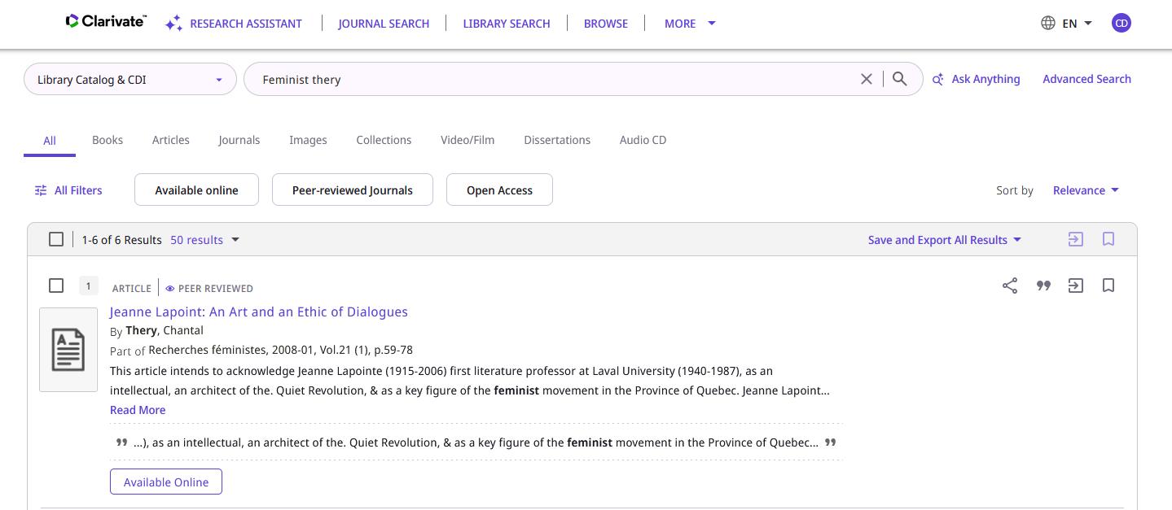
Not Using "Did You Mean" Example 1
The user does not receive a suggestion "Did you mean: feminist theory"
No "Did You Mean" suggestion

Slide 23
Not Using "Did You Mean" Example 2

Slide 24
Not Using "Did You Mean" Example 2
The user searches the Library Catalog for "Women excutives" instead of "Women executives".
The user "by accident" made a spelling error.

Slide 25
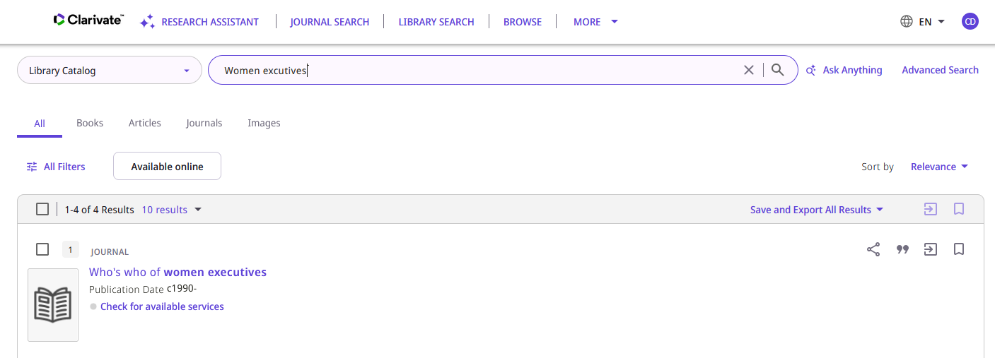
Not Using "Did You Mean" Example 2
The user does not receive a suggestion "Did you mean: women executives"
No "Did You Mean" suggestion

Slide 26
Not Using "Did You Mean" Example 3

Slide 27
Not Using "Did You Mean" Example 3
The user searches the Library Catalog for "Librry science Taipei" instead of "Library science Taipei".
The user "by accident" made a spelling error.

Slide 28
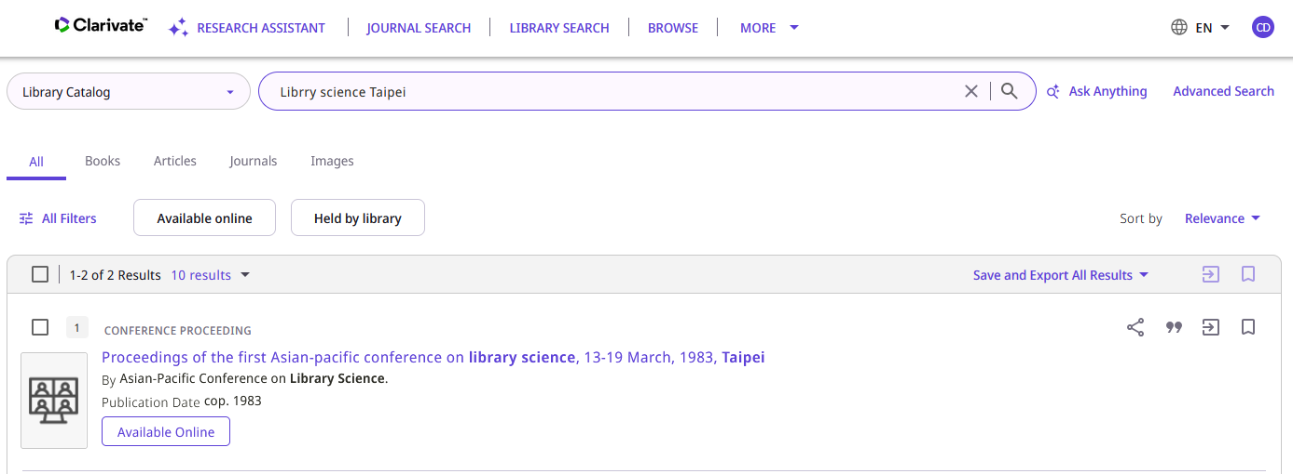
Not Using "Did You Mean" Example 3
The user does not receive a suggestion "Did you mean: library science taipei"
No "Did You Mean" suggestion

Slide 29
How does the "Did You Mean" work?

Slide 30
How does the "Did You Mean" work?
Rather than explain here the intricacies of how the "Did You Mean" works, the reader is referred to the online help where a full explanation is given.
See How Does DYM Work? Which is part of Linguistic Features for Primo VE.

Slide 31
Thank You

