Slide 1
Full Text Indexing for local records
in Primo VE NDE
Yoel Kortick | May 2026

Slide 2
Agenda
  Introduction
  Creating a Local Field for Full Text Indexing
  Sample records with full text indexing
  Using the full text indexing
  Configurations in the Primo VE NDE View

Slide 3

Introduction

Slide 4
Introduction
In Primo VE NDE is it possible to index full text externally held in a file of type PDF, TXT, or HTML for discovery.
In order for this functionality to be used, the link to the externally-held full text must be stored in a local search field.
During the indexing of a local field, Primo VE will perform the following actions on each of the full-text records:
  Remove stop words based on language.
  Remove HTML tags.
  Index up to 10,000 terms.

Slide 5
Introduction
External full-text indexing occurs when a URL in the metadata leads to a full-text target, which may be a file of type PDF, TXT, or HTML.
If the URL leads to a PDF file containing searchable text within the file, Primo will index that full-text target for searching.
Full-text indexing is configured by mapping the full text's URL in the source to a local field.

Slide 6
Creating a Local Field for Full Text Indexing

Slide 7
Creating a Local Field for Full Text Indexing
The Define a Local Field page allows for the creation of local fields to enhance discovery via additional display fields, facets, and search indexes.
For this specific case, Primo maps the full-text link in a source record to a local field, where the full-text file is indexed for search.
Note that it is not possible (not is it necessary) to configure multiple local fields to handle full-text indexing.

Slide 8
Creating a Local Field for Full Text Indexing
The steps to create a local field to handle full-text indexing are as follows:
Access the Manage Display and Local Fields page at “Configuration Menu > Discovery > Display Configuration > Manage Display and Local Fields”.
Select Add field > Add local field to open the Define a Local Field page.
Specify the following fields:
  Field to edit – Specify which local field will be used for full-text indexing.
  Display label – Specify the display label for this local field.
  Enable field for search – Clear this option.
  Use full text links for indexing – Select this check box to instruct the system to fetch and index externally held full text. This option can be assigned only to a single local field and cannot be selected if used for another local field.
Define from which field the full-text link should be taken for indexing.

Slide 9
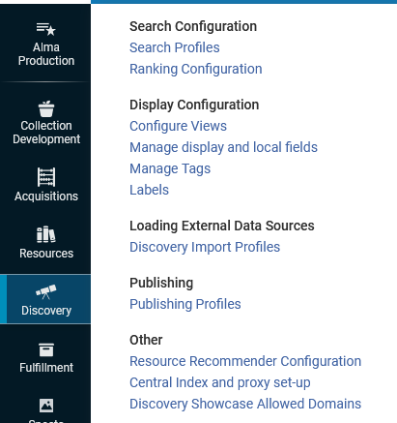
Creating a Local Field for Full Text Indexing
Access the Manage Display and Local Fields page

Slide 10
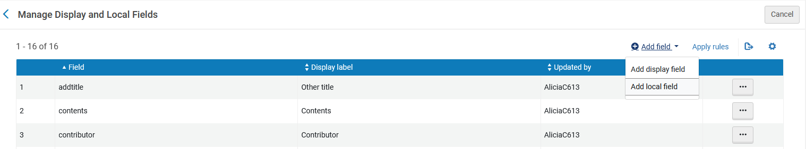
Creating a Local Field for Full Text Indexing
Select “Add field > Add local field” to open the Define a Local Field page.

Slide 11
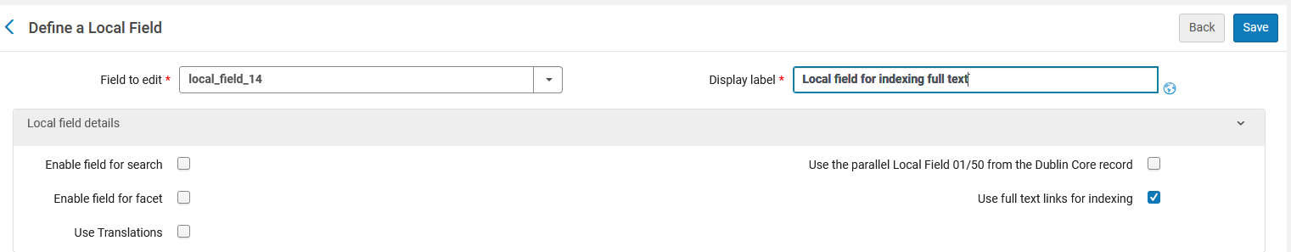
Creating a Local Field for Full Text Indexing
Field to edit – Specify which local field will be used for full-text indexing.
Display label – Specify the display label for this local field.
Enable field for search – Clear this option.
Use full text links for indexing – Select this check box to instruct the system to fetch and index externally held full text. This option can be assigned only to a single local field and cannot be selected if used for another local field.

Slide 12
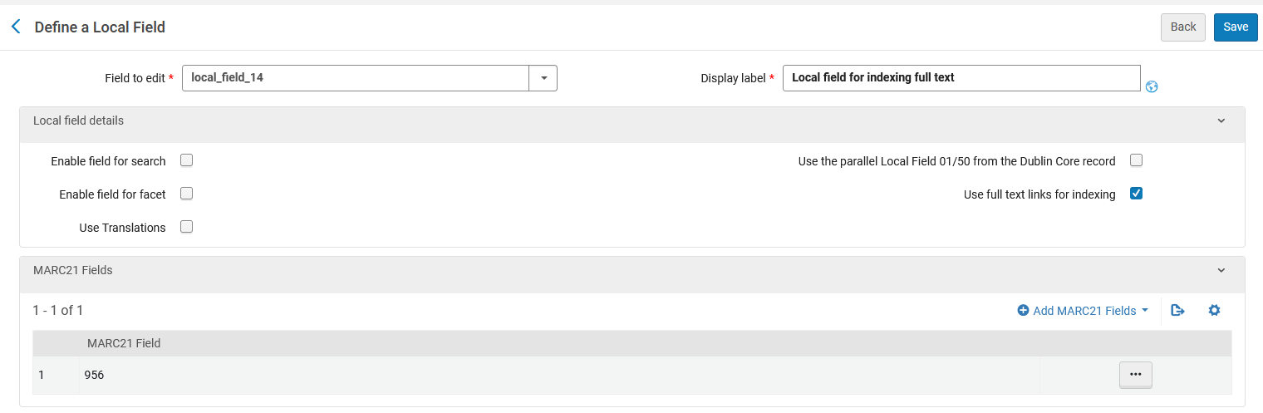
Creating a Local Field for Full Text Indexing
Define from which field the full-text link should be taken for indexing.
In this example, the link to the full text is mapped from the MARC 956 field to the local field using the MARC21 Bibliographic Field mapping method.

Slide 13
Sample records with full text indexing

Slide 14
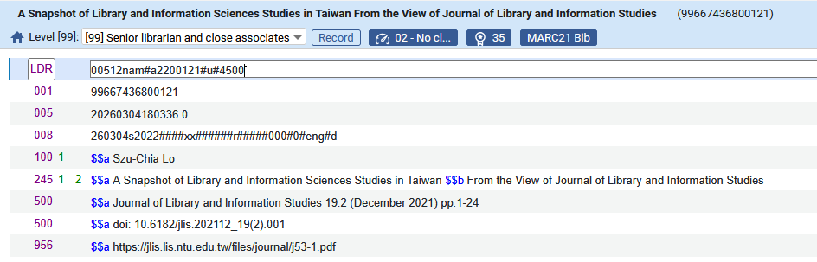
Sample records with full text indexing
Title “A Snapshot of Library and Information Sciences Studies in Taiwan” has a 956 field with
956__ $$a https://jlis.lis.ntu.edu.tw/files/journal/j53-1.pdf

Slide 15
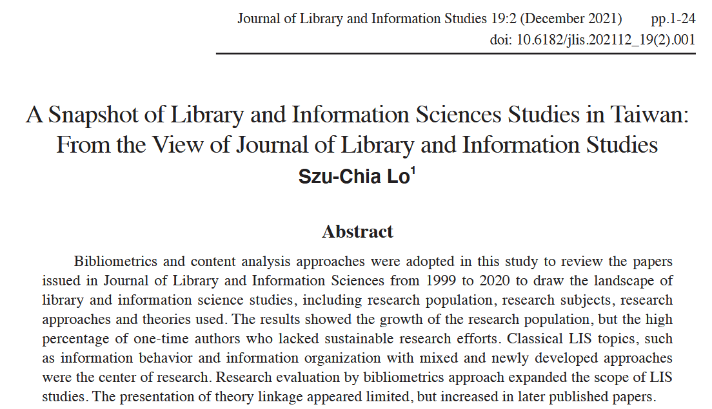
Sample records with full text indexing
The URL https://jlis.lis.ntu.edu.tw/files/journal/j53-1.pdf contains the text:
Bibliometrics and content analysis approaches were adopted in this study to review the papers

Slide 16
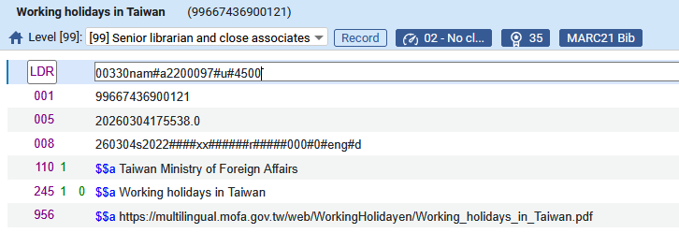
Sample records with full text indexing
Title “Working holidays in Taiwan” has a 956 field with
956__ $$a https://multilingual.mofa.gov.tw/web/WorkingHolidayen/Working_holidays_in_Taiwan.pdf

Slide 17

Sample records with full text indexing
The URL https://multilingual.mofa.gov.tw/web/WorkingHolidayen/Working_holidays_in_Taiwan.pdf
Contains the text:
Immerse yourself in traditional Chinese culture, preserved like nowhere else, with Taiwanese characteristics

Slide 18
Using the full text indexing

Slide 19

Using the full text indexing
We will now search for the full text “Bibliometrics and content analysis approaches were adopted in this study to review the papers” which is in the pdf file at https://jlis.lis.ntu.edu.tw/files/journal/j53-1.pdf which is in the bibliographic record with title “A Snapshot of Library and Information Sciences Studies in Taiwan”

Slide 20
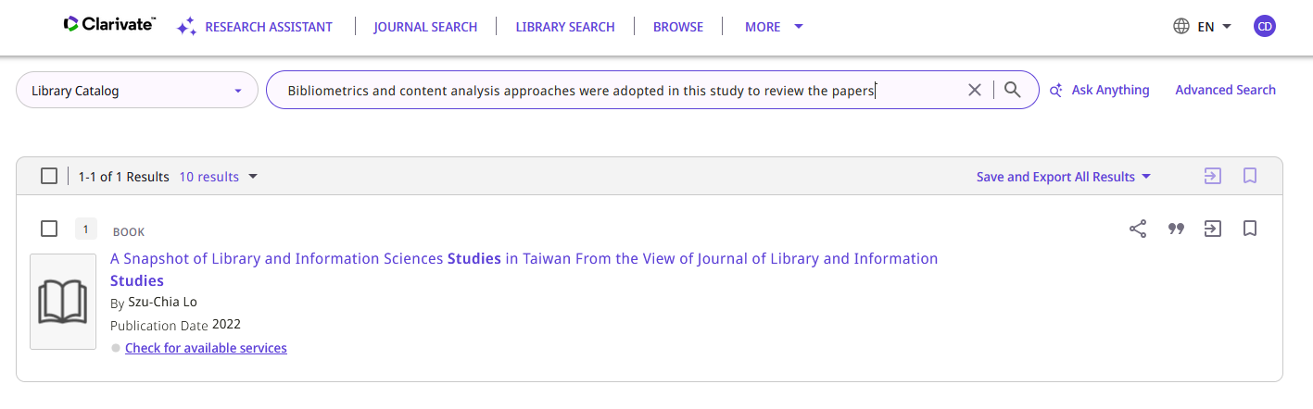
Using the full text indexing
The record is retrieved

Slide 21

Using the full text indexing
We will now search for the full text “Immerse yourself in traditional Chinese culture, preserved like nowhere else, with Taiwanese characteristics” which is in the pdf file at https://multilingual.mofa.gov.tw/web/WorkingHolidayen/Working_holidays_in_Taiwan.pdf which is in the bibliographic record with title “Working holidays in Taiwan”

Slide 22
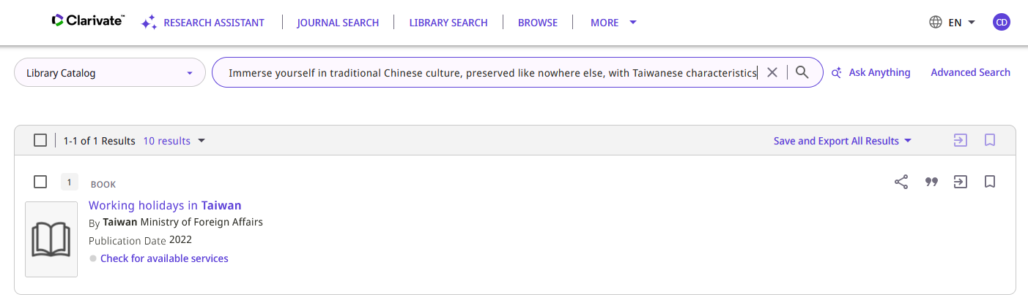
Using the full text indexing
The record is retrieved

Slide 23
Configurations in the Primo VE NDE View

Slide 24
Configurations in the Primo VE NDE View
The fact that local records were searched for full text is not “by default”, and when it is enabled end users have the option to disable it.
Thus, the institution can configure whether users can search local records for full text, and if enabled, whether it is searched by default for local search scopes.
Once enabled, users can enable/disable the search for local full text by toggling the “Search in Full Text” option.
Note: Before this development in Primo VE NDE, local records were searched for full text by default, and users had no option to disable it.
  See “NDE UI - Control Search of Local Full Text” in the July 2025 Primo VE Release Notes

Slide 25
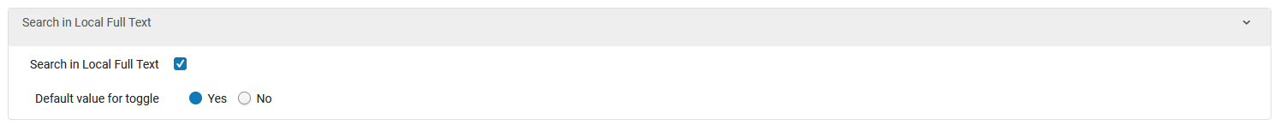
Configurations in the Primo VE NDE View
In the “Brief Results” tab of Primo VE NDE view we have the following defined.
We have defined to have the ability to search in Local Full Text, and we have defined that it will be the default value for the toggle.

Slide 26
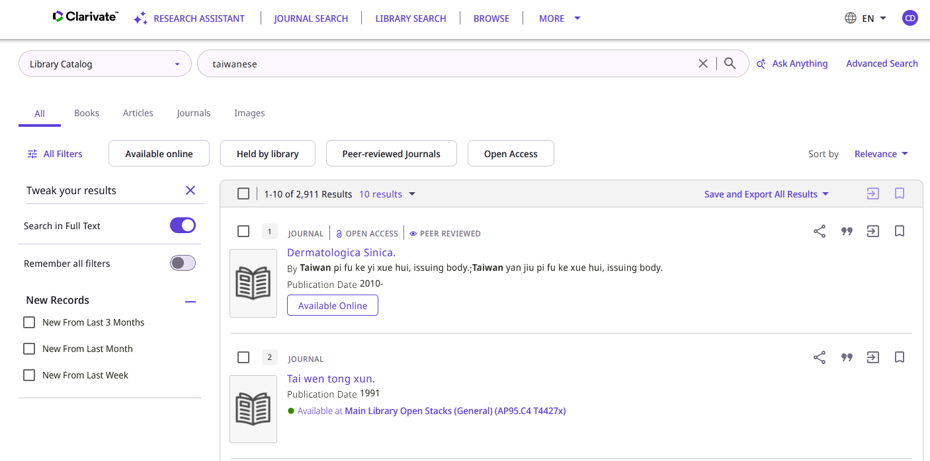
Configurations in the Primo VE NDE View
Therefore, if an end user searches Primo and clicks to view the filters he or she will see this:
“Search in Full Text” appears and is by default checked. User can change this if desired.

Slide 27
Configurations in the Primo VE NDE View
Now we make a change and make the default value for toggle be “No”.
In the “Brief Results” tab of Primo VE NDE view we have the following defined.
We have defined to have the ability to search in Local Full Text, and we have defined that it will not be the default value for the toggle.

Slide 28
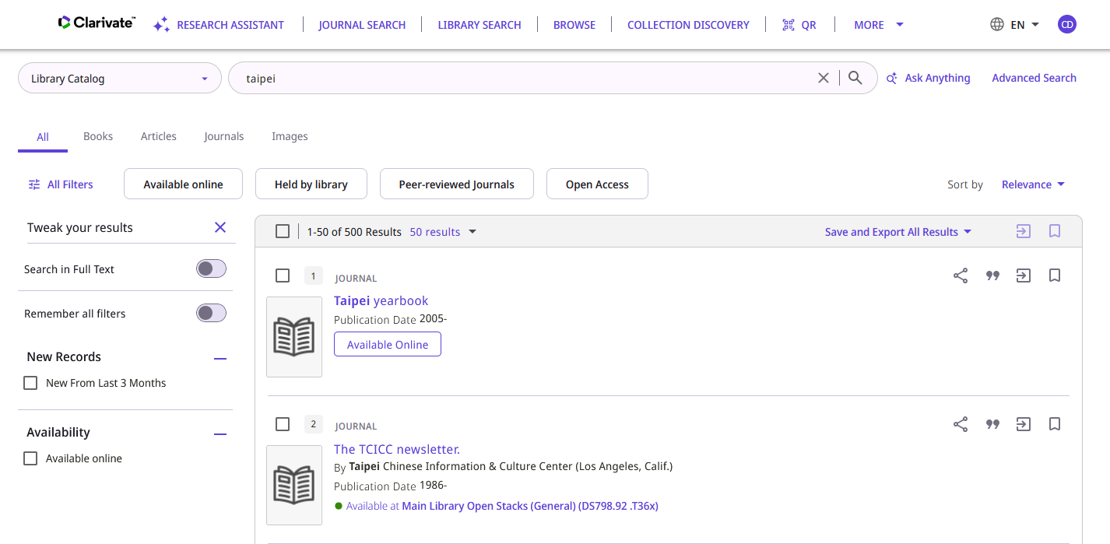
Configurations in the Primo VE NDE View
Therefore, if an end user searches Primo and clicks to view the filters he or she will see this:
“Search in Full Text” appears and is not by default checked. User can change this if desired.

Slide 29
Thank You

