Slide 1
How to create a search profile slot
In Primo VE NDE for only electronic resources
Yoel Kortick | May 2026

Slide 2
Introduction
Step 1: Define a “Custom Local Data Scope”
Step 2: Use the “Custom Local Data Scope” to create a new “Search Profile”
Step 3: Add a search profile slot which uses the new “Search Profile” to a specific view
Test it out
Agenda

Slide 3

Introduction

Slide 4
Introduction
We will describe here how to create a search profile slot in Primo VE for which all results will be bibliographic records which have electronic inventory.

Slide 5
Step 1: Define a “Custom Local Data Scope”

Slide 6
Step 1: Define a “Custom Local Data Scope”
Define a “Custom Local Data Scope”
  Navigate to “Configuration > Discovery > Search Configuration > Search Profiles”
  Switch to middle tab “Custom Local Data Scopes”
  On right side click “Add a Custom Scope”
  Fill in a code and name, for example code “ONLY_E_RESOURCES” name “Only E Resources”
  On right side click “Add a Condition”
  Choose search index “Inventory: Available Electronic”. Choose operator “Exists”.
  Add the condition
  Save the “Custom Local Data Scope”

Slide 7
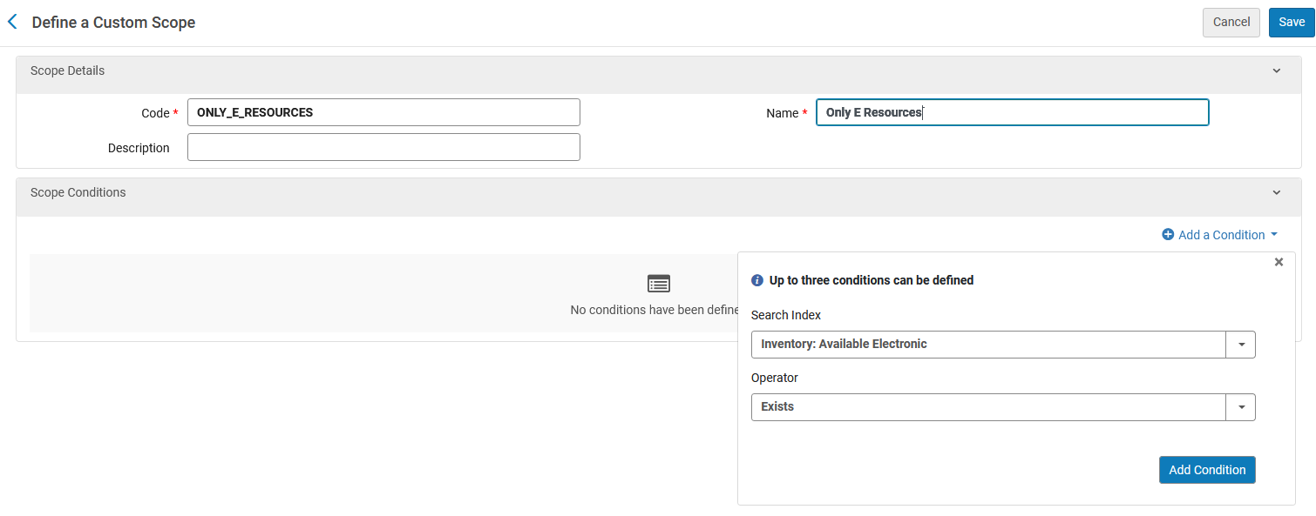
Step 1: Define a “Custom Local Data Scope”

Slide 8
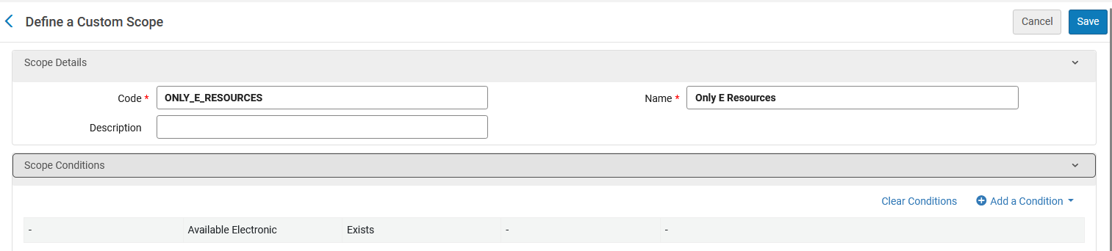
Step 1: Define a “Custom Local Data Scope”

Slide 9
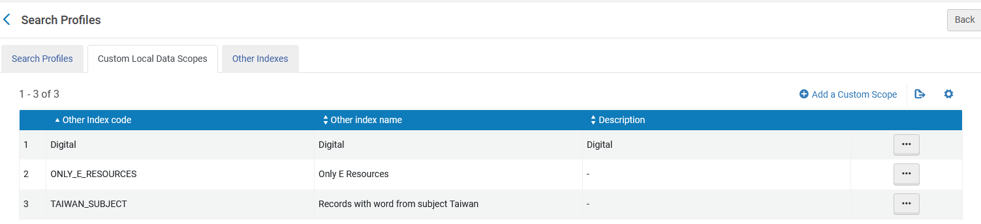
Step 1: Define a “Custom Local Data Scope”

Slide 10
Step 2: Use the “Custom Local Data Scope” to create a new “Search Profile”

Slide 11
Step 2: Use the “Custom Local Data Scope” to create a new “Search Profile”
Use the above “Custom Local Data Scope” to create a new “Search Profile”
  Navigate to “Configuration > Discovery > Search Configuration > Search Profiles”
  Switch to first tab “Search Profiles”
  Click “Add a Search Profile”
  Fill in a code and name, for example code “AVAILABLE_ELECTRONIC” and name “Records available electronically”
  On bottom click “Add Scope”
  In field "Select Scope Type" choose "Custom (Local Data)“
  In field "Select Custom Scope" choose the scope created in step 1 (code “ONLY_E_RESOURCES” name “Only E Resources”).
  Click “Add and close)
  Save

Slide 12
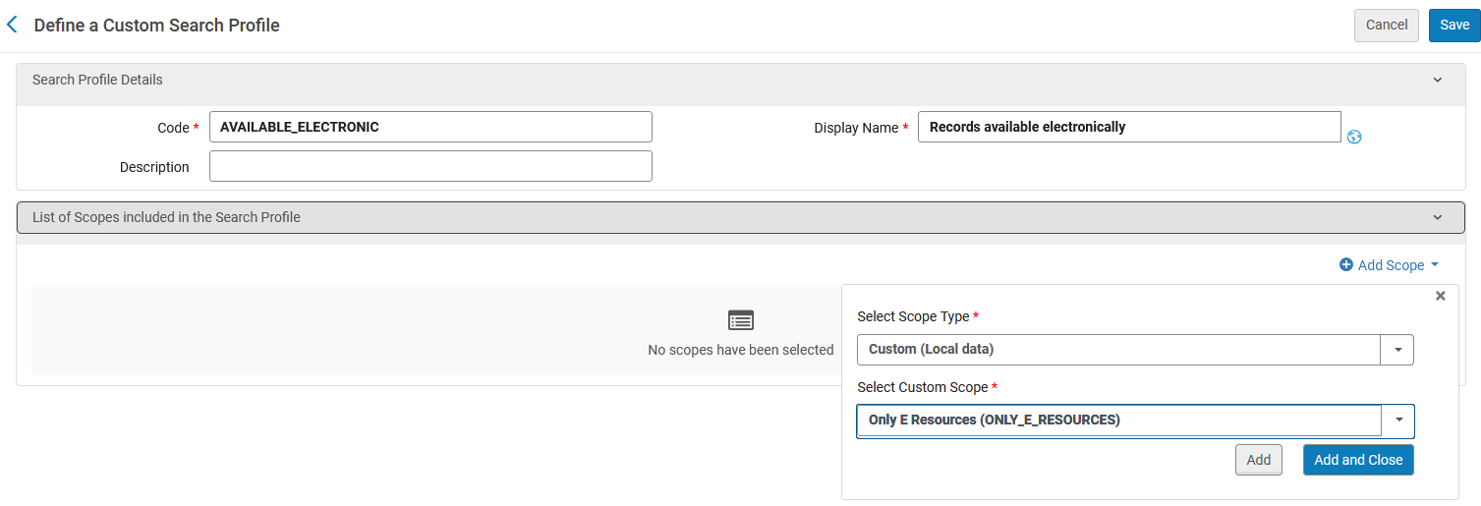
Step 2: Use the “Custom Local Data Scope” to create a new “Search Profile”

Slide 13
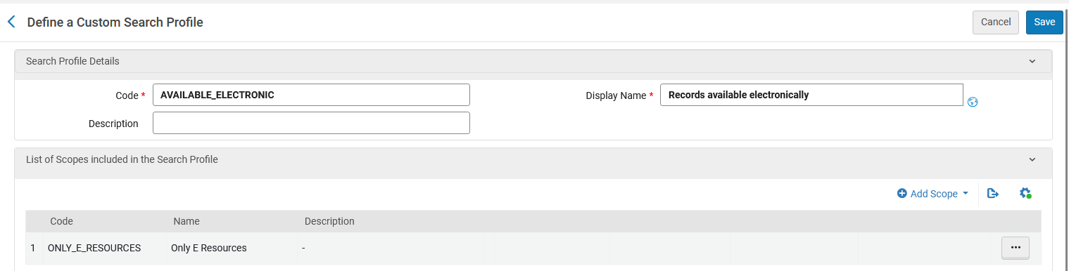
Step 2: Use the “Custom Local Data Scope” to create a new “Search Profile”

Slide 14
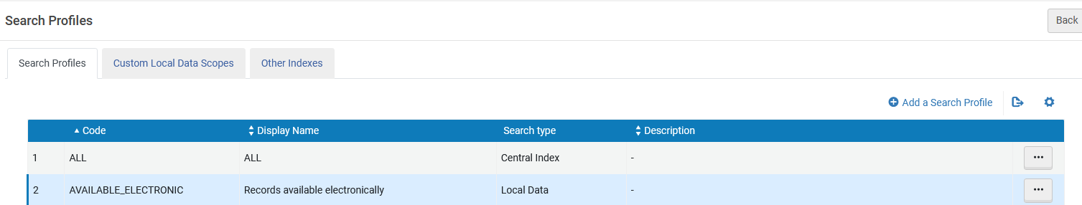
Step 2: Use the “Custom Local Data Scope” to create a new “Search Profile”

Slide 15
Step 3: Add a search profile slot which uses the new “Search Profile” to a specific view

Slide 16
Step 3: Add a search profile slot which uses the new “Search Profile” to a specific view
Add a search profile slot which uses the new “Search Profile” to a specific view
  Navigate to “Configuration > Discovery > Display Configuration > Configure Views”
  Edit the view to which you want to add the new search profile (we will use view “EXLDEV1_INST:Alma_NDE”)
  Go to tab “Search Profile Slots”
  Click "Add a slot"
  Fill in code and name, for example code “ERESOURCES” and name “Electronic Resources”
  On bottom activate the “Search Profile” created above (code “AVAILABLE_ELECTRONIC” and name “Records available electronically”)
  Save

Slide 17
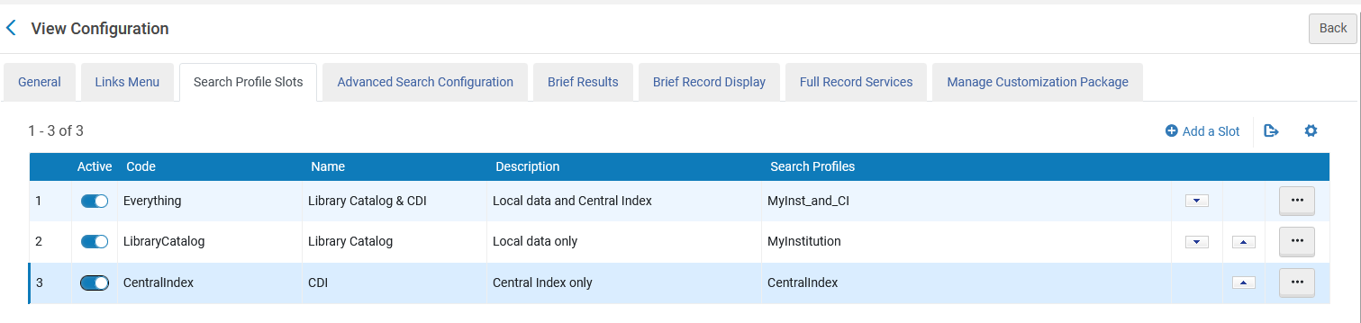
Step 3: Add a search profile slot which uses the new “Search Profile” to a specific view

Slide 18
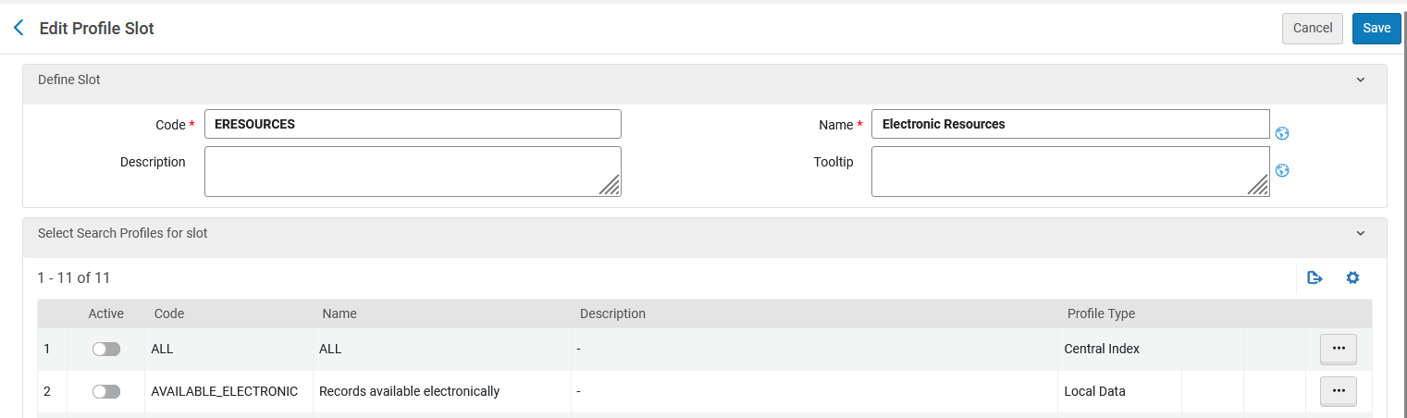
Step 3: Add a search profile slot which uses the new “Search Profile” to a specific view
Activate this

Slide 19
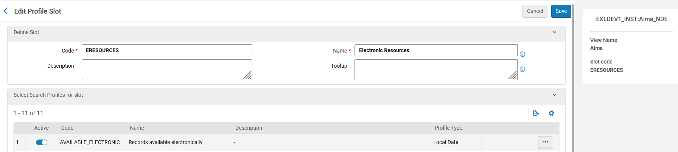
Step 3: Add a search profile slot which uses the new “Search Profile” to a specific view
We are adding search profile slot named “Electronic Resources” using search profile name “Records available electronically” to Primo VE NDE View “EXLDEV1_INST:Alma_NDE”

Slide 20
Test it out

Slide 21
Test it out
We see the following on the next slide:
If we
  Search Primo VE NDE View “EXLDEV1_INST:Alma_NDE”
  Use the scope “Library Catalog” for “sheryl sandberg lean in”
We get eleven results
Some of the eleven results have physical inventory and some have electronic inventory.

Slide 22
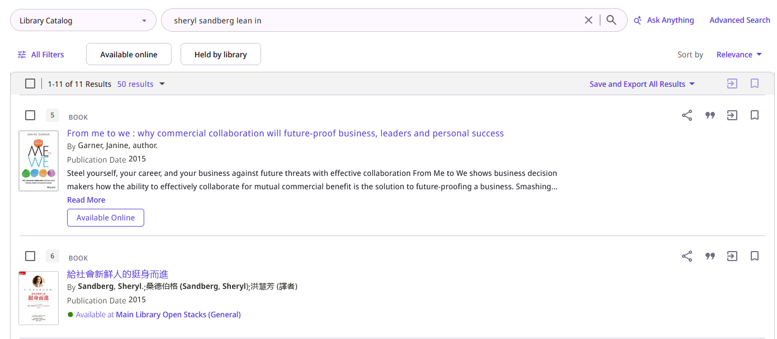
Test it out
If we search Primo VE NDE View “EXLDEV1_INST:Alma_NDE” using the scope “Library Catalog” for “sheryl sandberg lean in” we get eleven results, and some have physical inventory and some have electronic inventory.

Slide 23
Test it out
However, we see the following on the next slide:
If we
  Search Primo VE NDE View “EXLDEV1_INST:Alma_NDE”
  Use the scope “Records available electronically” (instead of the scope “Library Catalog”) for “sheryl sandberg lean in”
We get four results ((instead of eleven results)
All of the results have electronic inventory (instead of some of the results)
This means that the scope works.
  It gives the user only results which have electronic inventory.

Slide 24
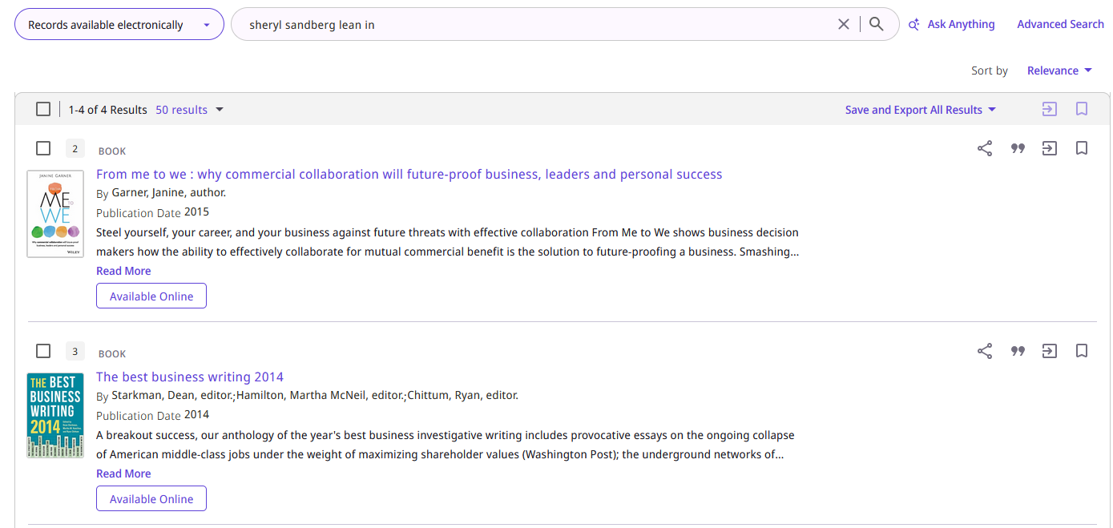
Test it out
If we search Primo VE NDE View “EXLDEV1_INST:Alma_NDE” using the scope “Records available electronically” for “sheryl sandberg lean in” we get four results, and all have electronic inventory.

Slide 25
Thank You

