Slide 1
How to update page titles
In Primo VE NDE
Yoel Kortick | May 2026

Slide 2
Agenda
  Introduction
  Accessing the configuration
  A live demo to update page titles

Slide 3

Introduction

Slide 4
Introduction
The Header/Footer Tiles Labels code table allow the institution to customize the following titles in the NDE UI:
  main.title—Discovery
  main.description—Discovery - {{query}}
  nui.full.display.title—Primo by Ex Libris
  nui.brief.title—{{recordTitle}} - {{institutionName}}

Slide 5
Accessing the configuration

Slide 6
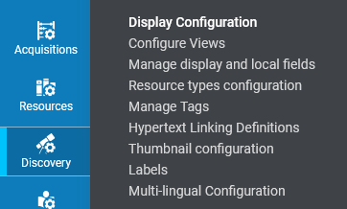
Accessing the configuration
The Header/Footer Tiles Labels code table is accessed at “Configuration > Discovery > Display Configuration > Labels”

Slide 7
A live demo to update page titles

Slide 8
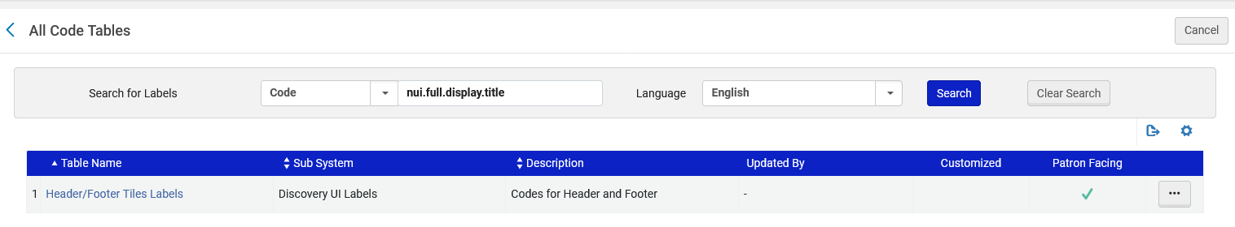
A live demo to update page titles
We will now look at the Header/Footer Tiles Labels code table.

Slide 9
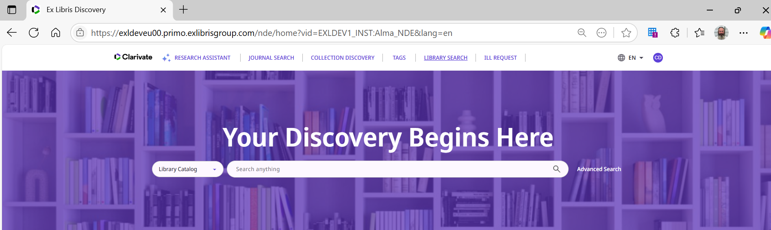
A live demo to update page titles
If we begin using Primo and have not yet done any searches or other activities, then the page title is “Ex Libris Discovery”

Slide 10
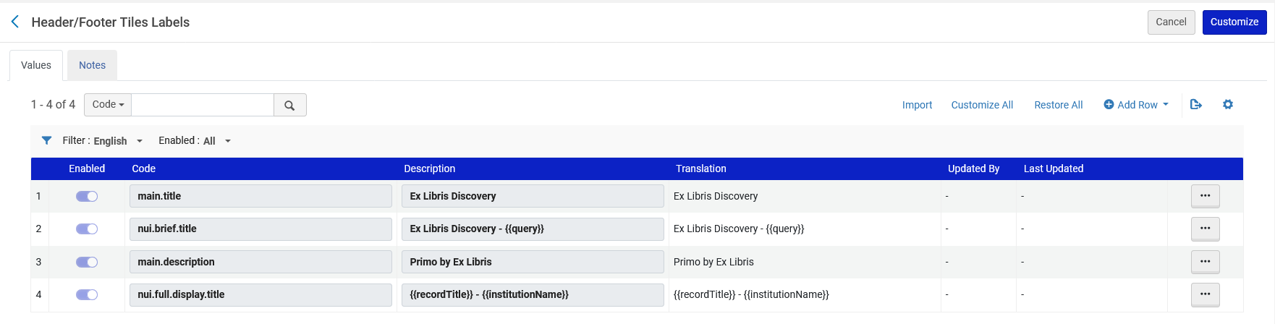
A live demo to update page titles
The reason the page title is “Ex Libris Discovery” is because of this line we have in the Header/Footer Tiles Labels code table

Slide 11
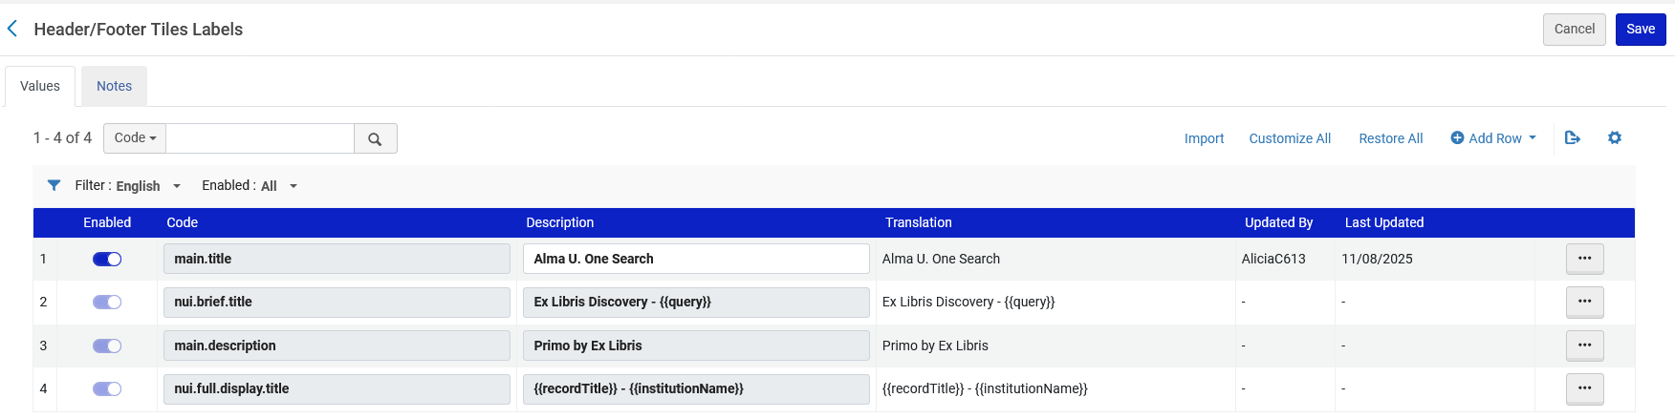
A live demo to update page titles
Now we have changed the text from “Ex Libris Discovery” to “Alma U. One Search”

Slide 12
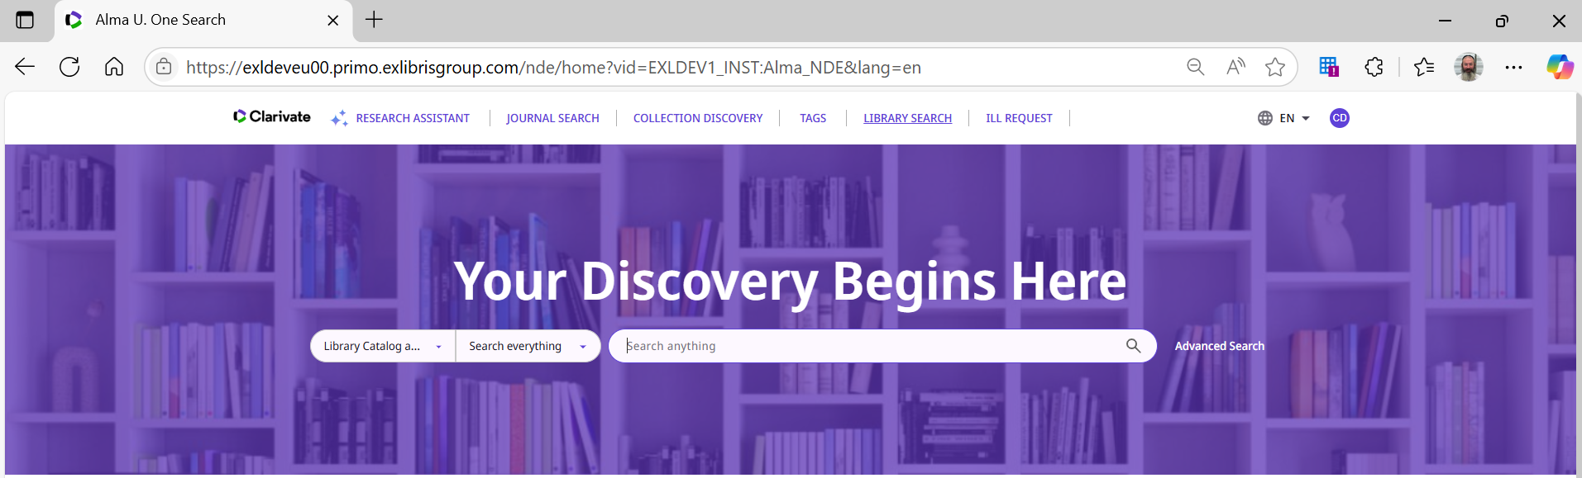
A live demo to update page titles
We see the change in Primo VE NDE

Slide 13
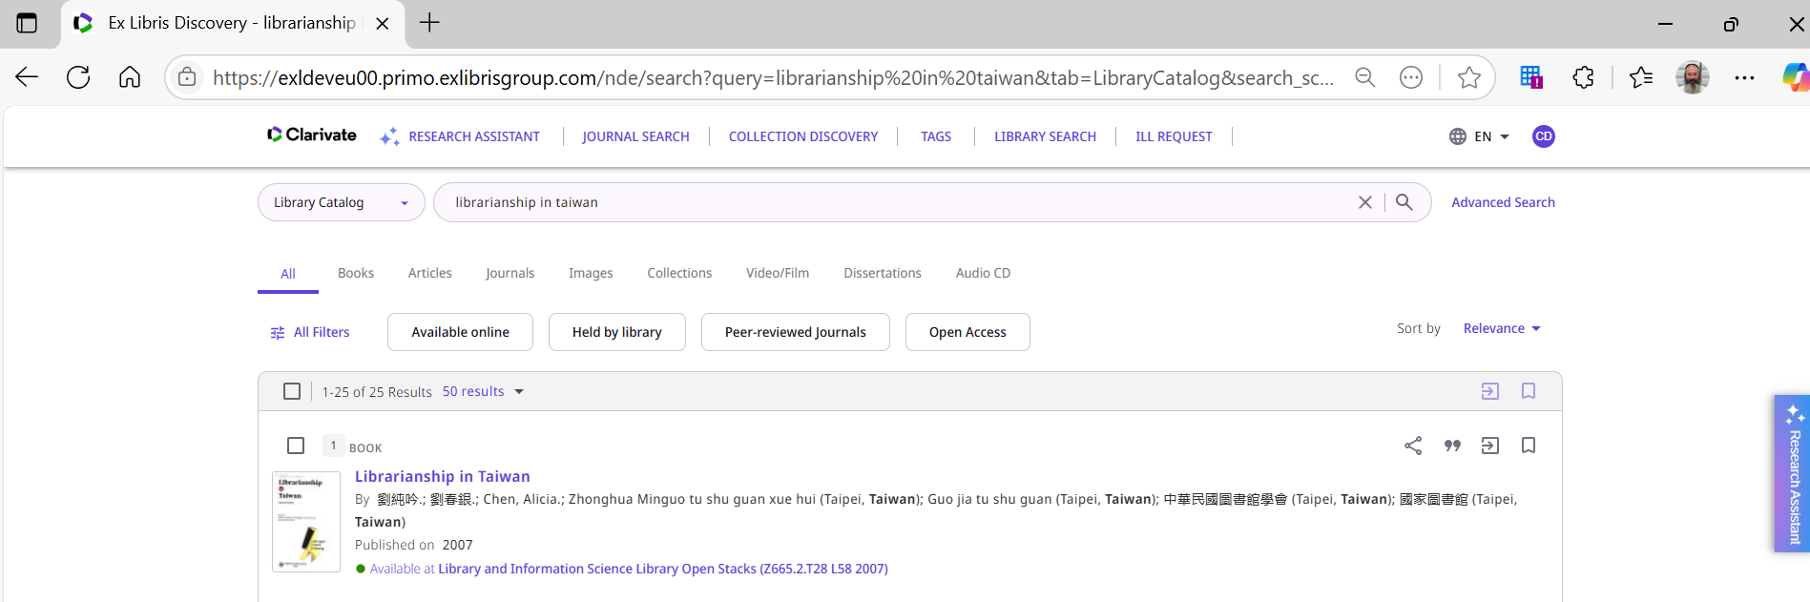
A live demo to update page titles
If we search Primo VE NDE for “Librarianship in Taiwan” then the page title is “Ex Libris Discovery – librarianship in Taiwan”.

Slide 14
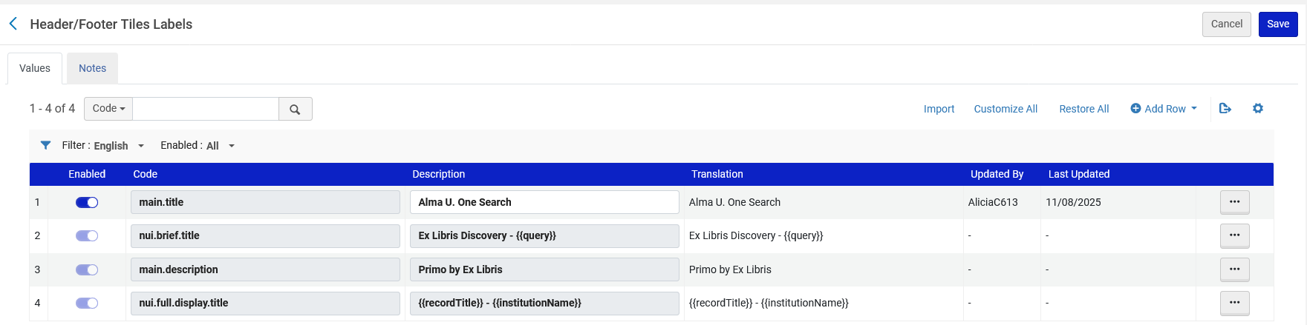
A live demo to update page titles
The reason the page title is “Ex Libris Discovery – librarianship in Taiwan” is because of this line we have in the Header/Footer Tiles Labels code table

Slide 15
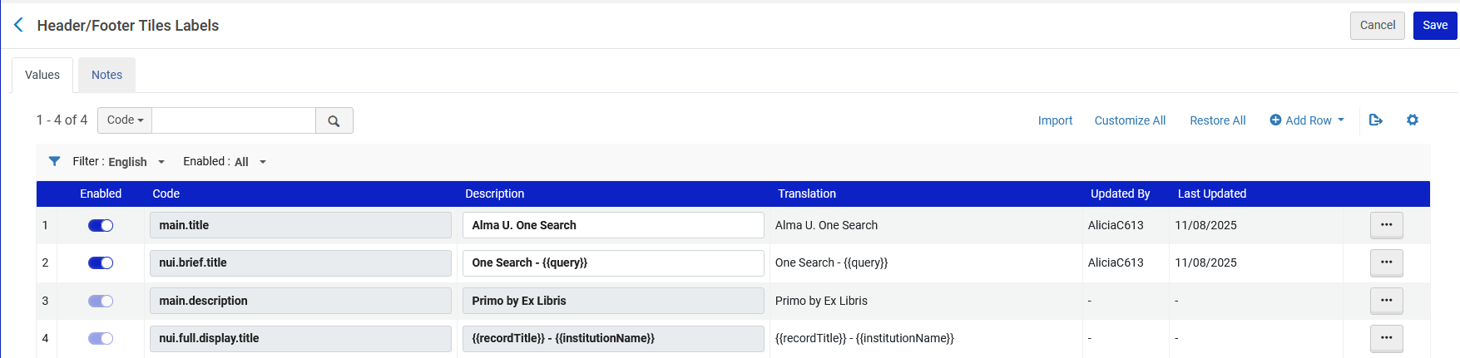
A live demo to update page titles
Now we have changed the text from “Ex Libris Discovery - {{query}}” to “One Search - {{query}}”

Slide 16
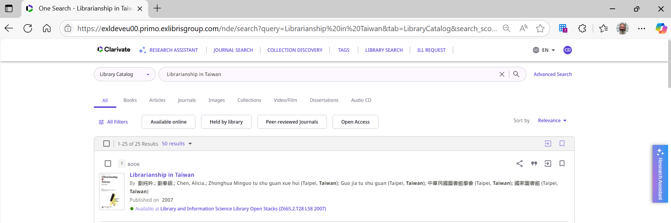
A live demo to update page titles
We see the change in Primo VE NDE

Slide 17
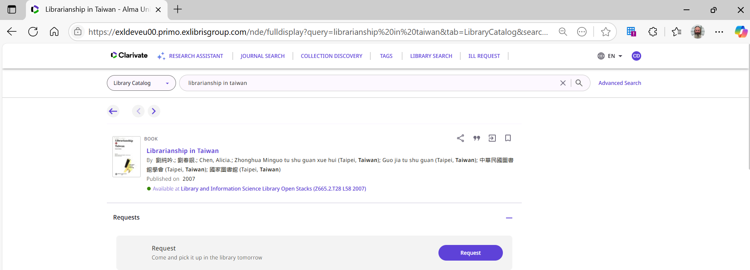
A live demo to update page titles
If we click a search result title “Librarianship in Taiwan” to get to the full view, then the page title is “Librarianship in Taiwan – Alma University” (my institution name is ”Alma University”).
17

Slide 18

A live demo to update page titles
The reason the page title is “Librarianship in Taiwan – Alma University” is because of this line we have in the Header/Footer Tiles Labels code table

Slide 19
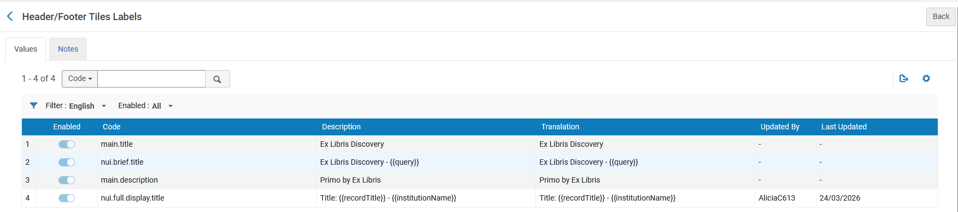
A live demo to update page titles
Now we have changed it from:
  {{recordTitle}} - {{institutionName}}
To:
  Title: {{recordTitle}} - {{institutionName}}

Slide 20
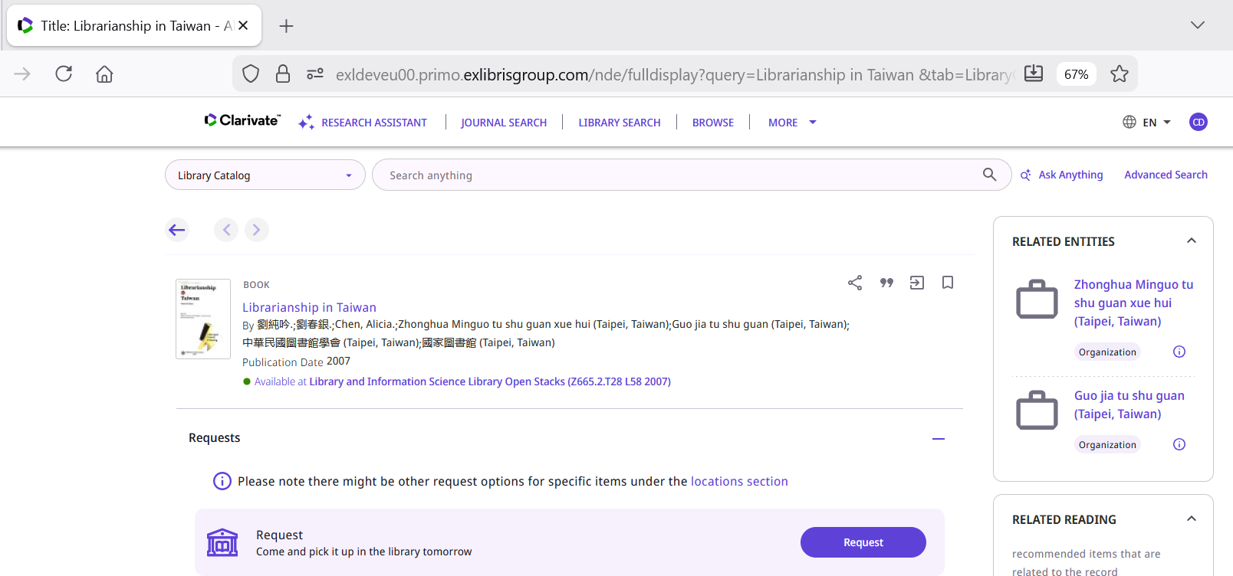
A live demo to update page titles
We see the change

Slide 21
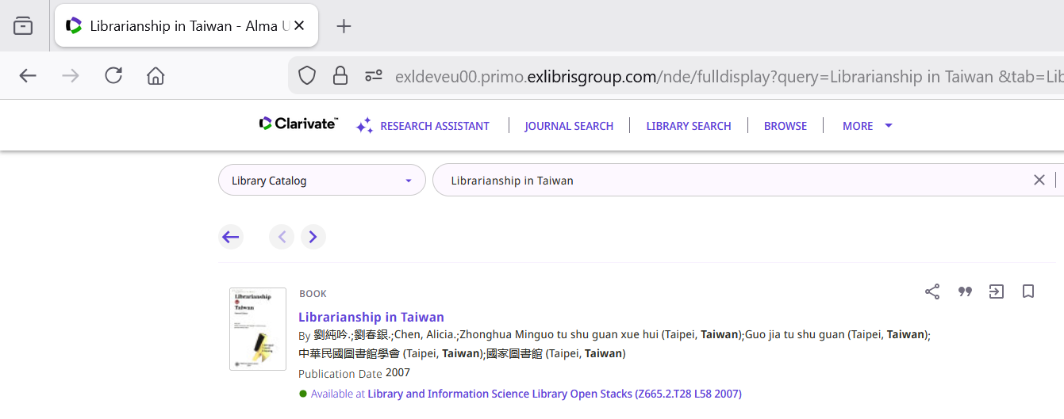
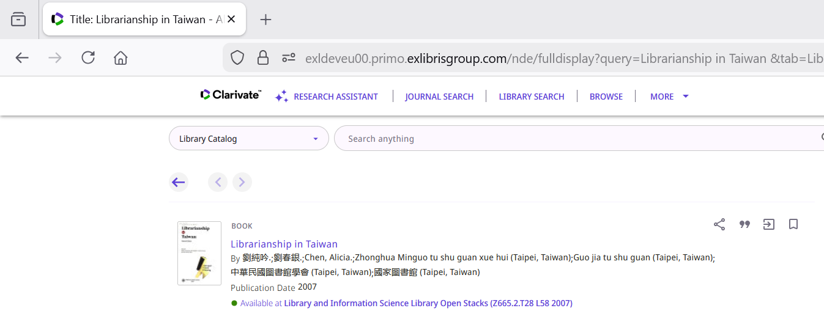
A live demo to update page titles
Before
After

Slide 22
Thank You

