Slide 1
Primo VE NDE Configuration
Yoel Kortick
Yoel.Kortick@clarivate.com

Slide 2
Agenda
  Using the Customization Package Manager
  Specific examples using the Customization Package Manager

Slide 3
Using the Customization Package Manager

Slide 4
Using the Customization Package Manager
The Manage Customization Package allows the institution to upload and manage customization packages, enabling the branding and customization of Primo VE.
If no packages are loaded, the system uses the out-of-the-box configurations.

Slide 5
Using the Customization Package Manager
To access the Customization Package Manager:
  Access “Configure Views”
  Edit the View
  Select the “Manage Customization Package” tab
  Use the “Download Package” and “Upload Package” sections.

Slide 6
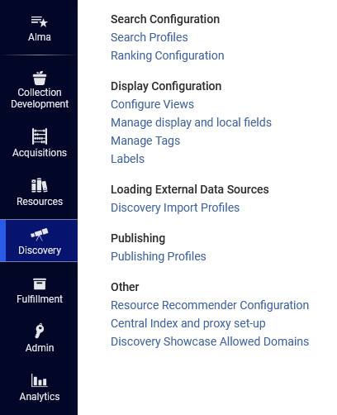
Using the Customization Package Manager
Access “Configure Views”

Slide 7
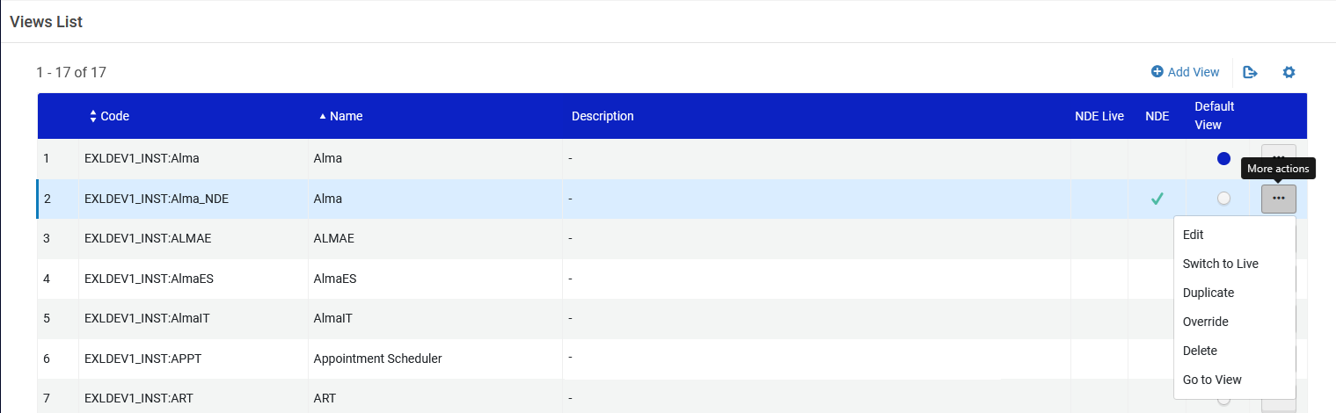
Using the Customization Package Manager
Edit the View

Slide 8
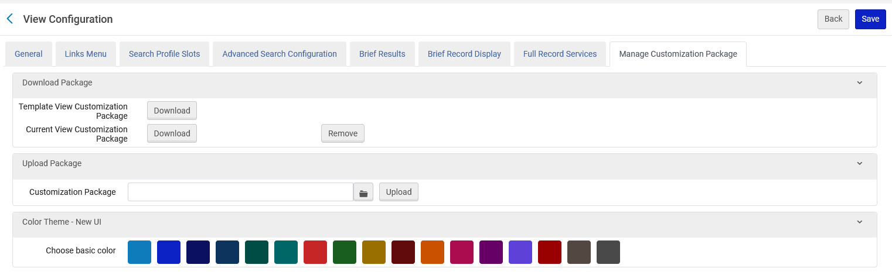
Using the Customization Package Manager
Select the “Manage Customization Package” tab
Use the “Download Package” and “Upload Package” sections.

Slide 9
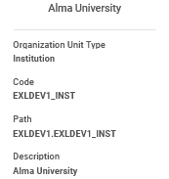
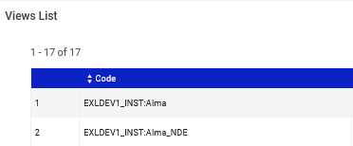
Using the Customization Package Manager
The Customization Package must be named as follows (and it will automatically get this name structure when downloaded): <institution_code>-<view_code>
In our example the institution code is EXLDEV1_INST and the view code is Alma_NDE
Therefore, the package is named EXLDEV1_INST-Alma_NDE.zip

Slide 10

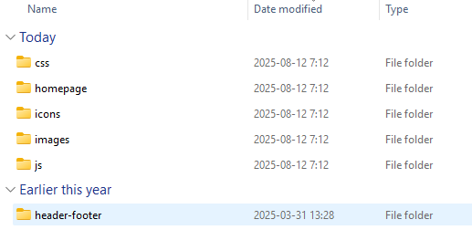
Using the Customization Package Manager
The Customization Package must contain a folder with the name of the package and then the following subfolders under EXLDEV1_INST-Alma_NDE\assets
These folders are described at Understanding the File Structure of a Customization Package

Slide 11
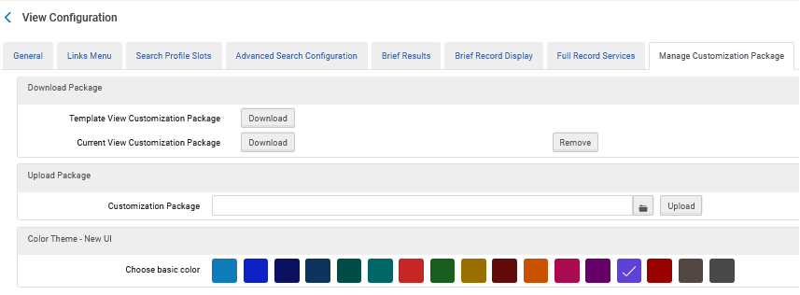
Using the Customization Package Manager
To create a customization package, click the “Download” button next to either “Template View Customization Package” or “Current View Customization Package”.
If this is the first time using the customization package, download the template package in the Download Package section. Otherwise, download the current package to ensure you use the latest version.
We will click “Download” next to “Template View Customization Package”

Slide 12

Using the Customization Package Manager
After clicking “Download” next to “Template View Customization Package” file “template_package.zip” has been downloaded
We will unzip the file

Slide 13
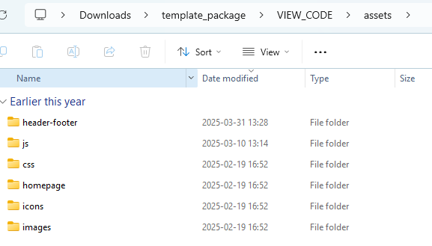
Using the Customization Package Manager
Under “template_package/VIEW_CODE/assets” we have the previously-mentioned six folders

Slide 14
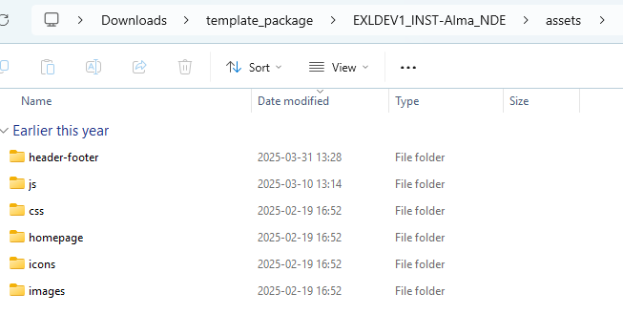
Using the Customization Package Manager
We have renamed the VIEW_CODE to the previously-mentioned correct format
We can now make changes to the folders, zip the package and reload it to Alma.

Slide 15
Specific examples using the Customization Package Manager

Slide 16
Specific examples using the Customization Package Manager
See Specific examples using the Primo VE NDE Customization Package Manager
For example:
  How to use the Primo VE NDE Customization Package to customize the library logo
  How to use the Primo VE NDE Customization Package to customize a color theme
  How to use the Primo VE NDE Customization Package to add headers and footers
  How to use the Primo VE NDE Customization Package to change the Homepage

Slide 17


Yoel Kortick
Yoel.Kortick@clarivate.com
About Clarivate
Clarivate is a leading global provider of transformative intelligence. We offer enriched data,
insights & analytics, workflow solutions and expert services in the areas of Academia & Government, Intellectual Property and Life Sciences & Healthcare. For more information, please visit clarivate.com.
© 2026 Clarivate. All rights reserved
Clarivate and its logo, as well as all other trademarks used herein are trademarks of their respective owners and used under license.

