Slide 1
What determines that a record is Open Access or Peer Reviewed in Primo VE
Yoel Kortick
Senior Librarian

Slide 2

Introduction
A "Peer Reviewed" example
An "Open Access" example for a CDI record
An "Open Access" example for a local record
Further reading (for topics not discussed here)
Agenda

Slide 3
Introduction

Slide 4
Introduction
Peer-reviewed articles are published in scholarly journals where experts in the field evaluate submissions before publication. In Primo, this label is based on how the journal is classified, not on an evaluation of each individual article.
Open Access items are available online for anyone to read without payment or login. Availability may be provided by the publisher or an open repository.
In Primo VE CDI citations as well as Journals in the library catalog may be faceted by "Peer Reviewed" and by "Open Access".
Additionally, an indication appears next to the record (both for the CDI citation as well as the library catalog Journal) indicating that the record is either "Peer Reviewed" or "Open Access" (or both).

Slide 5
Introduction
In Primo VE, the labels and facets "Peer reviewed" and "Open Access" are
  not determined by Primo itself through analysis of the content.
  driven by metadata supplied to Primo VE, primarily via the Central Discovery Index (CDI).
A resource is marked Peer reviewed when CDI metadata indicates that the journal is refereed.
A resource is marked Open Access when CDI metadata indicates the full text is freely available online without authentication.
In this presentation we will show specifically from where this indication comes.

Slide 6
Introduction
As explained at from Adding Open Access Indicator to Local Records , It is also possible to add Open Access Indicator to Local Records
While the previous slide covered content from the Central Index and the CZ, it is also possible to display the Open Access indicator for local Alma records by adding the following MARC information to them:
  506 0_ $f Unrestricted online access $2 star
  The $f and $2 subfields must be entered as shown above and must not contain any punctuation (such as a period). Otherwise, the indicator will not appear.
Note that this is the same criteria used for displaying Open Access Indicators in the Alma user interface and is described at Peer Reviewed and Open Access in Alma

Slide 7
Introduction
For an explanation of how the "Peer reviewed" and "Open Access" labels appear in the Alma user interface see Peer Reviewed and Open Access in Alma

Slide 8
A "Peer Reviewed" example

Slide 9
A "Peer Reviewed" example
CDI citation title "Beyond the Glass Ceiling: Does Gender Matter?" is Peer Reviewed.
It comes from publication "Management Science, 2012, Vol 58, Issue 2, p 219" ISSN 0025-1909.
The publication (and not only the CDI citation) is also Peer Reviewed.
The PNX of both the CDI citation and the resource from which it comes have an indication that the resource is Peer Reviewed.
The "Peer reviewed" facet and the "Peer reviewed" indication on the records exist because the PNX of the records have a "Peer Reviewed" indication

Slide 10
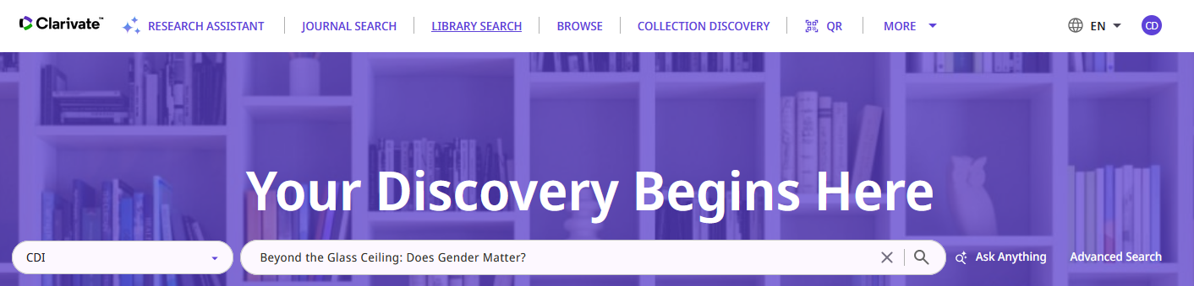
A "Peer Reviewed" example
We will search for the CDI citation

Slide 11
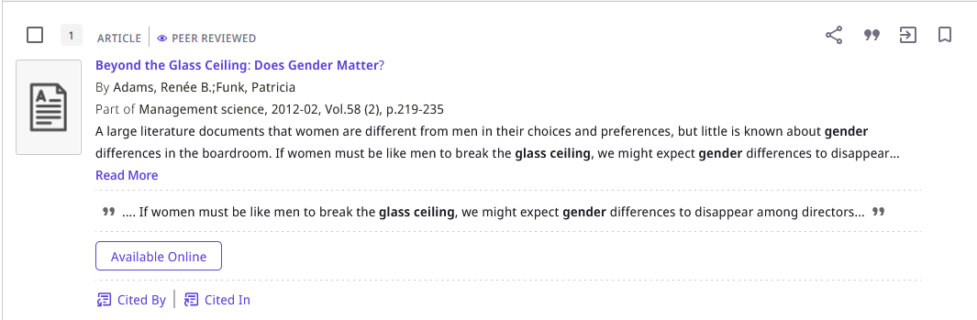
A "Peer Reviewed" example
We retrieve the CDI citation and see that it is "Peer Reviewed"

Slide 12
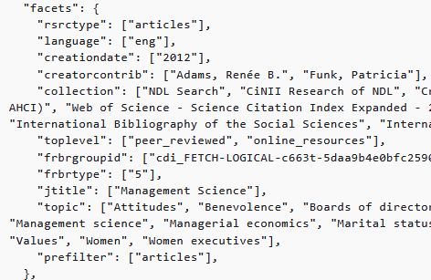
A "Peer Reviewed" example
When viewing the PNX of the CDI citation we see the "Peer Reviewed" indication.
Here is the "Peer Reviewed" indication in the "facets" section of the PNX:

Slide 13
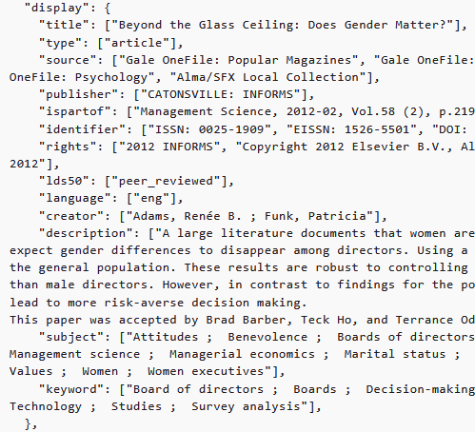
A "Peer Reviewed" example
Here is the "Peer Reviewed" indication in the "display" section of the PNX:

Slide 14
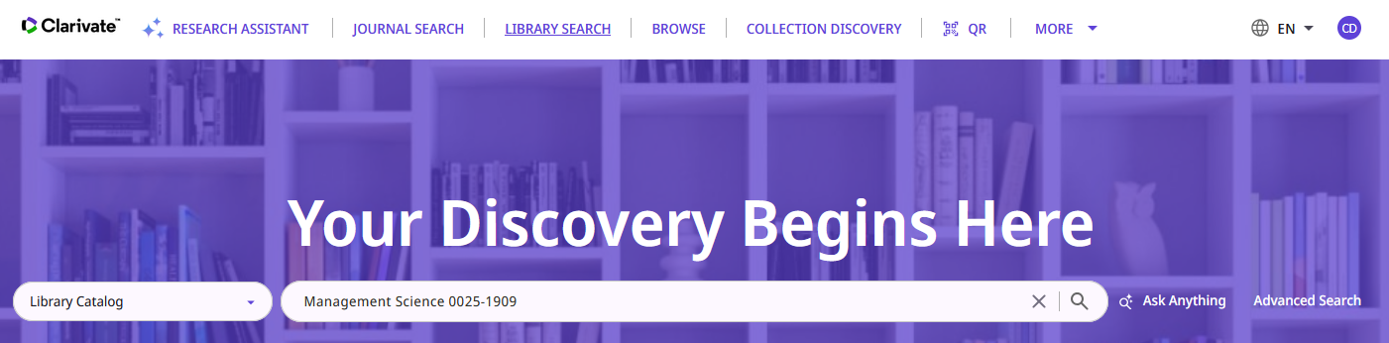
A "Peer Reviewed" example
Now let’s look at the journal from which the "Peer Reviewed" citation comes.
We already stated in the introduction that the label is based on how the journal is classified, not on an evaluation of each individual article.

Slide 15
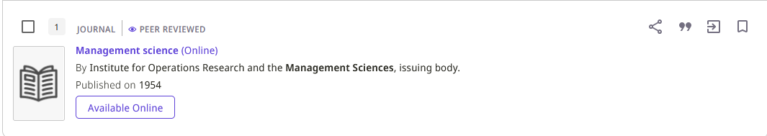
A "Peer Reviewed" example
In the search results we see that the journal (like the citation which came from the journal) is "Peer Reviewed"

Slide 16
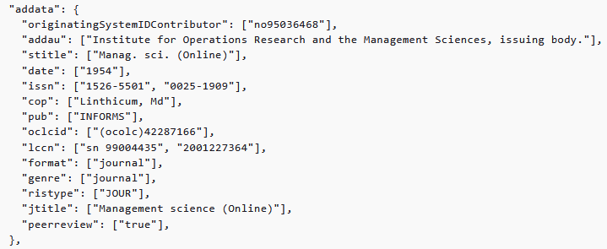
A "Peer Reviewed" example
The PNX of the journal also includes a "Peer Reviewed" indication in the "addata" section.

Slide 17
An "Open Access" example for a CDI record

Slide 18
An "Open Access" example for a CDI record
CDI citation title "The Importance of Feminism" is Open Access.
It comes from publication " History of women in the Americas, 2017-07, Vol.4" ISSN 2042-6348.
The publication (and not only the CDI citation) is also Open Access.
The PNX of both the CDI citation and the resource from which it comes have an indication that the resource is Open Access.
The "Open Access" facet and the "Open Access" indication on the records exist because the PNX of the records have an "Open Access" indication

Slide 19
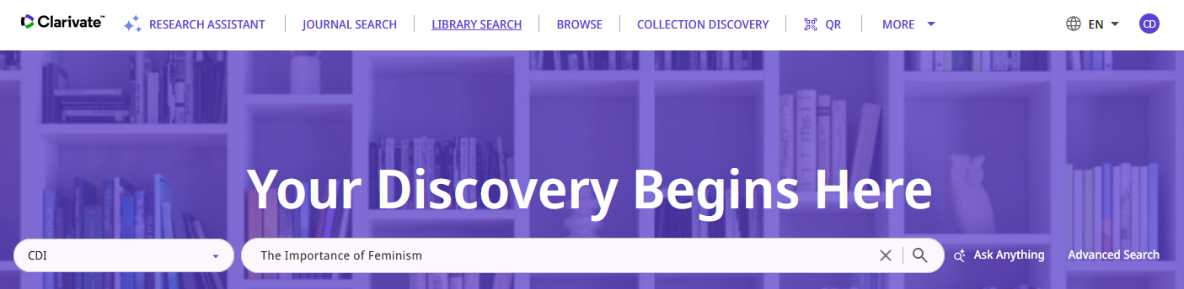
An "Open Access" example for a CDI record
We will search for the CDI citation

Slide 20
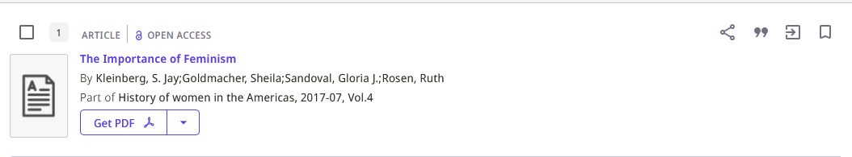
An "Open Access" example for a CDI record
We retrieve the CDI citation and see that it is "Open Access"

Slide 21
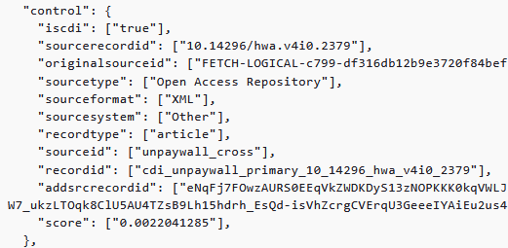
An "Open Access" example for a CDI record
When viewing the PNX of the CDI citation we see the "Open Access" indication.
Here is the "Open Access" indication in the "control" section of the PNX:
In other cases this might state, for example, "sourcetype": ["Open Website"],"

Slide 22
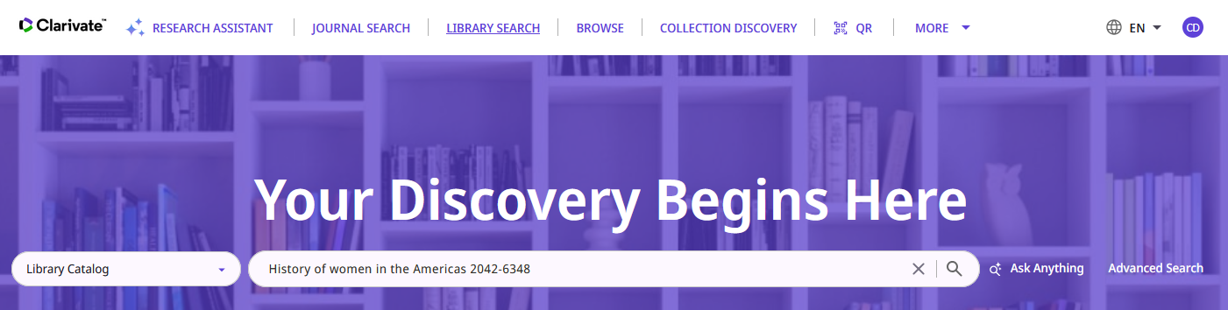
An "Open Access" example for a CDI record
Now let’s look at the journal from which the "Open Access" citation comes.
We already stated in the introduction that the label is based on how the journal is classified, not on an evaluation of each individual article.

Slide 23
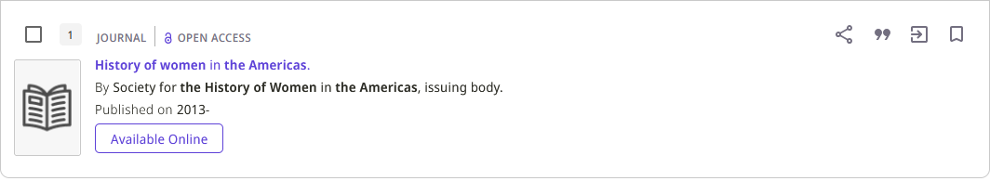
An "Open Access" example for a CDI record
In the search results we see that the journal (like the citation which came from the journal) is "Open Access"

Slide 24
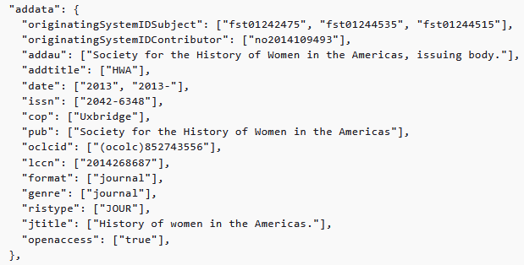
An "Open Access" example for a CDI record
The PNX of the journal also includes An "Open Access" indication in the "addata" section.

Slide 25
An "Open Access" example for a local record

Slide 26
An "Open Access" example for a local record
As explained at from Adding Open Access Indicator to Local Records , It is also possible to add Open Access Indicator to Local Records
While the previous slide covered content from the Central Index and the CZ, it is also possible to display the Open Access indicator for local Alma records by adding the following MARC information to them:
  506 0_ $f Unrestricted online access $2 star
  The $f and $2 subfields must be entered as shown above and must not contain any punctuation (such as a period). Otherwise, the indicator will not appear.
Note that this is the same criteria used for displaying Open Access Indicators in the Alma user interface and is described at Peer Reviewed and Open Access in Alma

Slide 27
An "Open Access" example for a local record
On the next slide is the bibliographic record for title “Tʻai-pei shih yüan hsüeh pao”.
The alternate title is “Journal of Taiwan Provincial Taipei Teachers College”.
It has field 5060_ including the following two subfields: $f Unrestricted online access $2 star

Slide 28
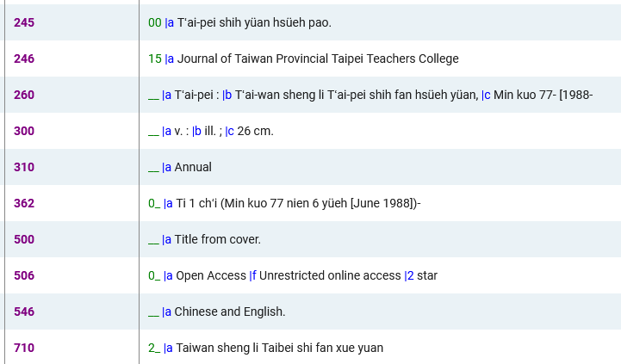
An "Open Access" example for a local record

Slide 29
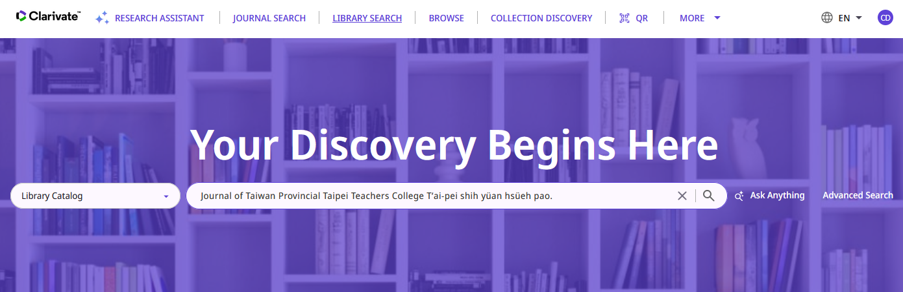
An "Open Access" example for a local record
We will search for the local record

Slide 30
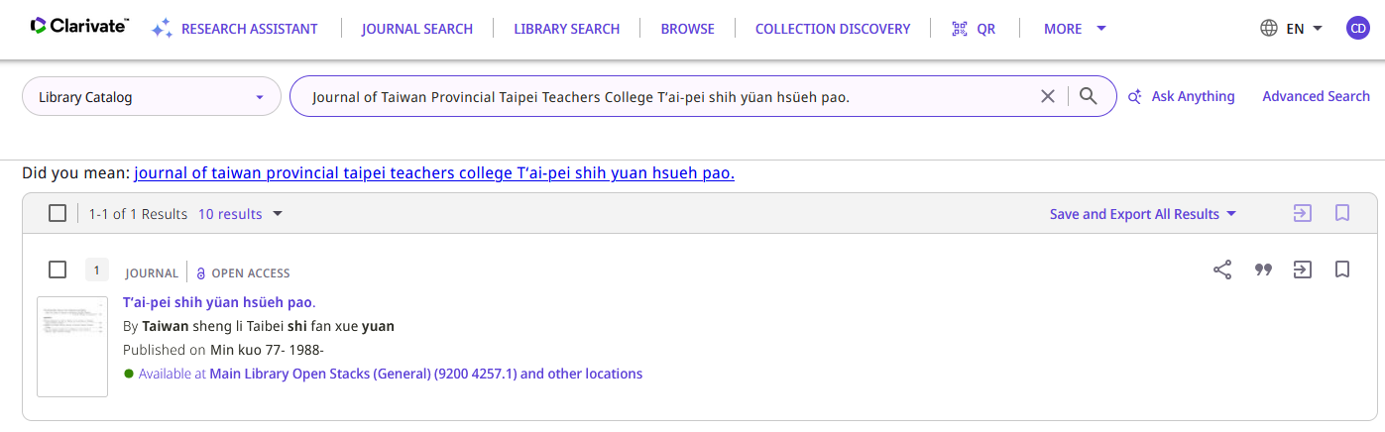
An "Open Access" example for a local record
We retrieve the record and see that it is "Open Access"

Slide 31
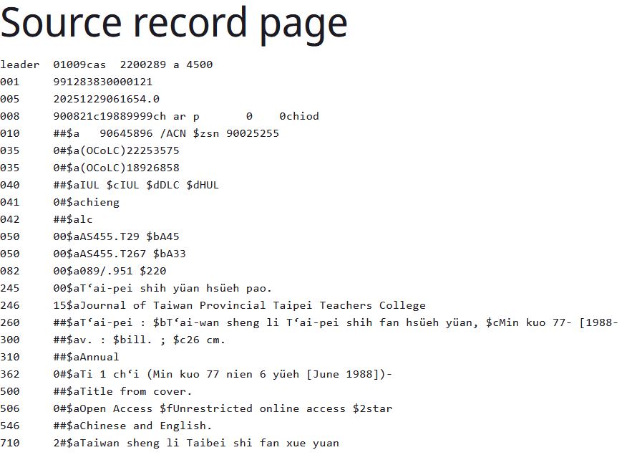
An "Open Access" example for a local record
Viewing the source record from within Primo we see the 5060_ subfields f and 2

Slide 32
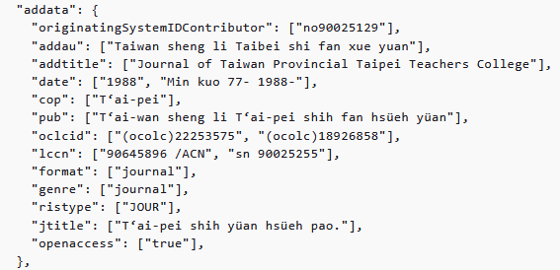
An "Open Access" example for a local record
When viewing the PNX of the CDI citation we see the "Open Access" indication.
Here is the "Open Access" indication in the “addata" section of the PNX:

Slide 33
Further reading (for topics not discussed here)

Slide 34
Further reading (for topics not discussed here)
For more advanced topics on Open Access, including (but not limited to) hybrid open access and how proxying works for Open Access links see Open Access Content in CDI
For information about how Ulrich's Periodicals Directory (Ulrichsweb) is used for Peer review in CDI see Peer Reviewed in CDI

Slide 35
xxx@exlibrisgroup.com

